Slide 1
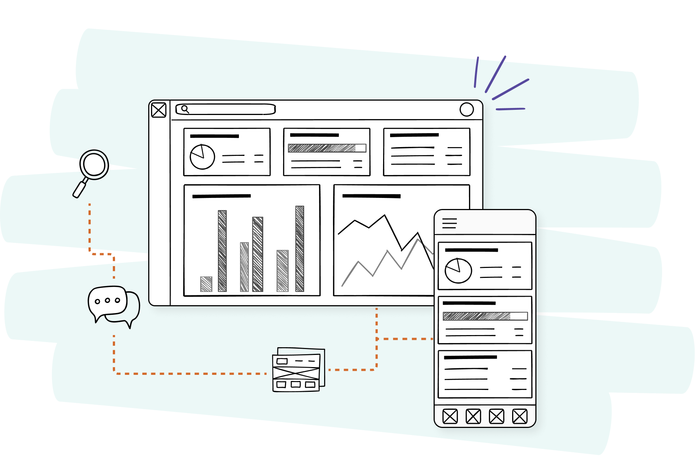
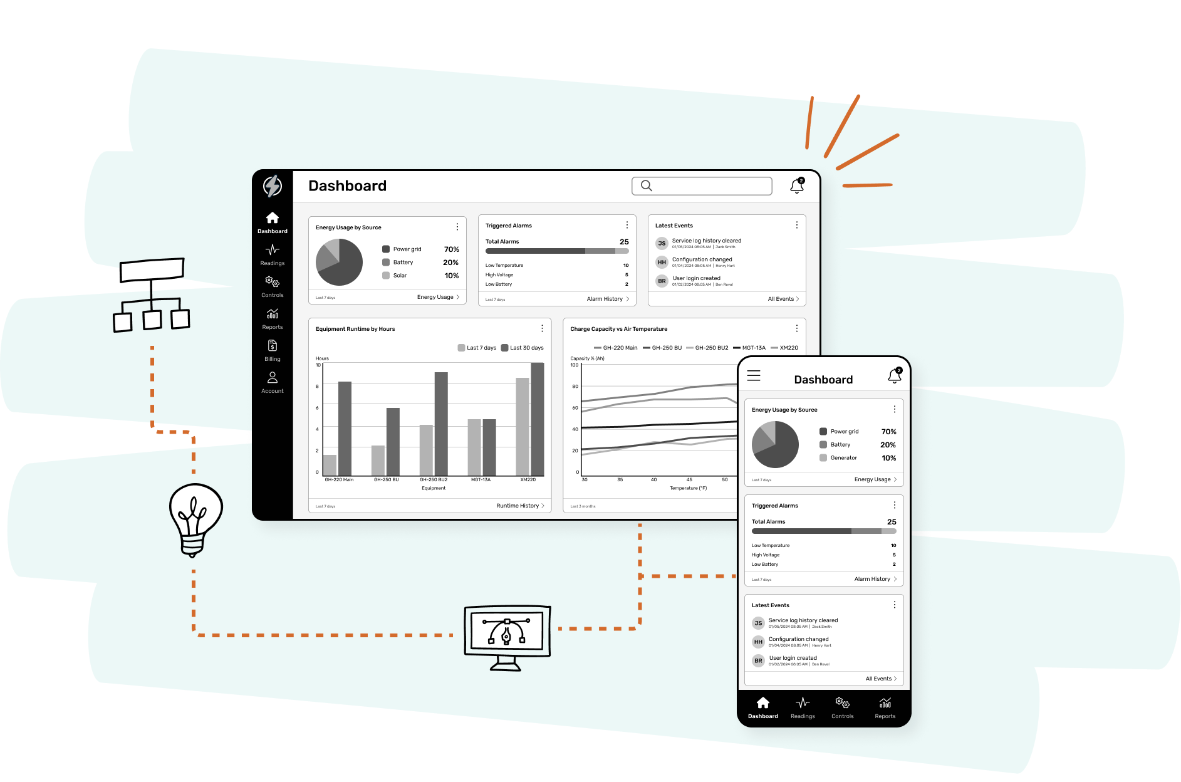
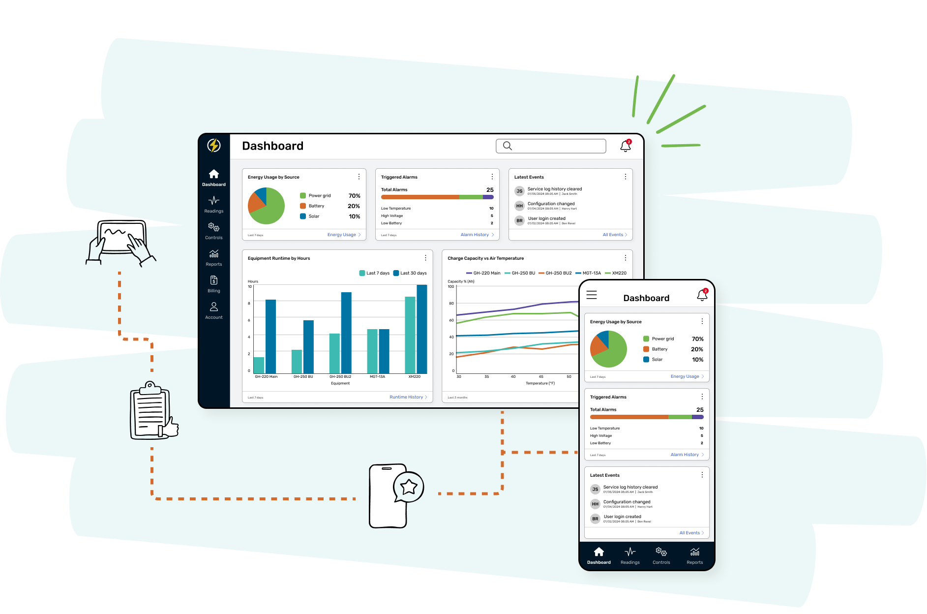
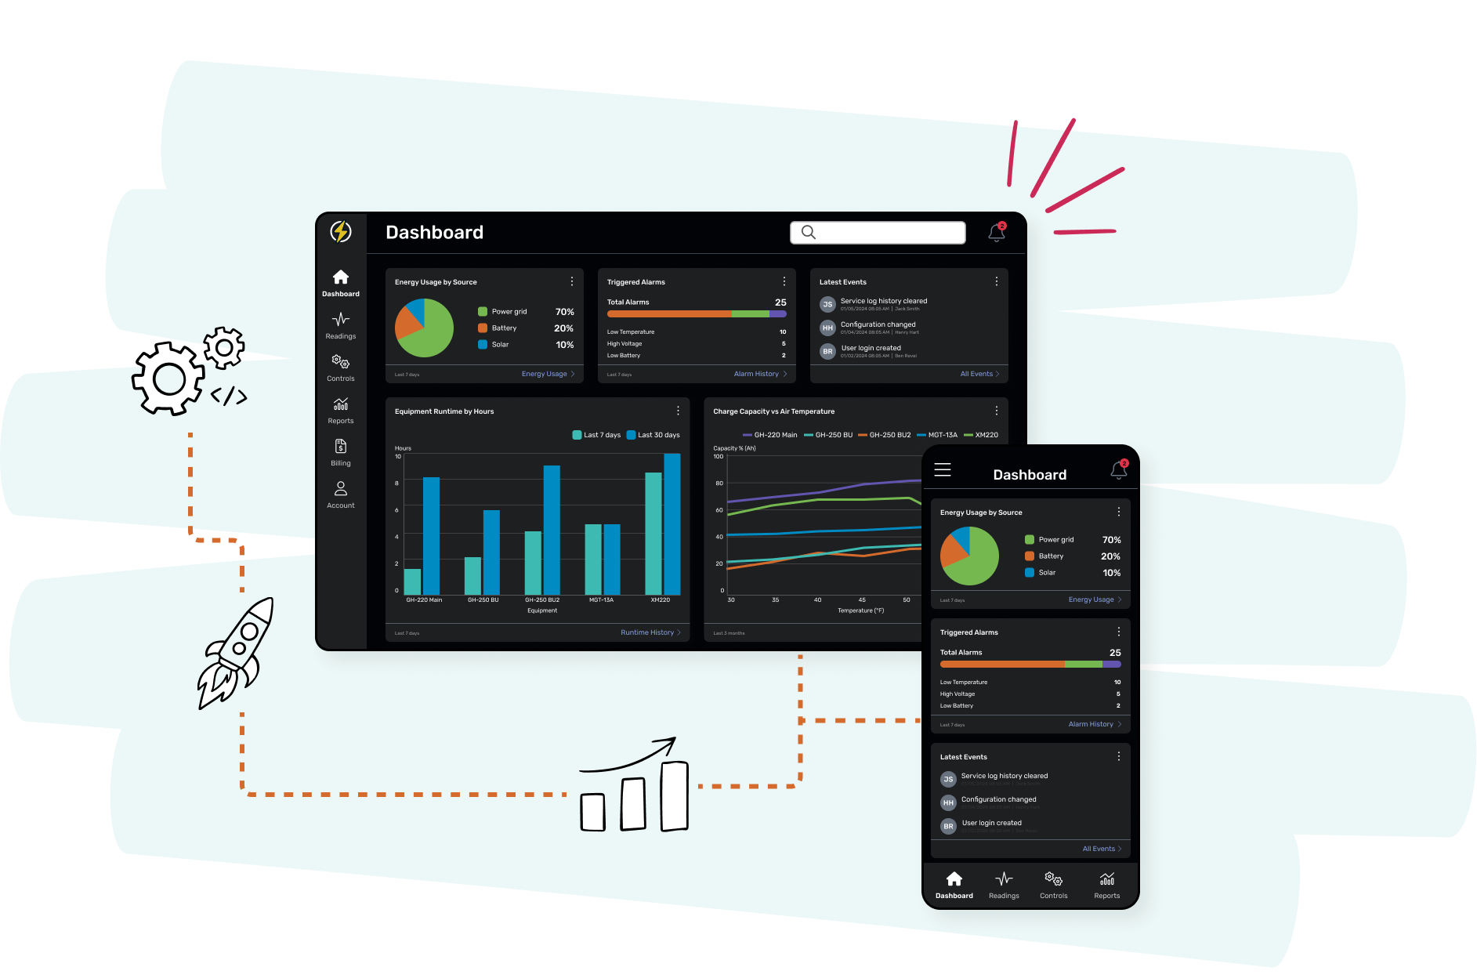


Slide 2
1
Who we are
2
Design solutions
3
Development solutions
4
Pricing models
5
Portfolio

Slide 3

Who we are

Slide 4
2014
year we started
200+
Built on reliability and trust
projects completed
100%
US-based
SSAE 18
certified

Slide 5










Clients

Slide 6
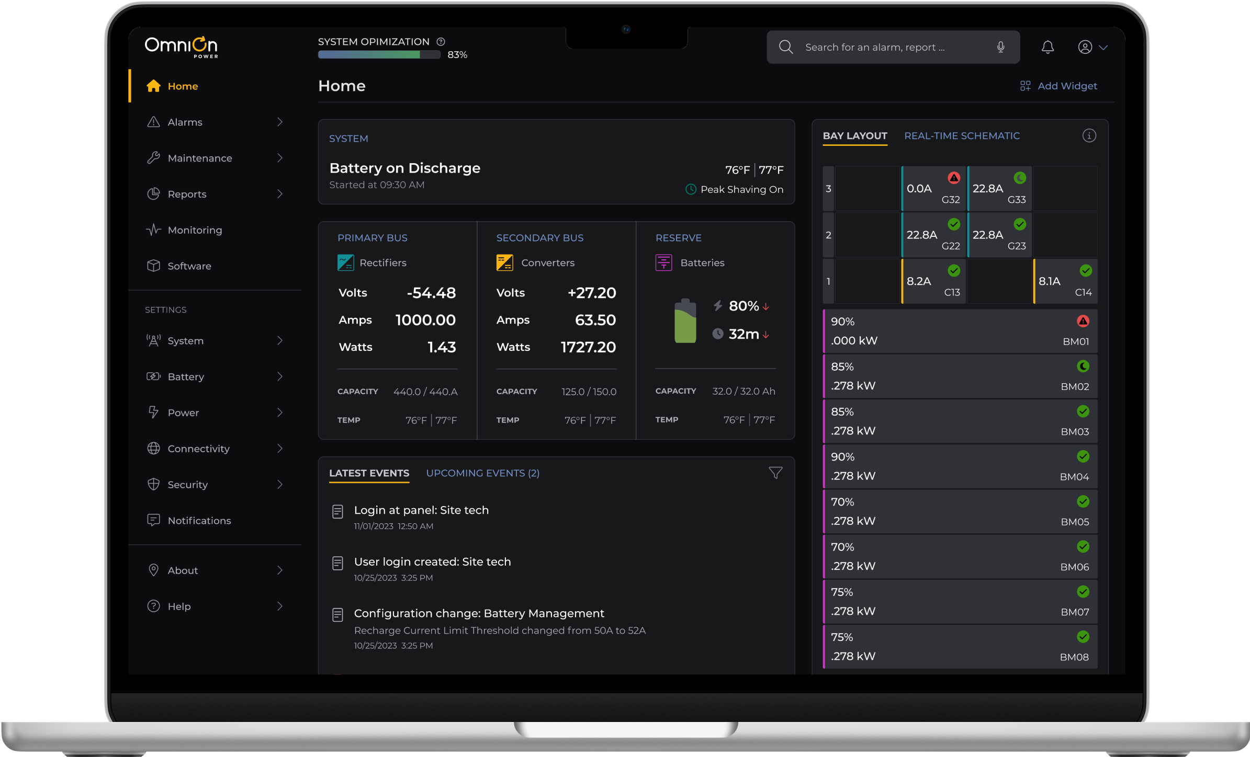
Expertise in software design

Slide 7
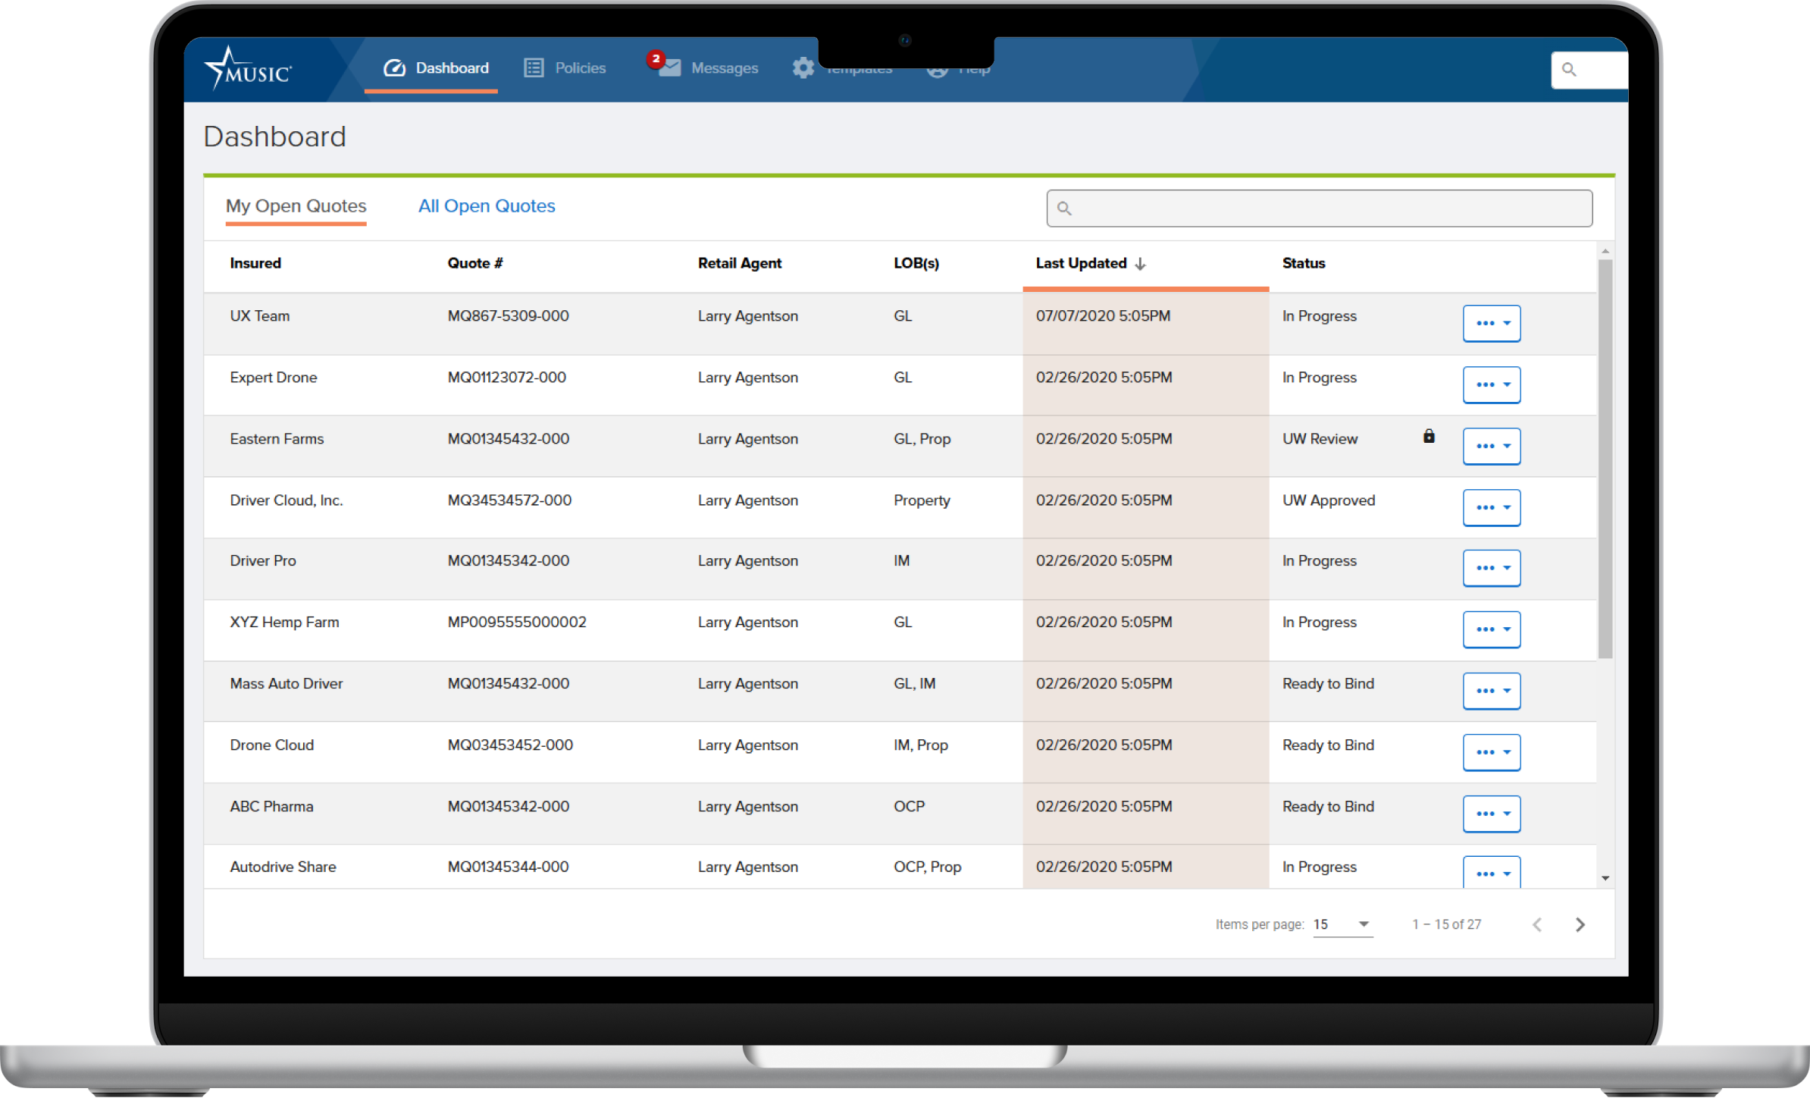
Enterprise software

Slide 8
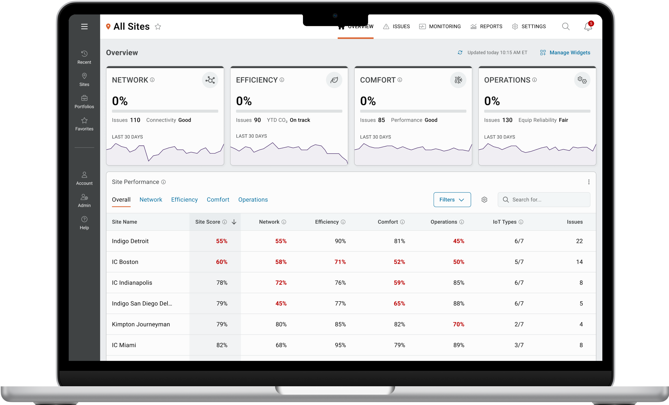
SaaS apps

Slide 9
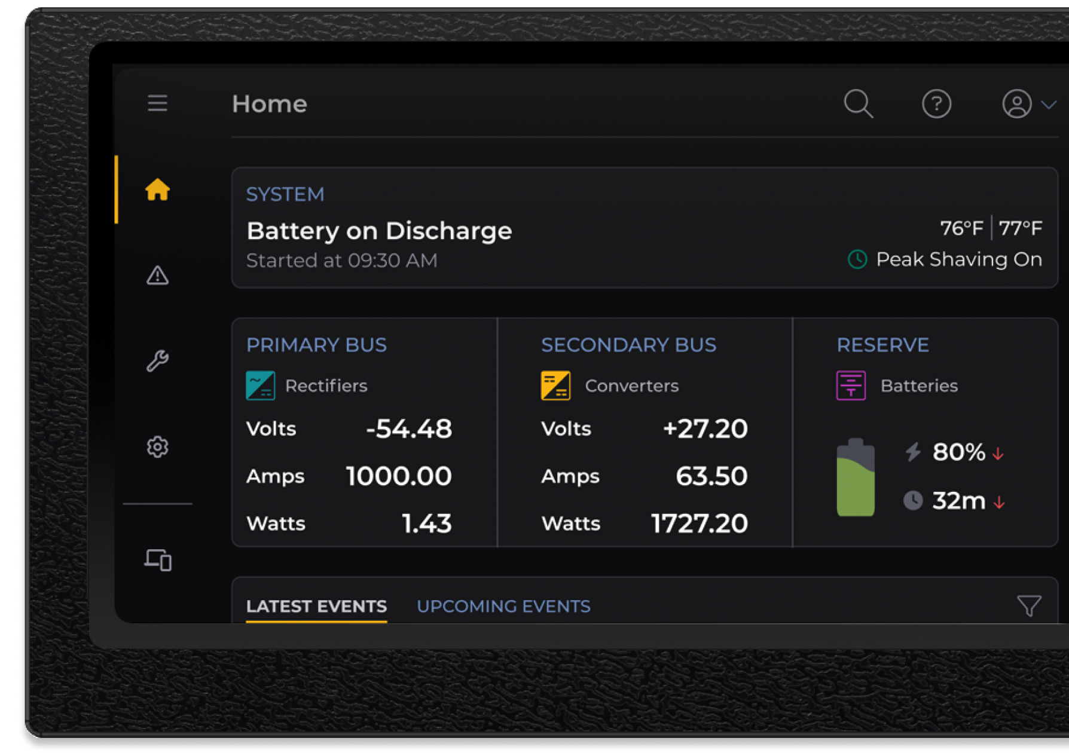
Hardware UIs

Slide 10

UX Team
noun
Creative scientists who believe in using evidence to drive all design decisions

Slide 11
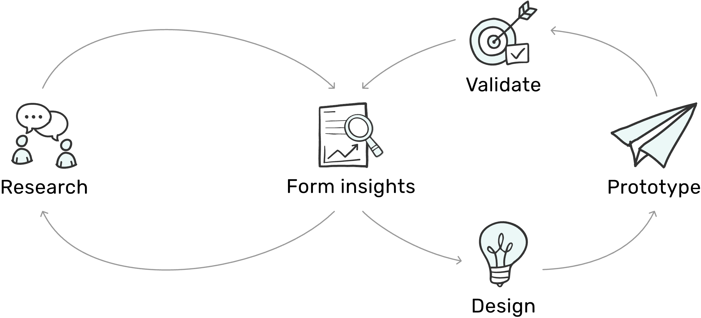
Evidence-based design process

Slide 12

Design solutions

Slide 13
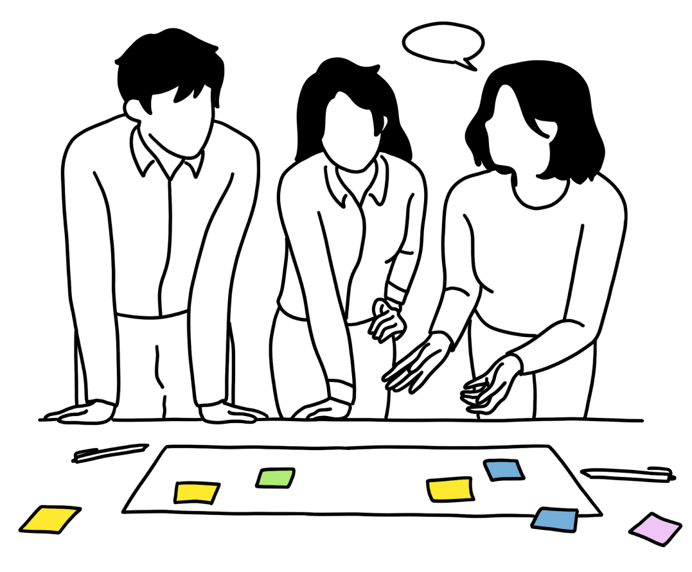
Research collects evidence to drive design decisions

Slide 14
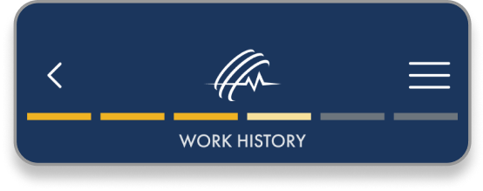
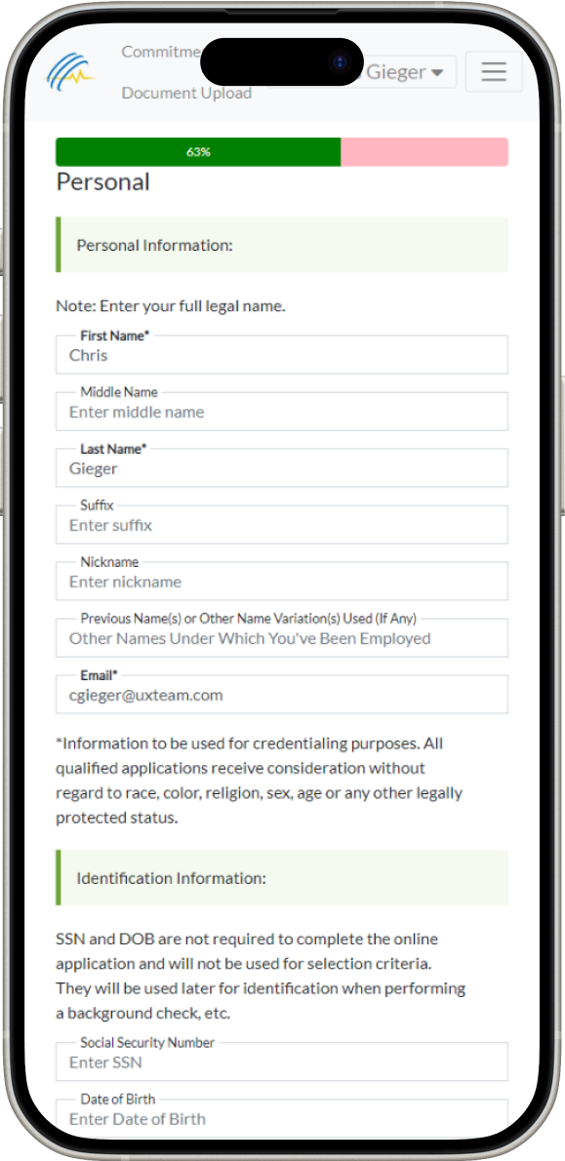
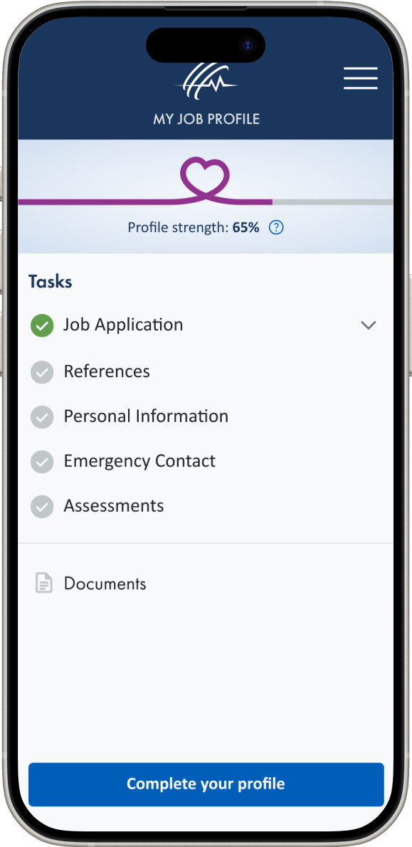

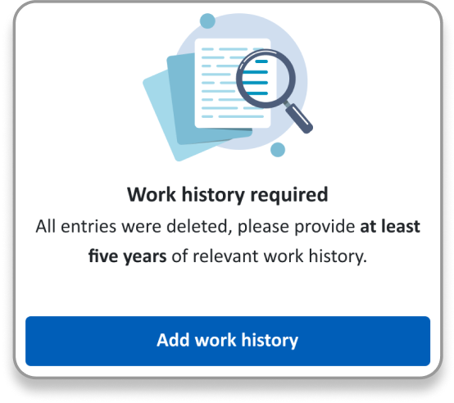

Key finding
Users were unsure if the job application was complete.
Solution
Task list
Progress indicators
Contextual prompts
Clear messaging

Slide 15
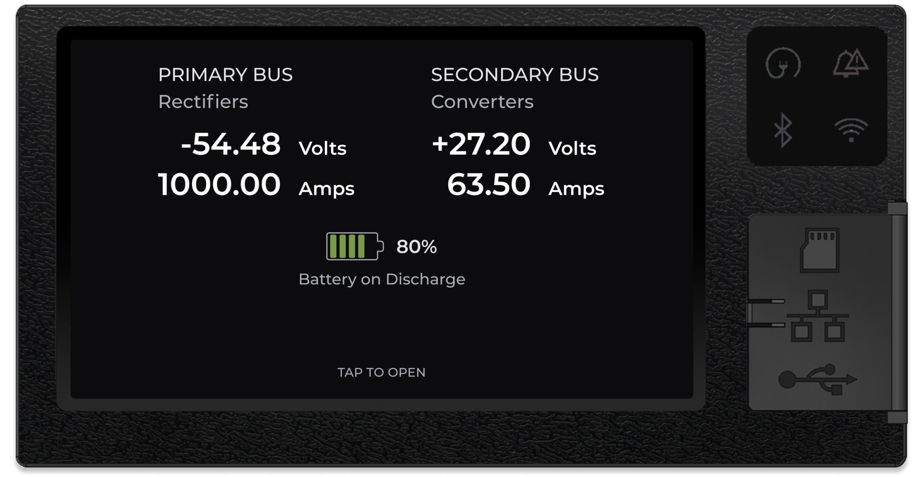
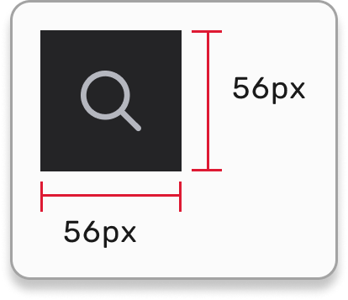
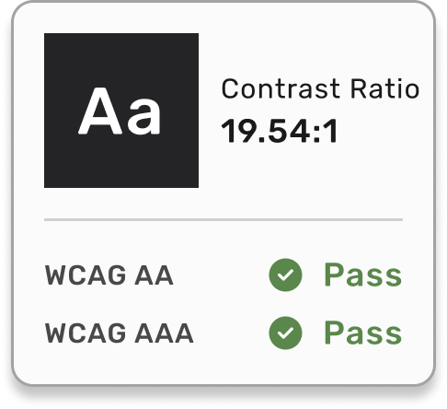
Key finding
Main users are men 50+, with larger hand sizes and visual accessibility needs.
Solution
Increased touch targets, font sizes, and color contrast that meet WCAG AAA standards.

Slide 16
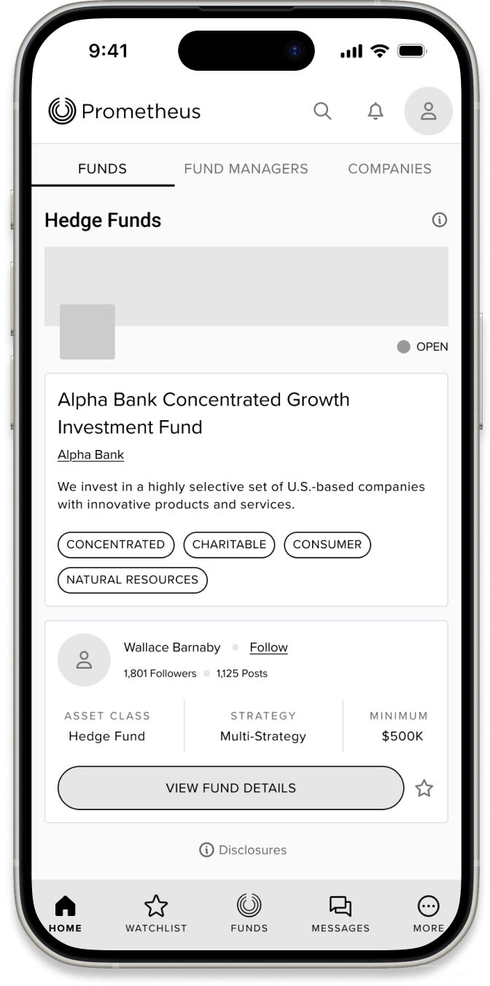
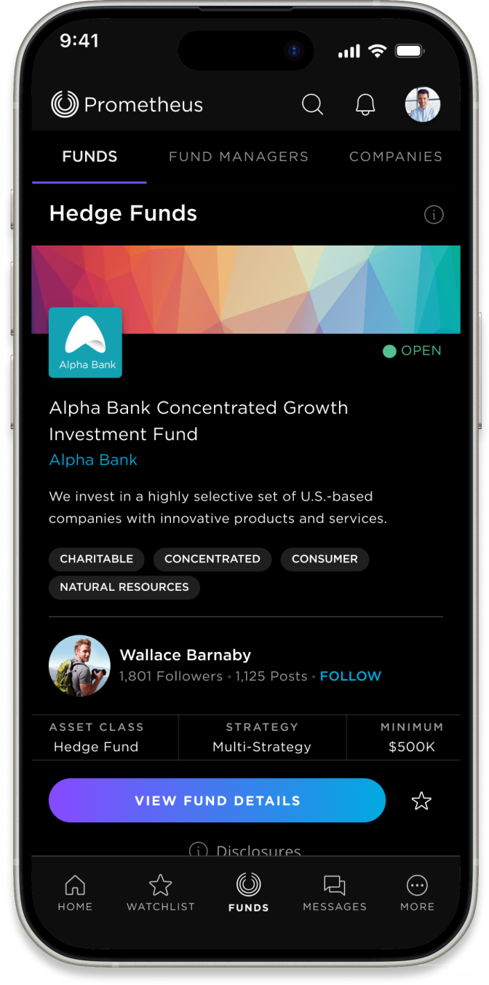
Design smarter, launch faster, and reduce dev costs with prototypes

Slide 17
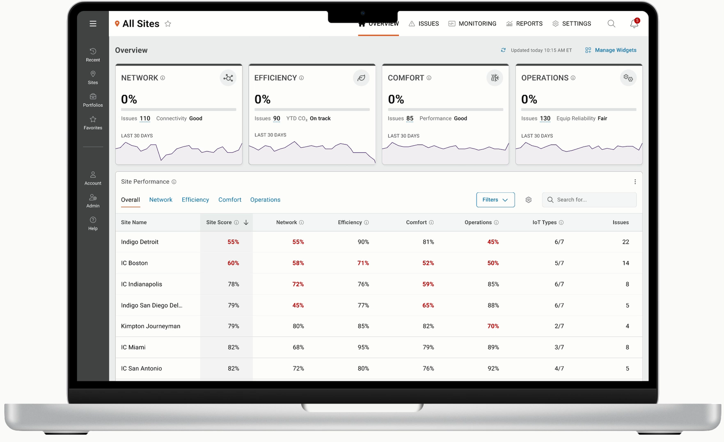
High-fidelity prototypes

Slide 18
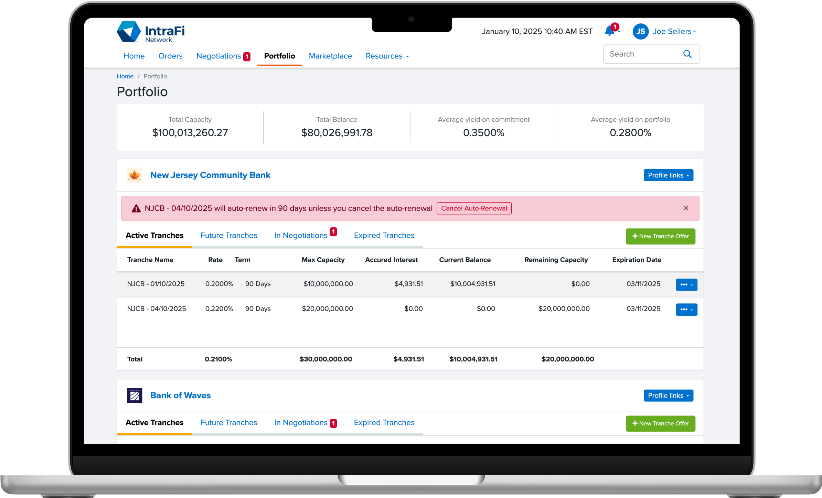
Front-end prototypes

Slide 19
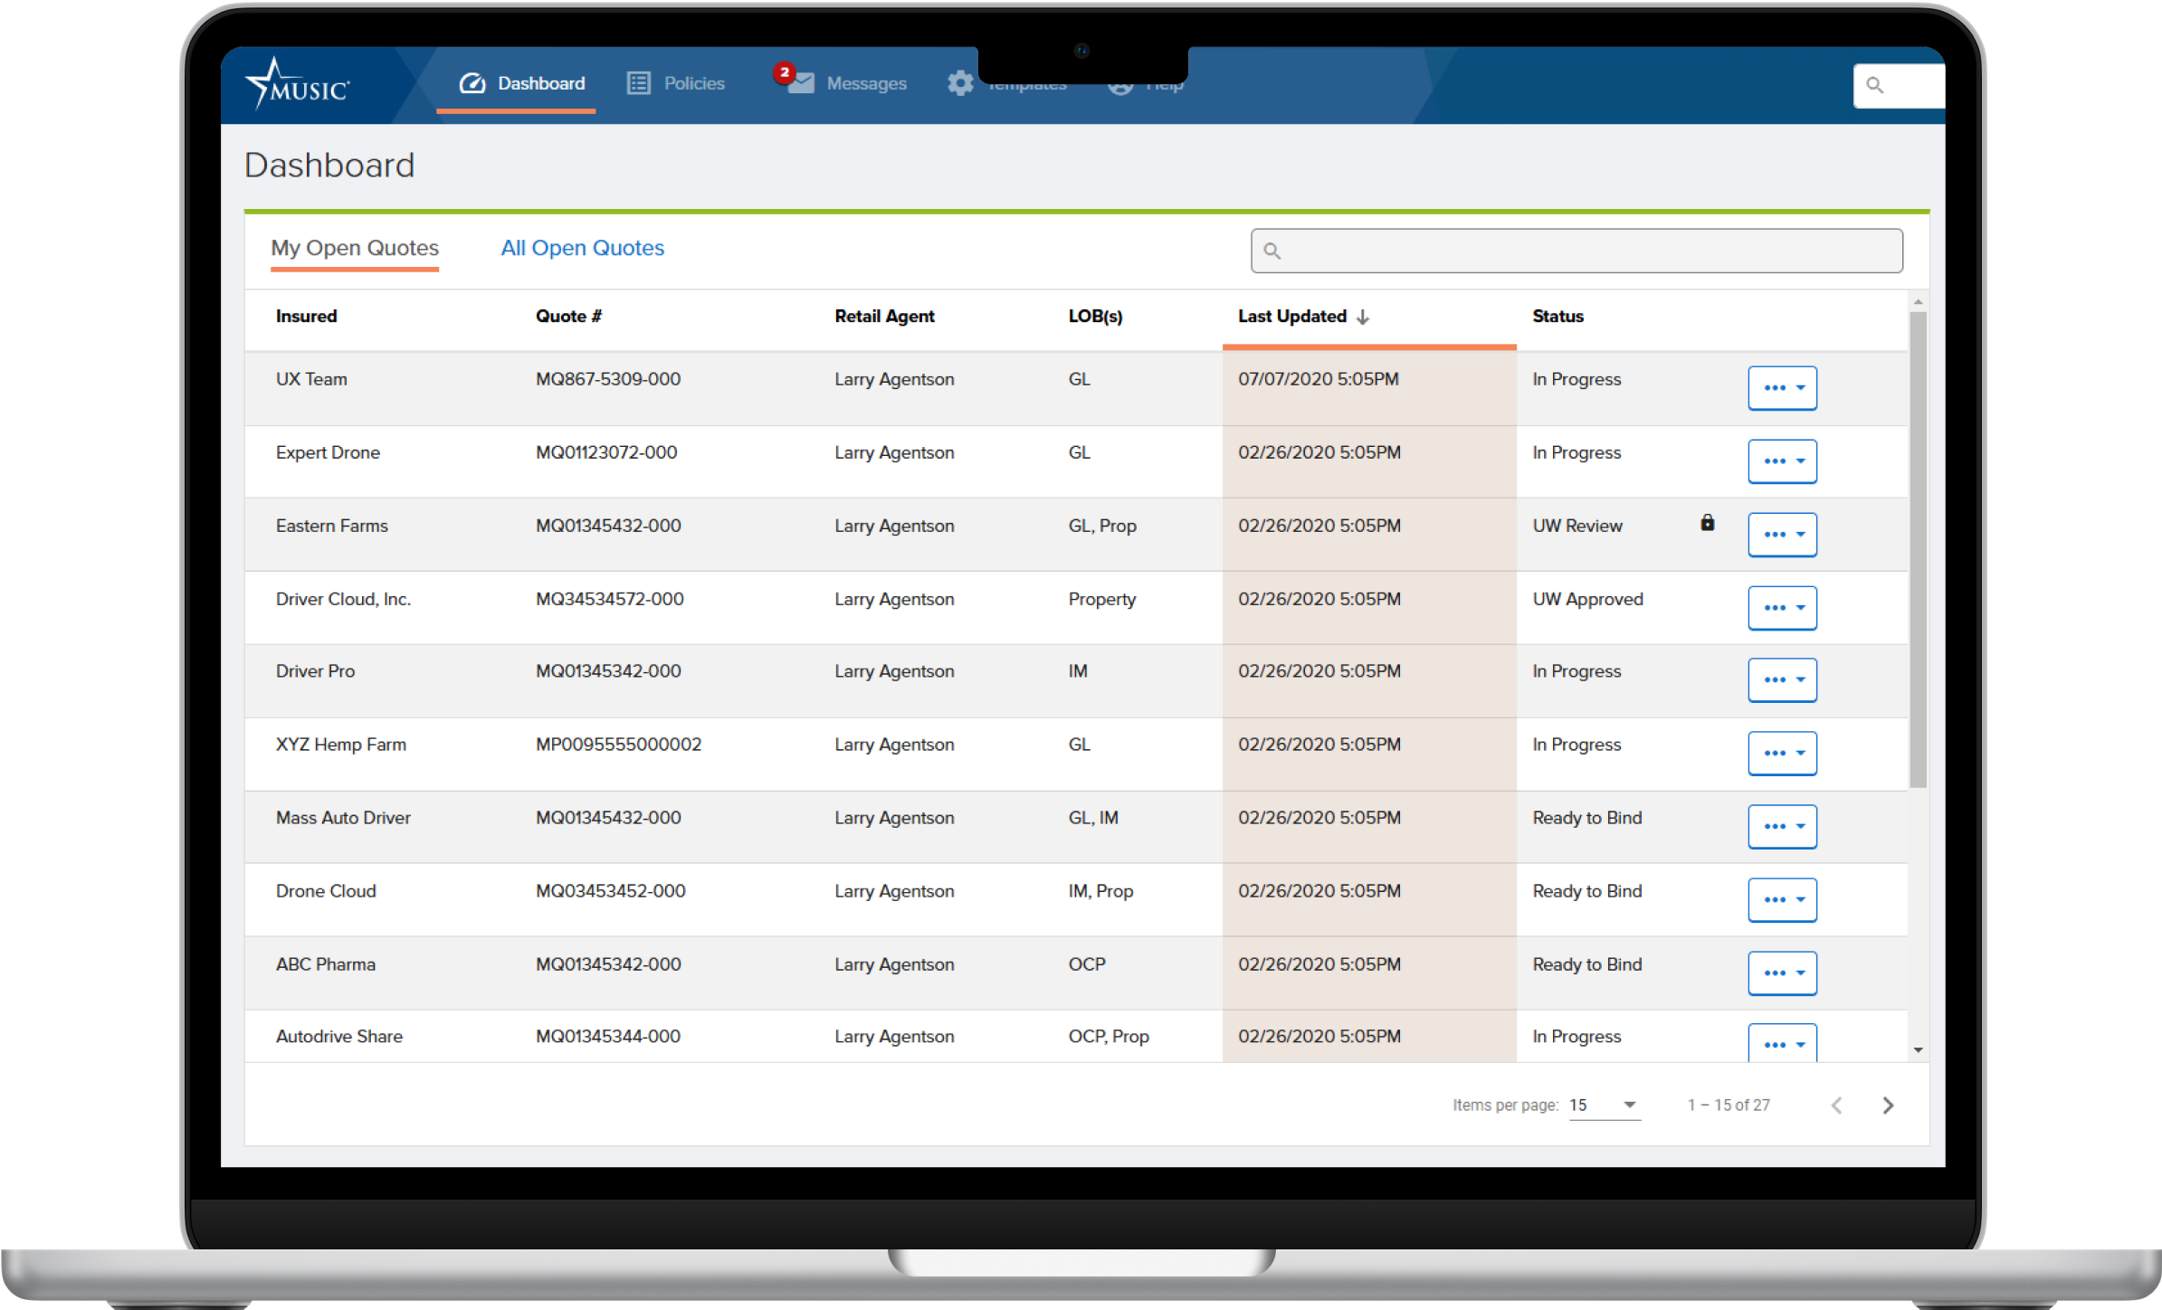





Front-end prototypes

Slide 20
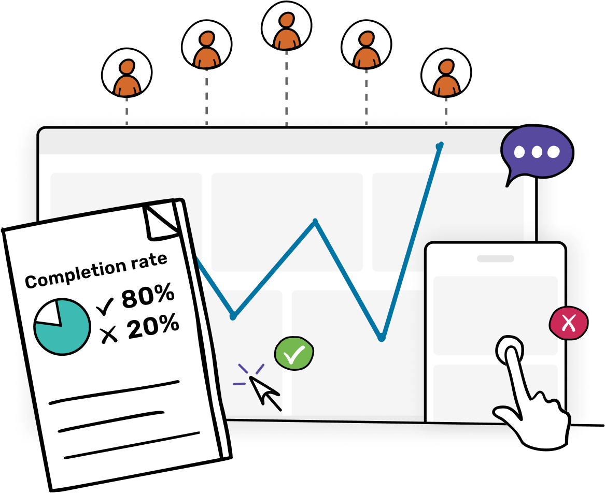
Usability testing reveals potential design flaws before development starts.

Slide 21
85% of usability problems can be uncovered by testing with just 5 users.
Source: Nielsen Norman Group

Slide 22
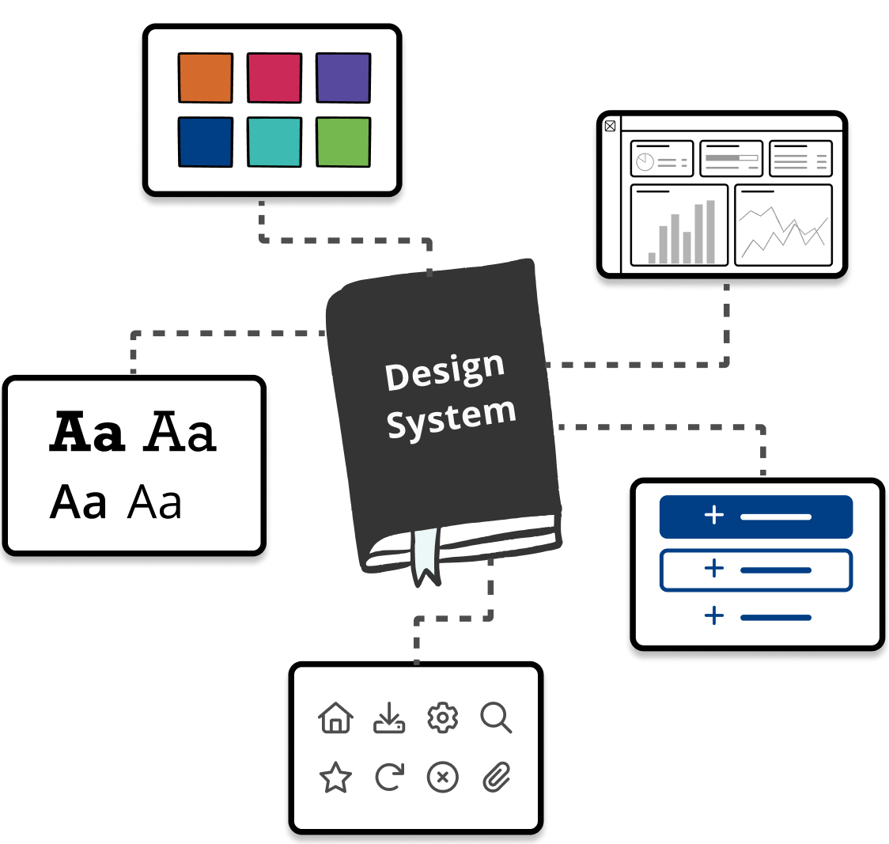
Design systems ensure consistency & boost efficiency

Slide 23
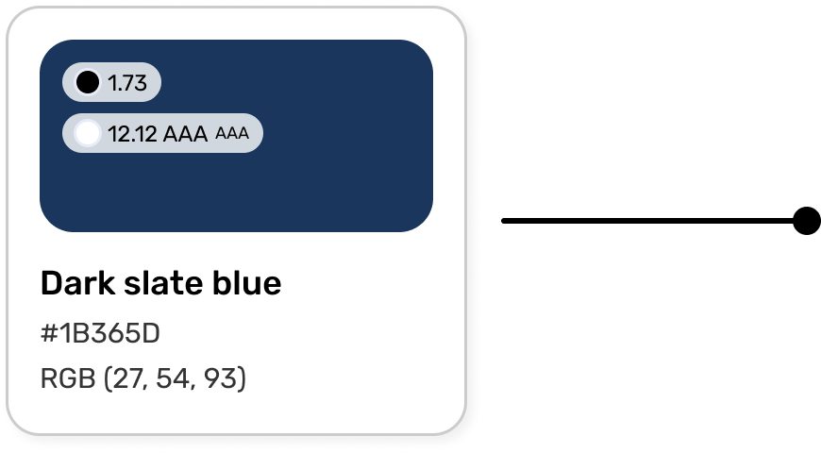
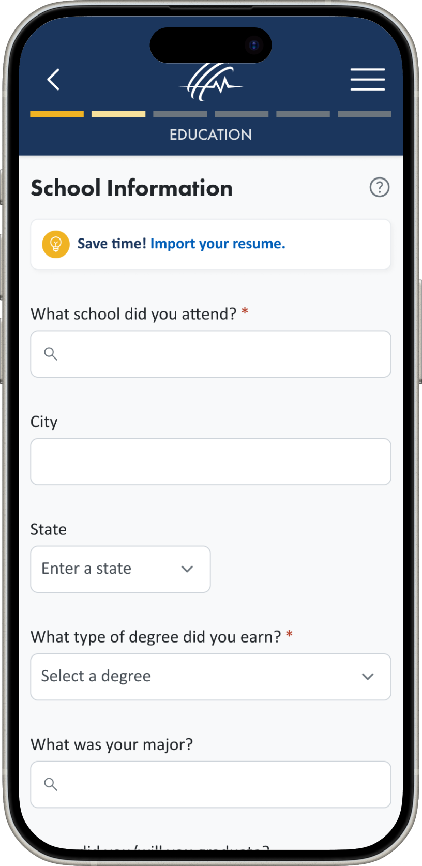
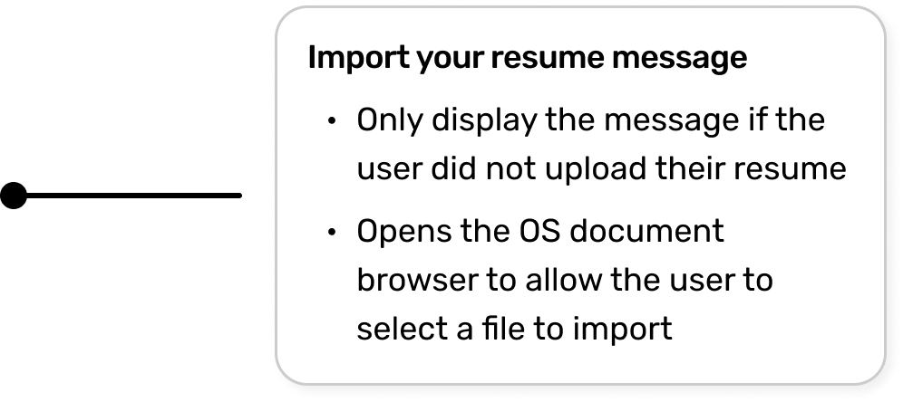
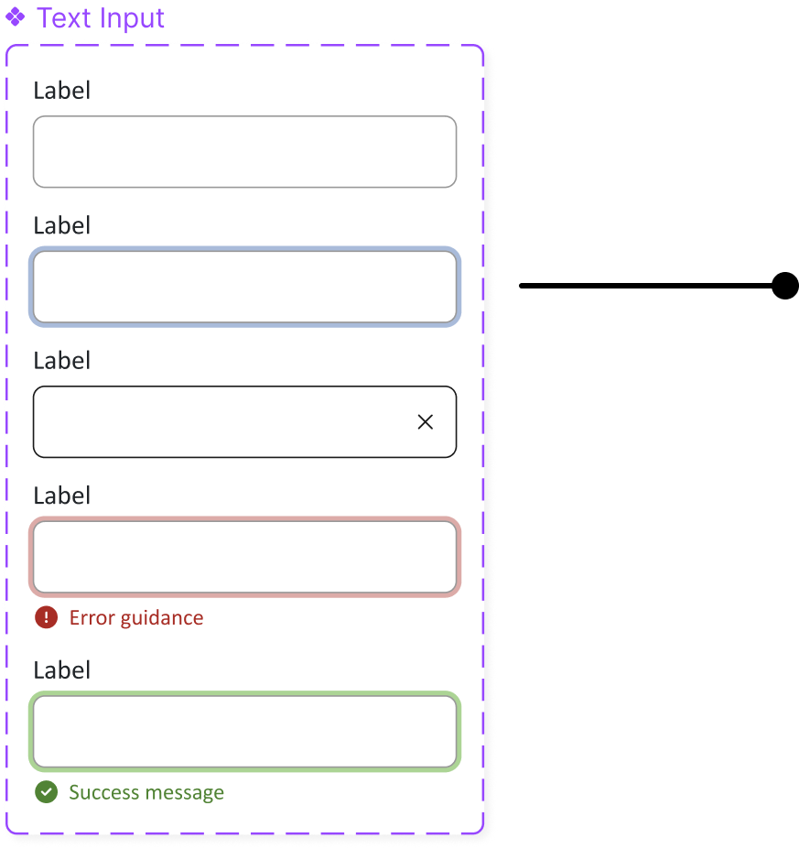
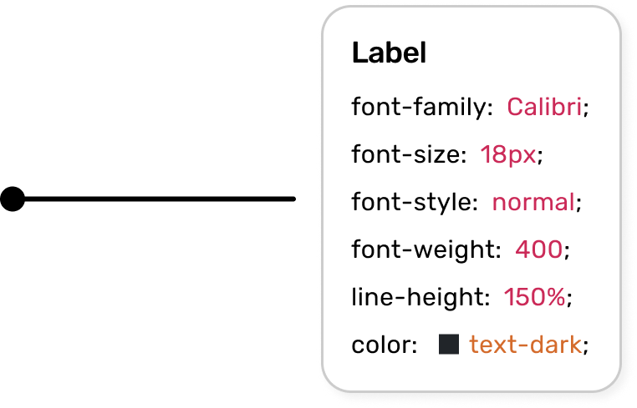

Slide 24

Development solutions

Slide 25




Prototype
Seamless dev hand-off at any stage
Documentation
UX support
Refinements

Slide 26
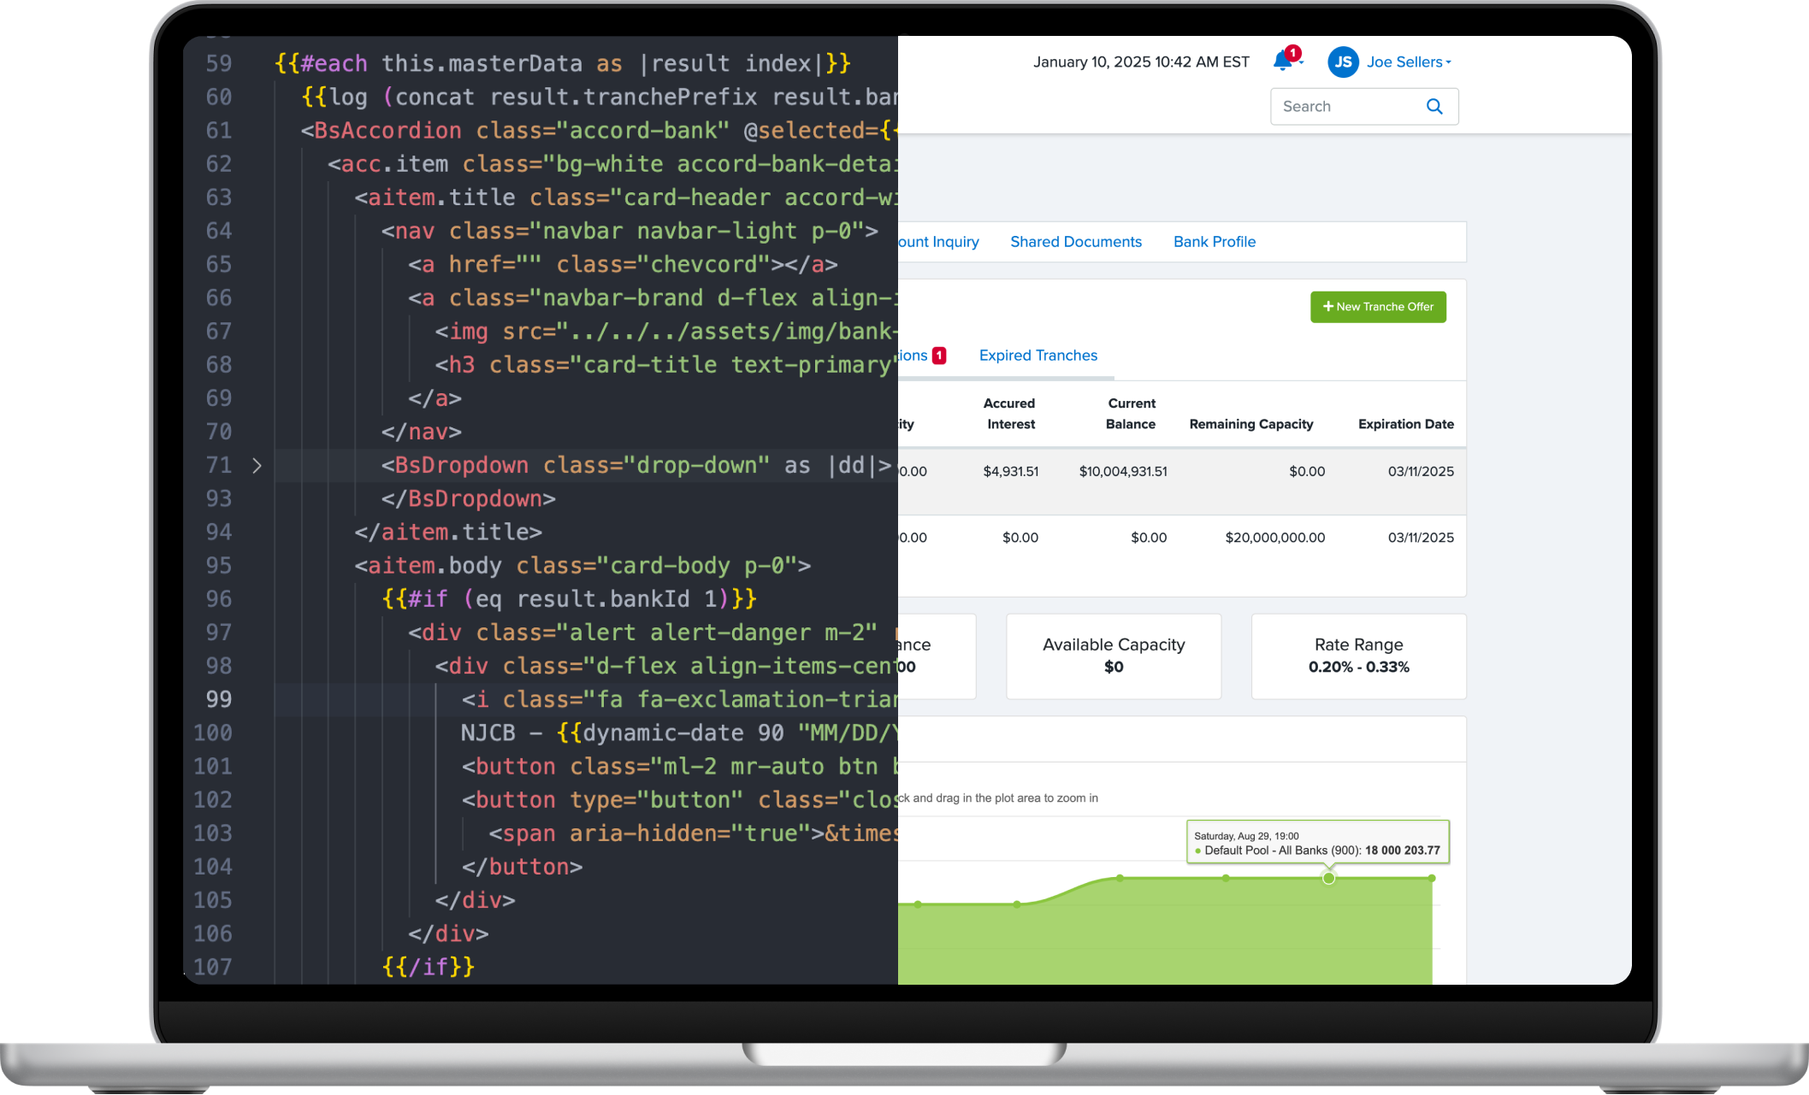
Front-end development

Slide 27




Middle & back-end development
Software architecture
Proof of concepts
QA testing
Application development

Slide 28

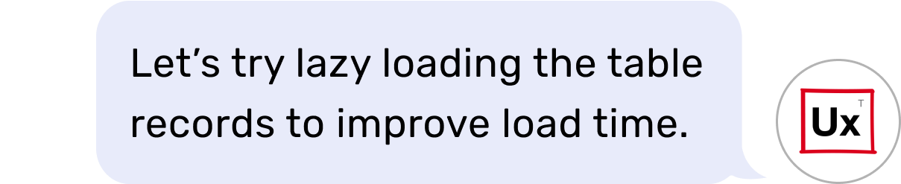

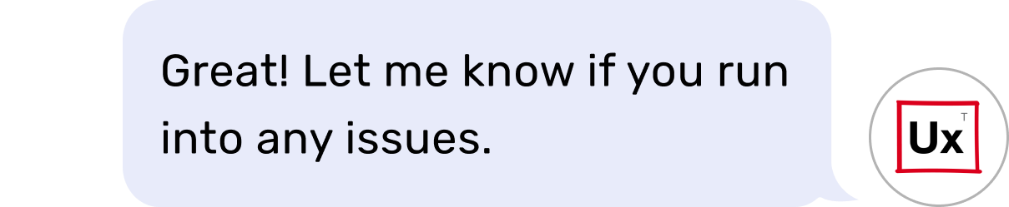
UX support during & after development

Slide 29

Pricing models

Slide 30
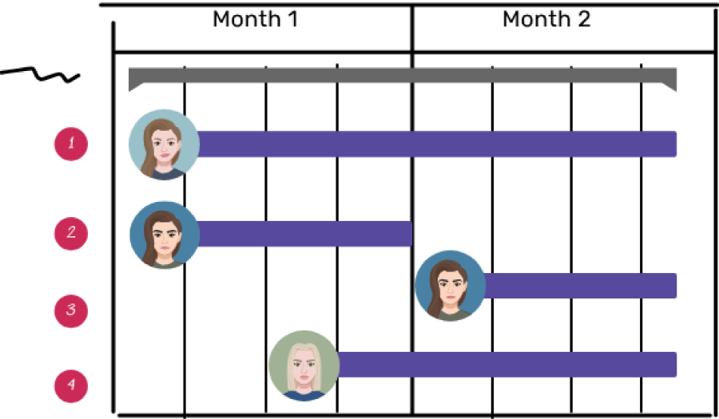
Transparent pricing models
Dedicated Team
One fixed price per project
$145/hour
Flex Team
Ongoing, unlimited projects
Starts at $10k/month

Slide 31
9900% ROI
Every $1 spent on UX generates a return of approximately $100.
Source: Forrester

Slide 32

Portfolio

Slide 33
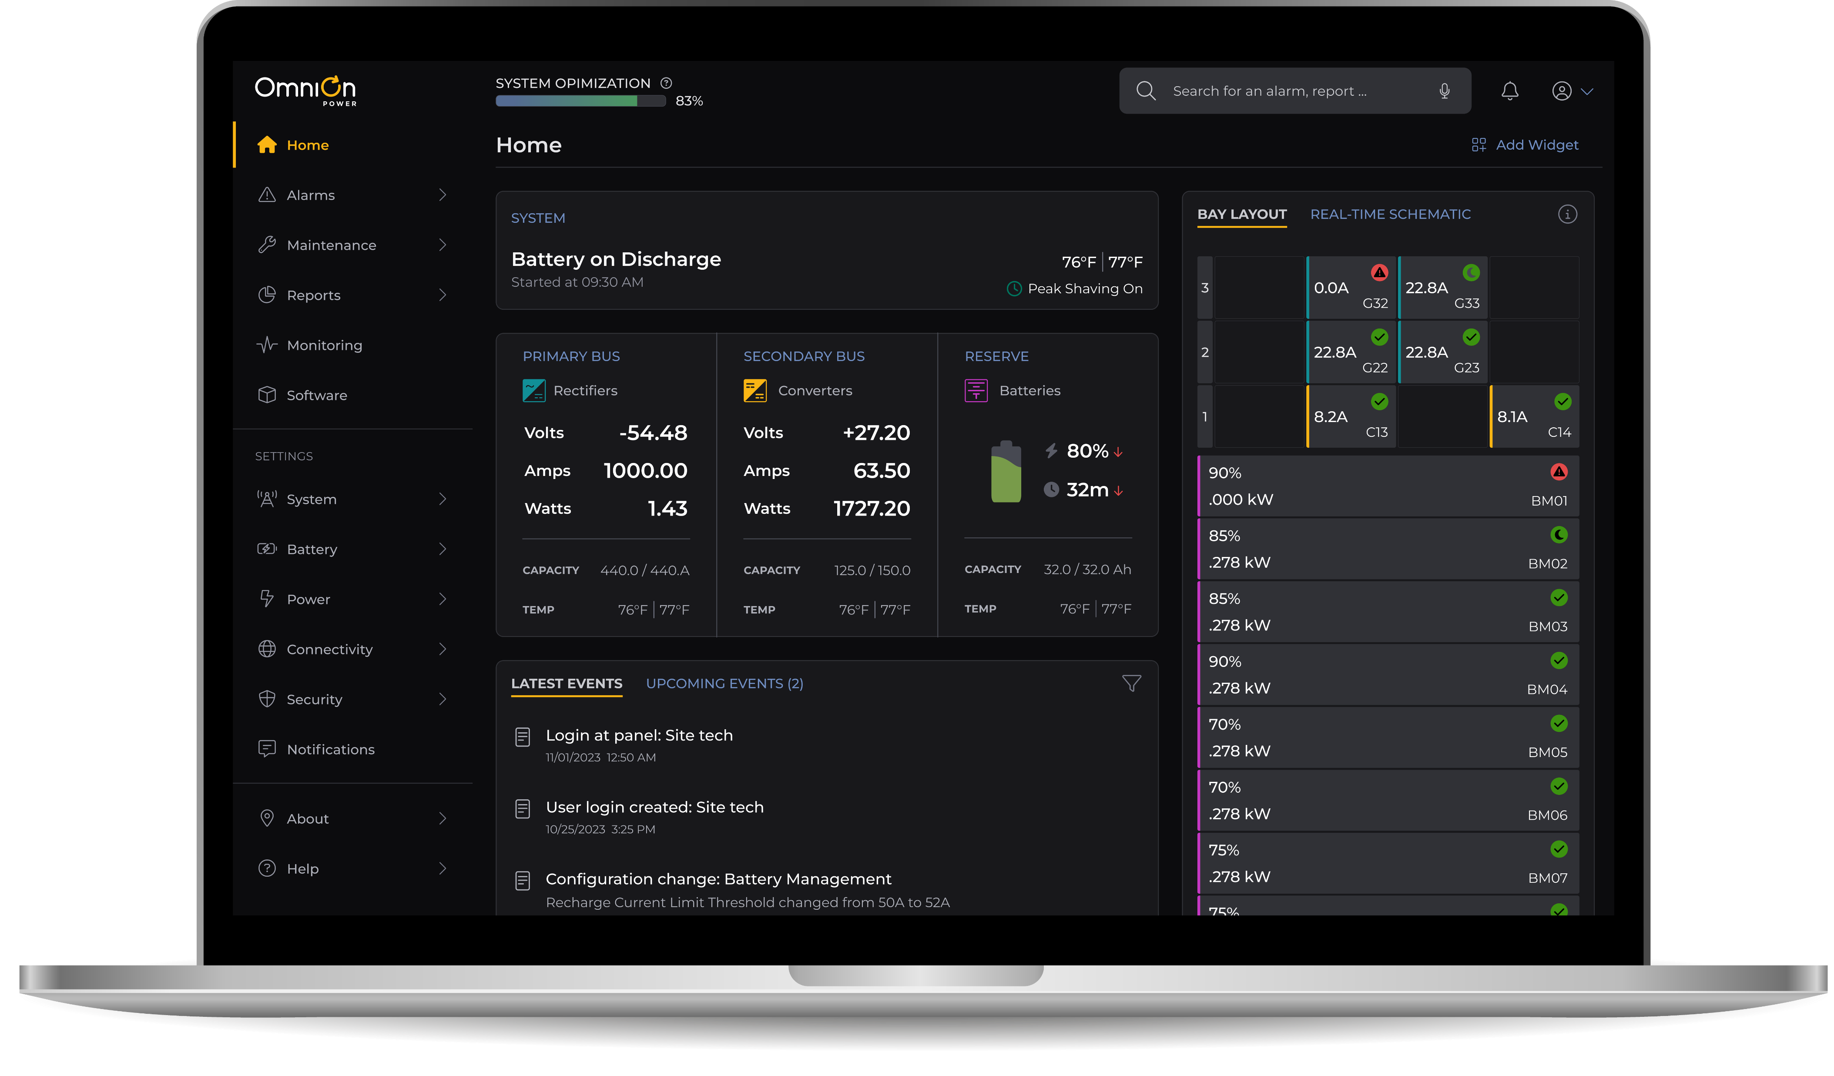




Industry
Power conversion
Application
SaaS, Hardware
Device

Slide 34
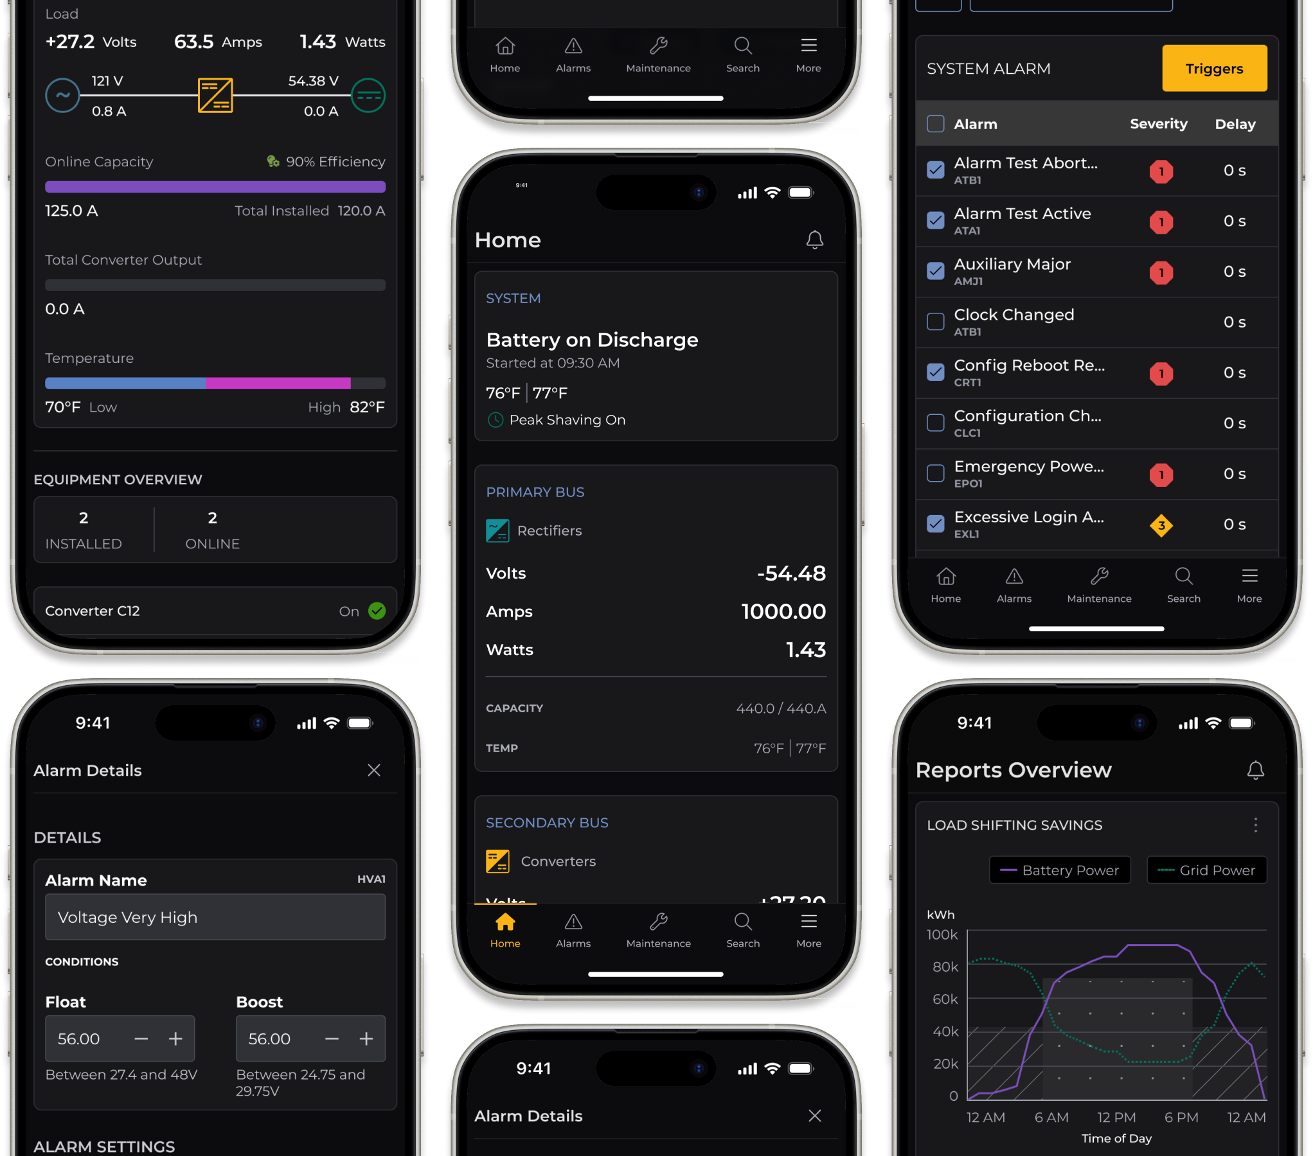

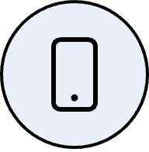
Industry
Power conversion
Application
SaaS, Hardware
Device

Slide 35
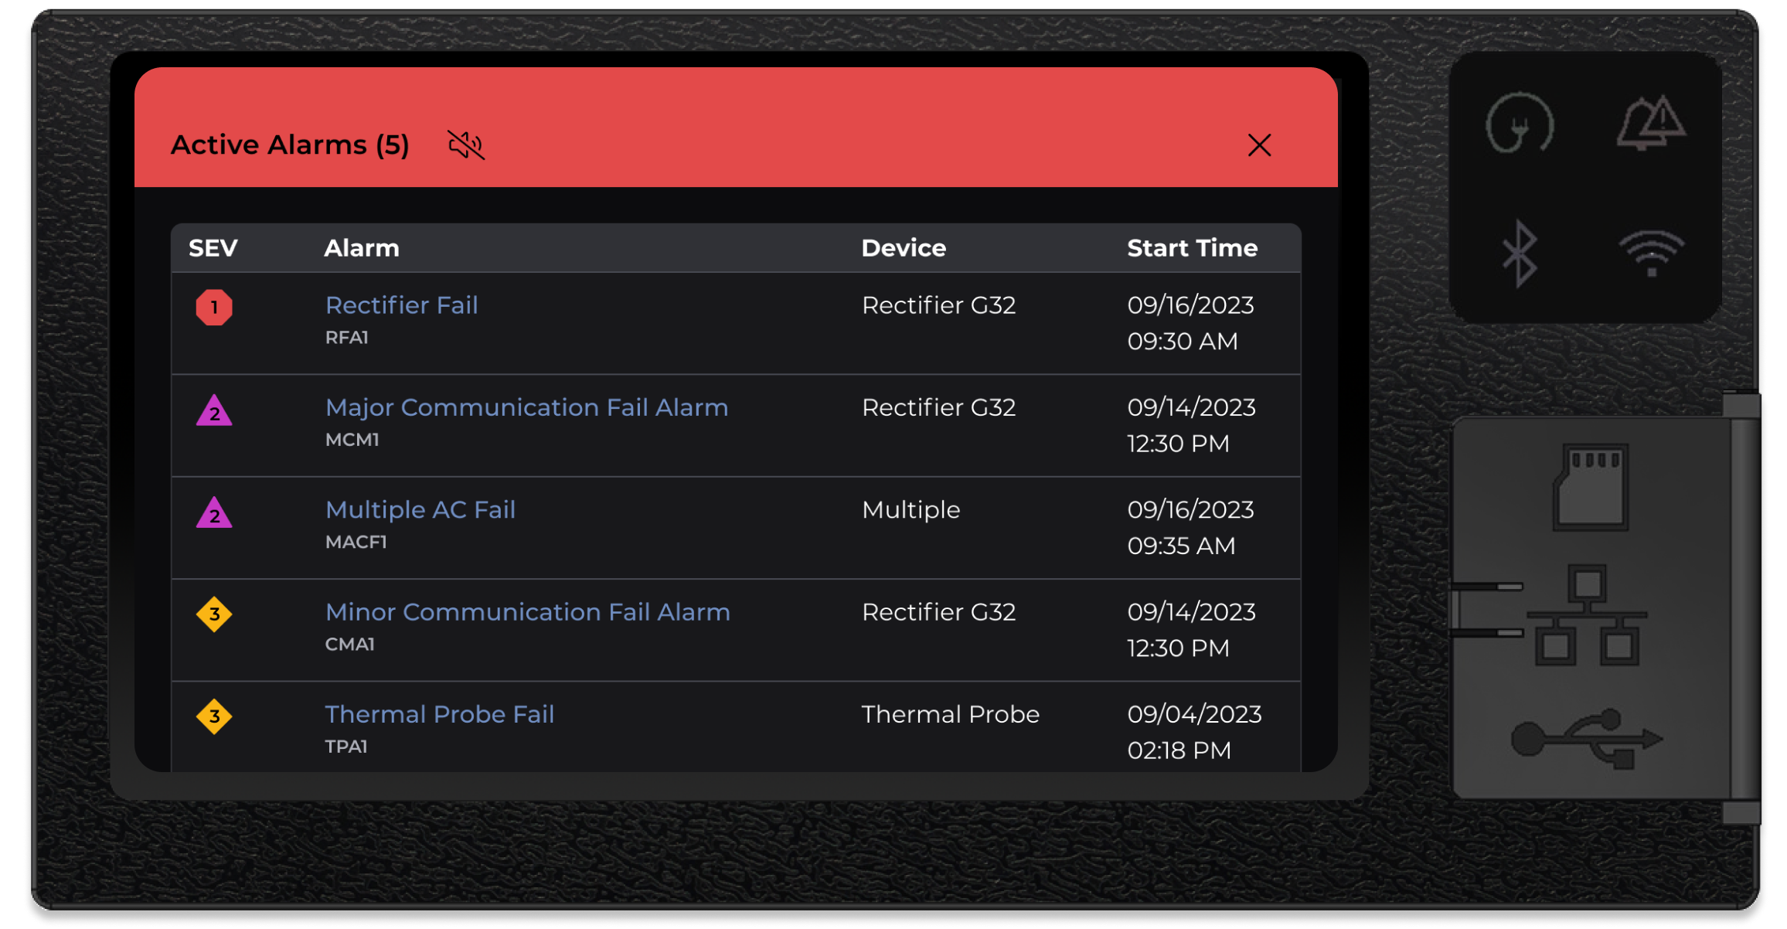
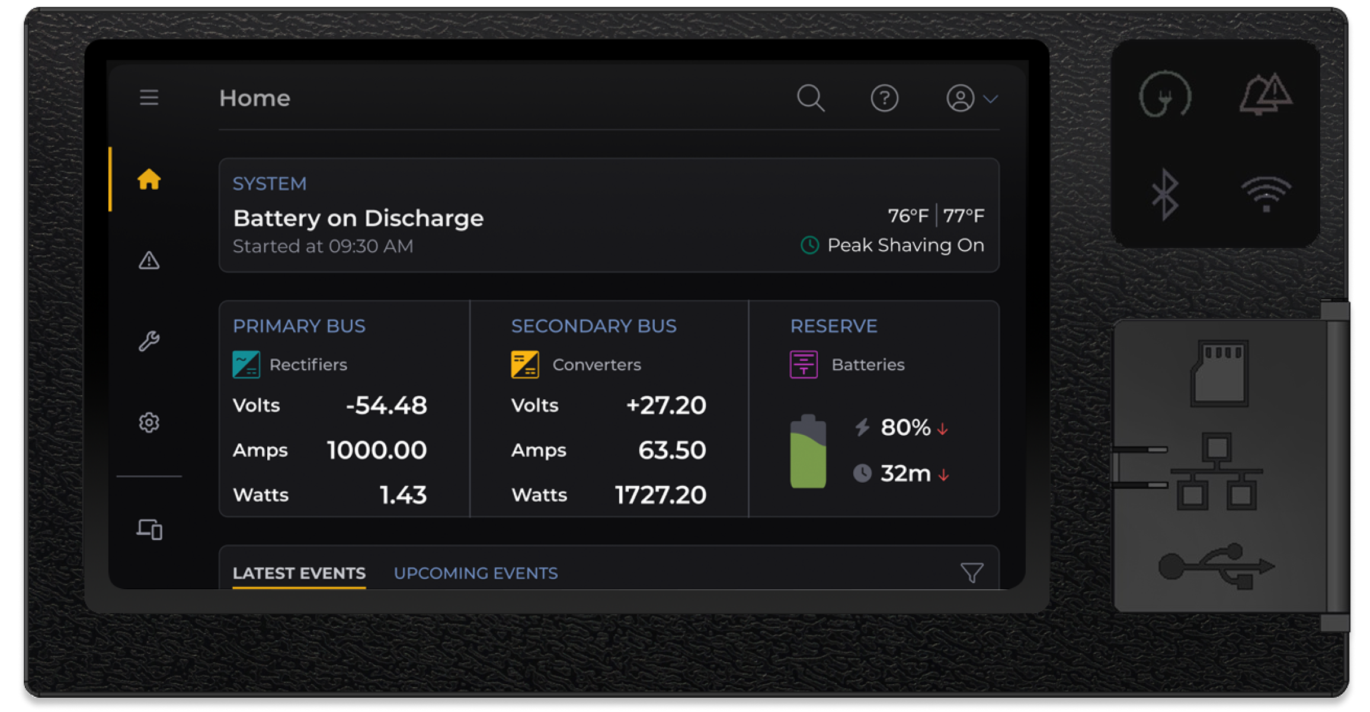

Industry
Power conversion
Application
SaaS, Hardware
Device

Slide 36
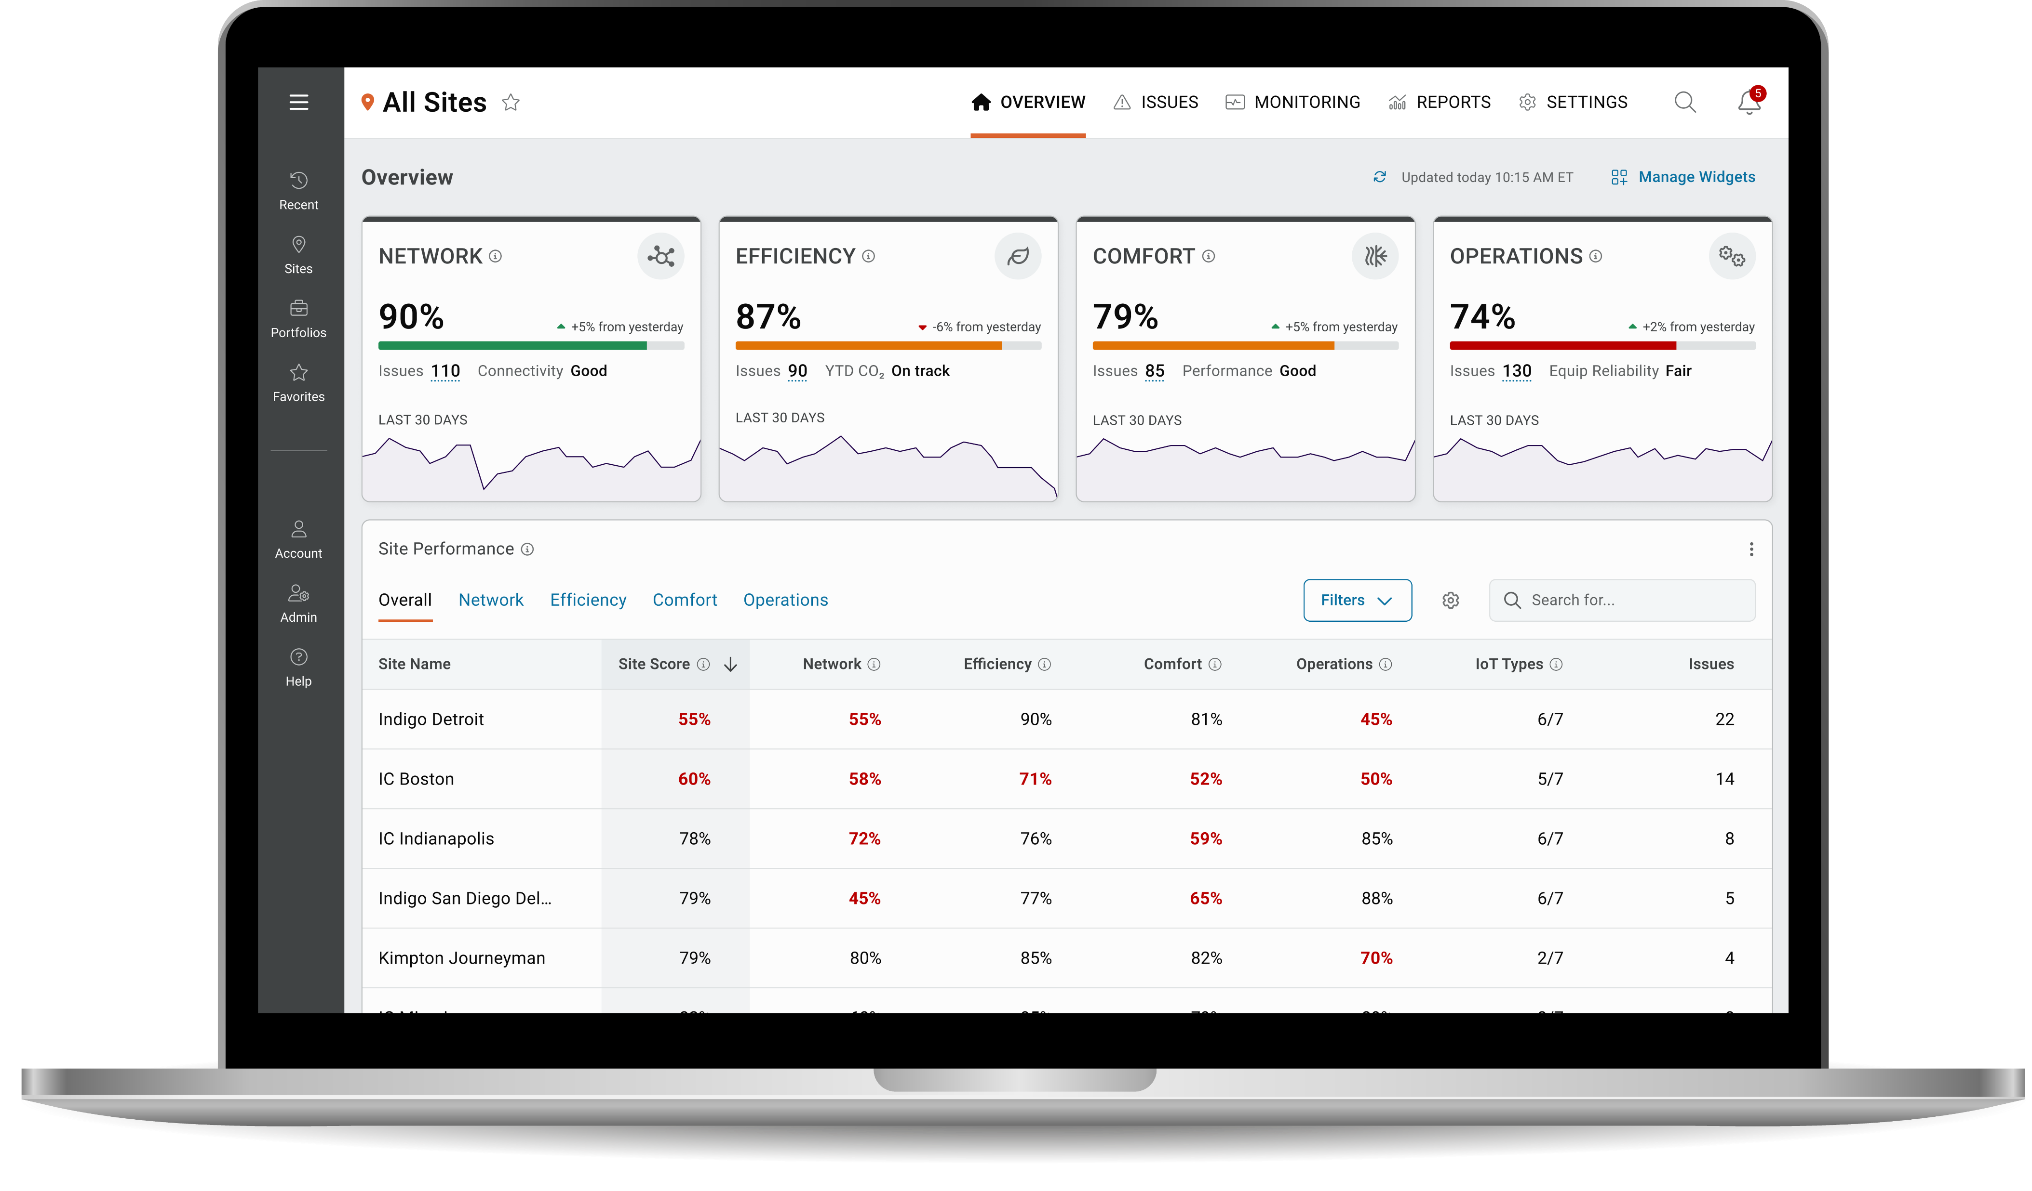

Industry
Building management
Application
SaaS
Device

Slide 37
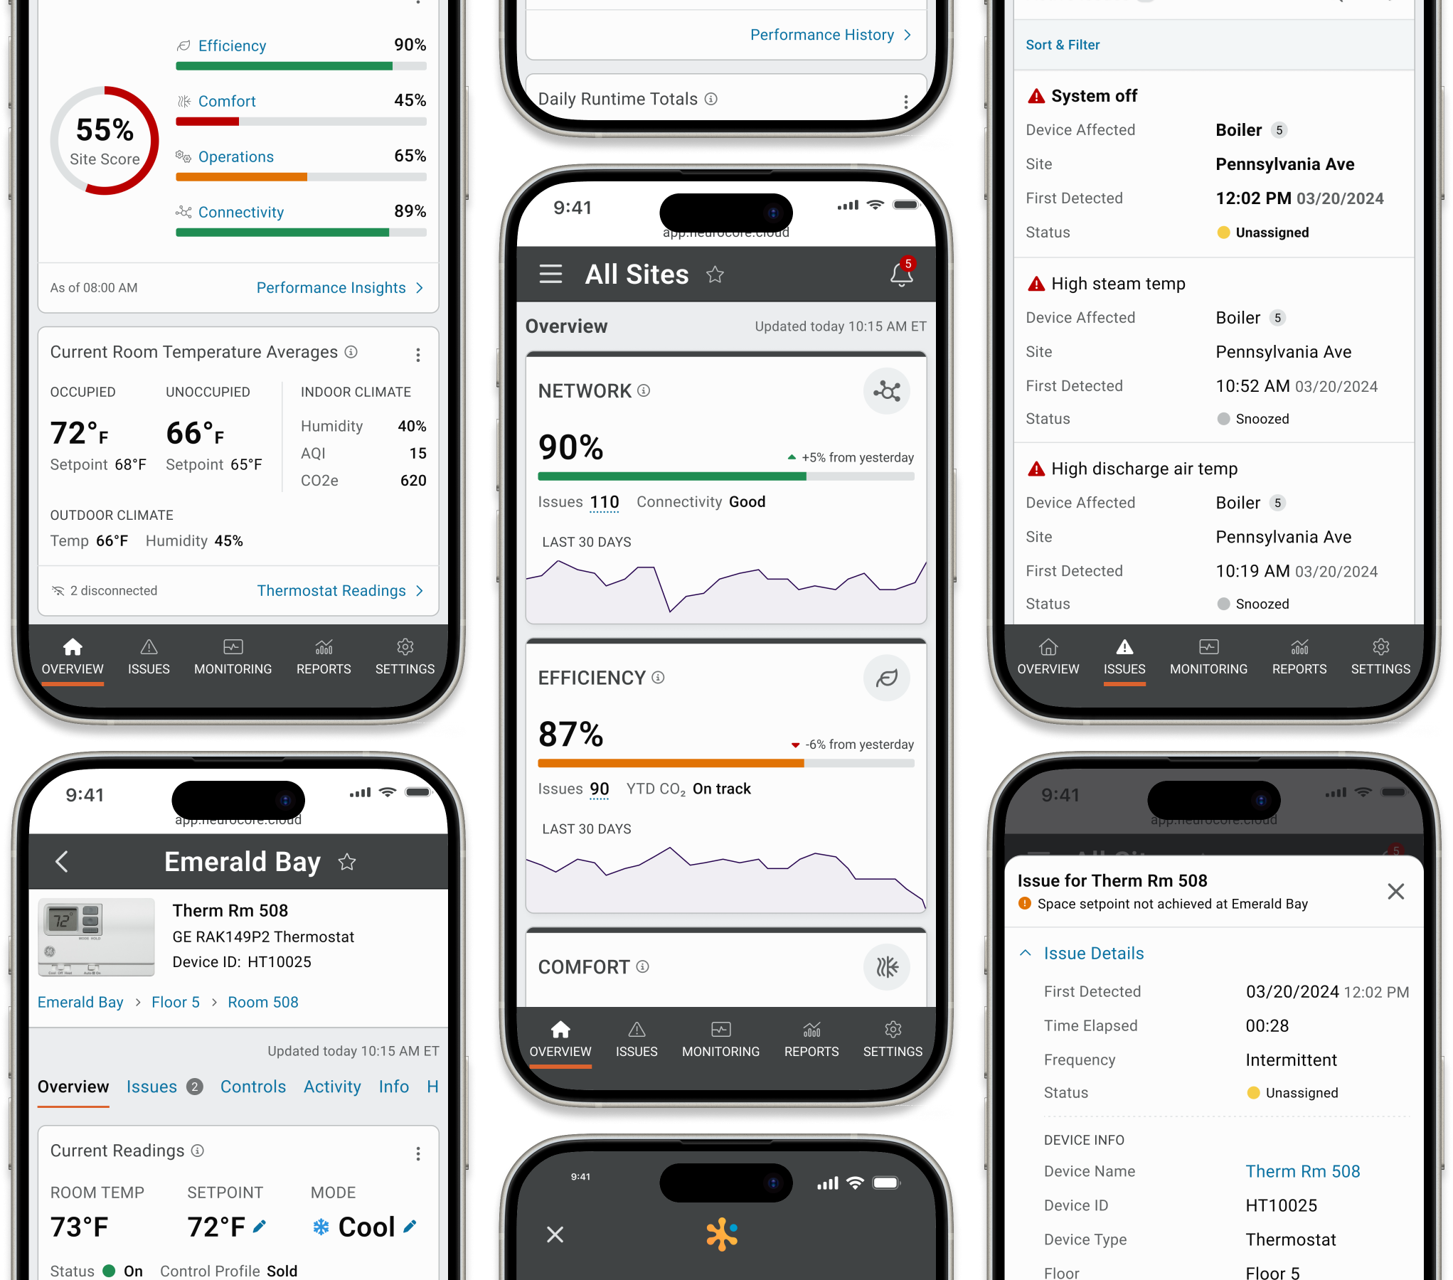
Industry
Building management
Application
SaaS
Device

Slide 38
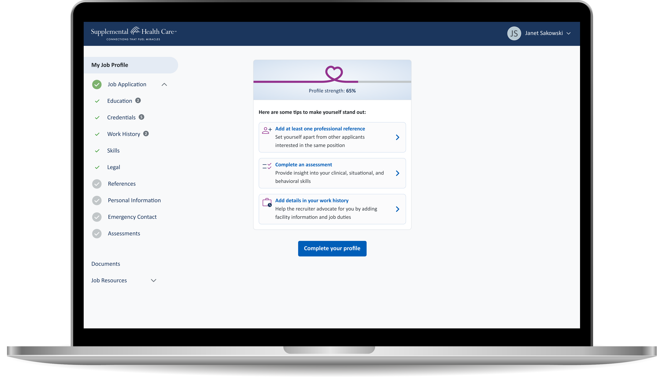

Industry
Healthcare staffing
Application
SaaS
Device

Slide 39
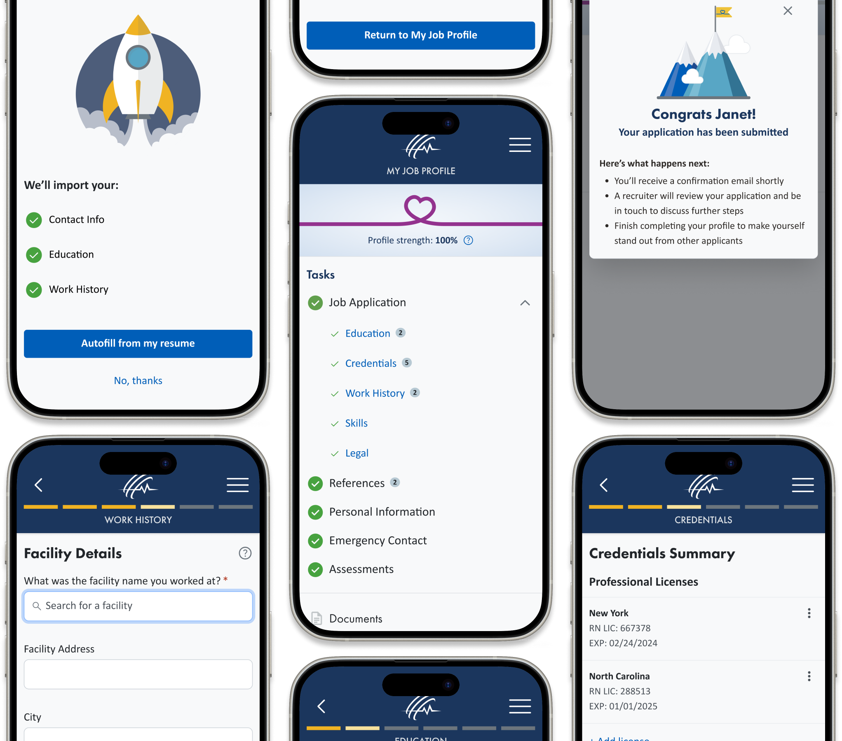
Industry
Building management
Application
Healthcare staffing
Device

Slide 40
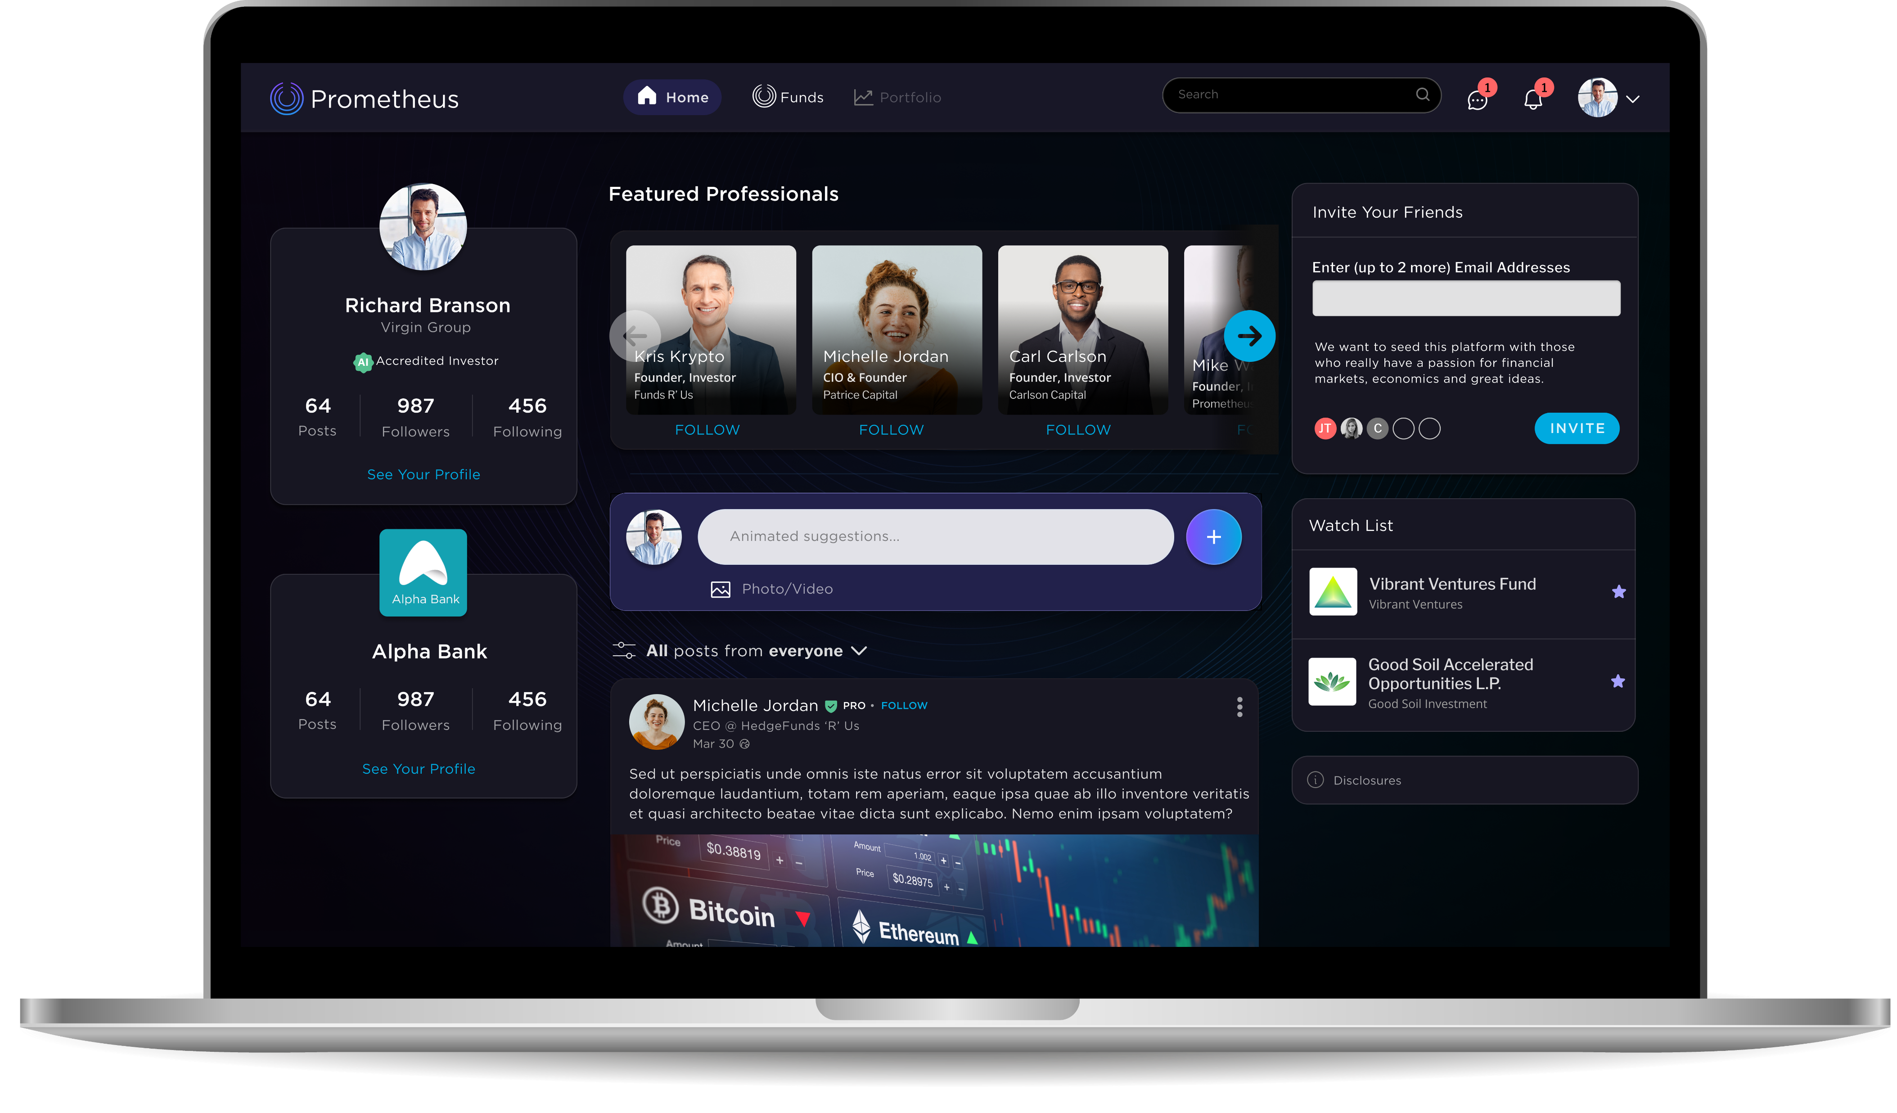

Industry
Fintech
Application
SaaS
Device

Slide 41
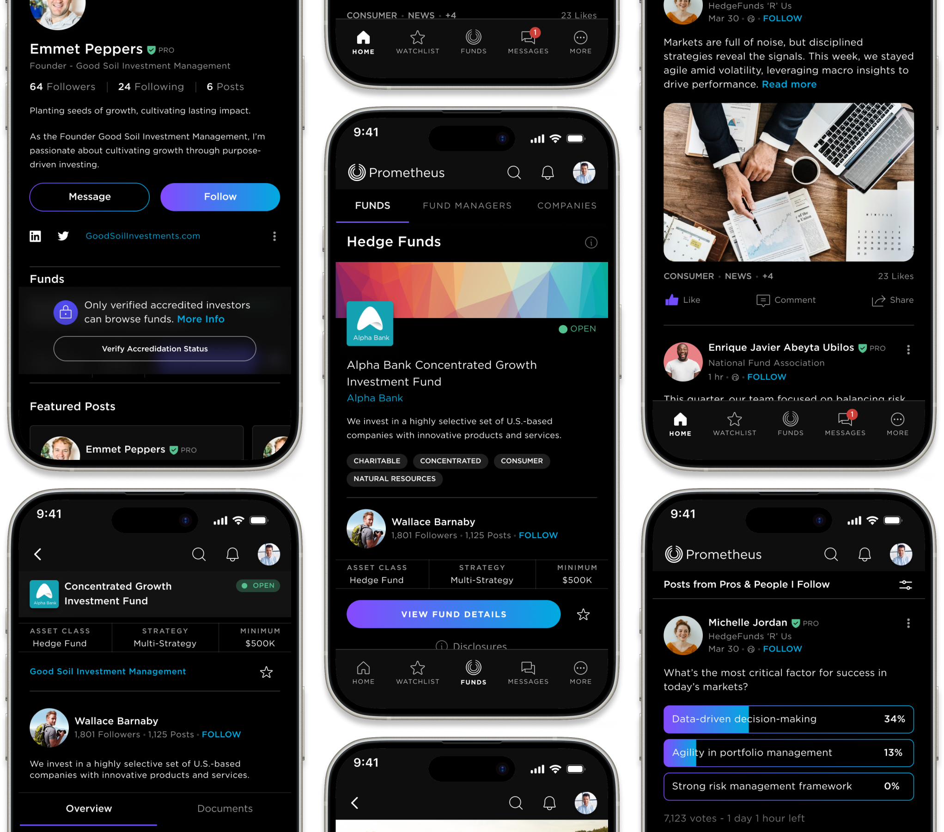
Industry
Fintech
Application
SaaS
Device

Slide 42
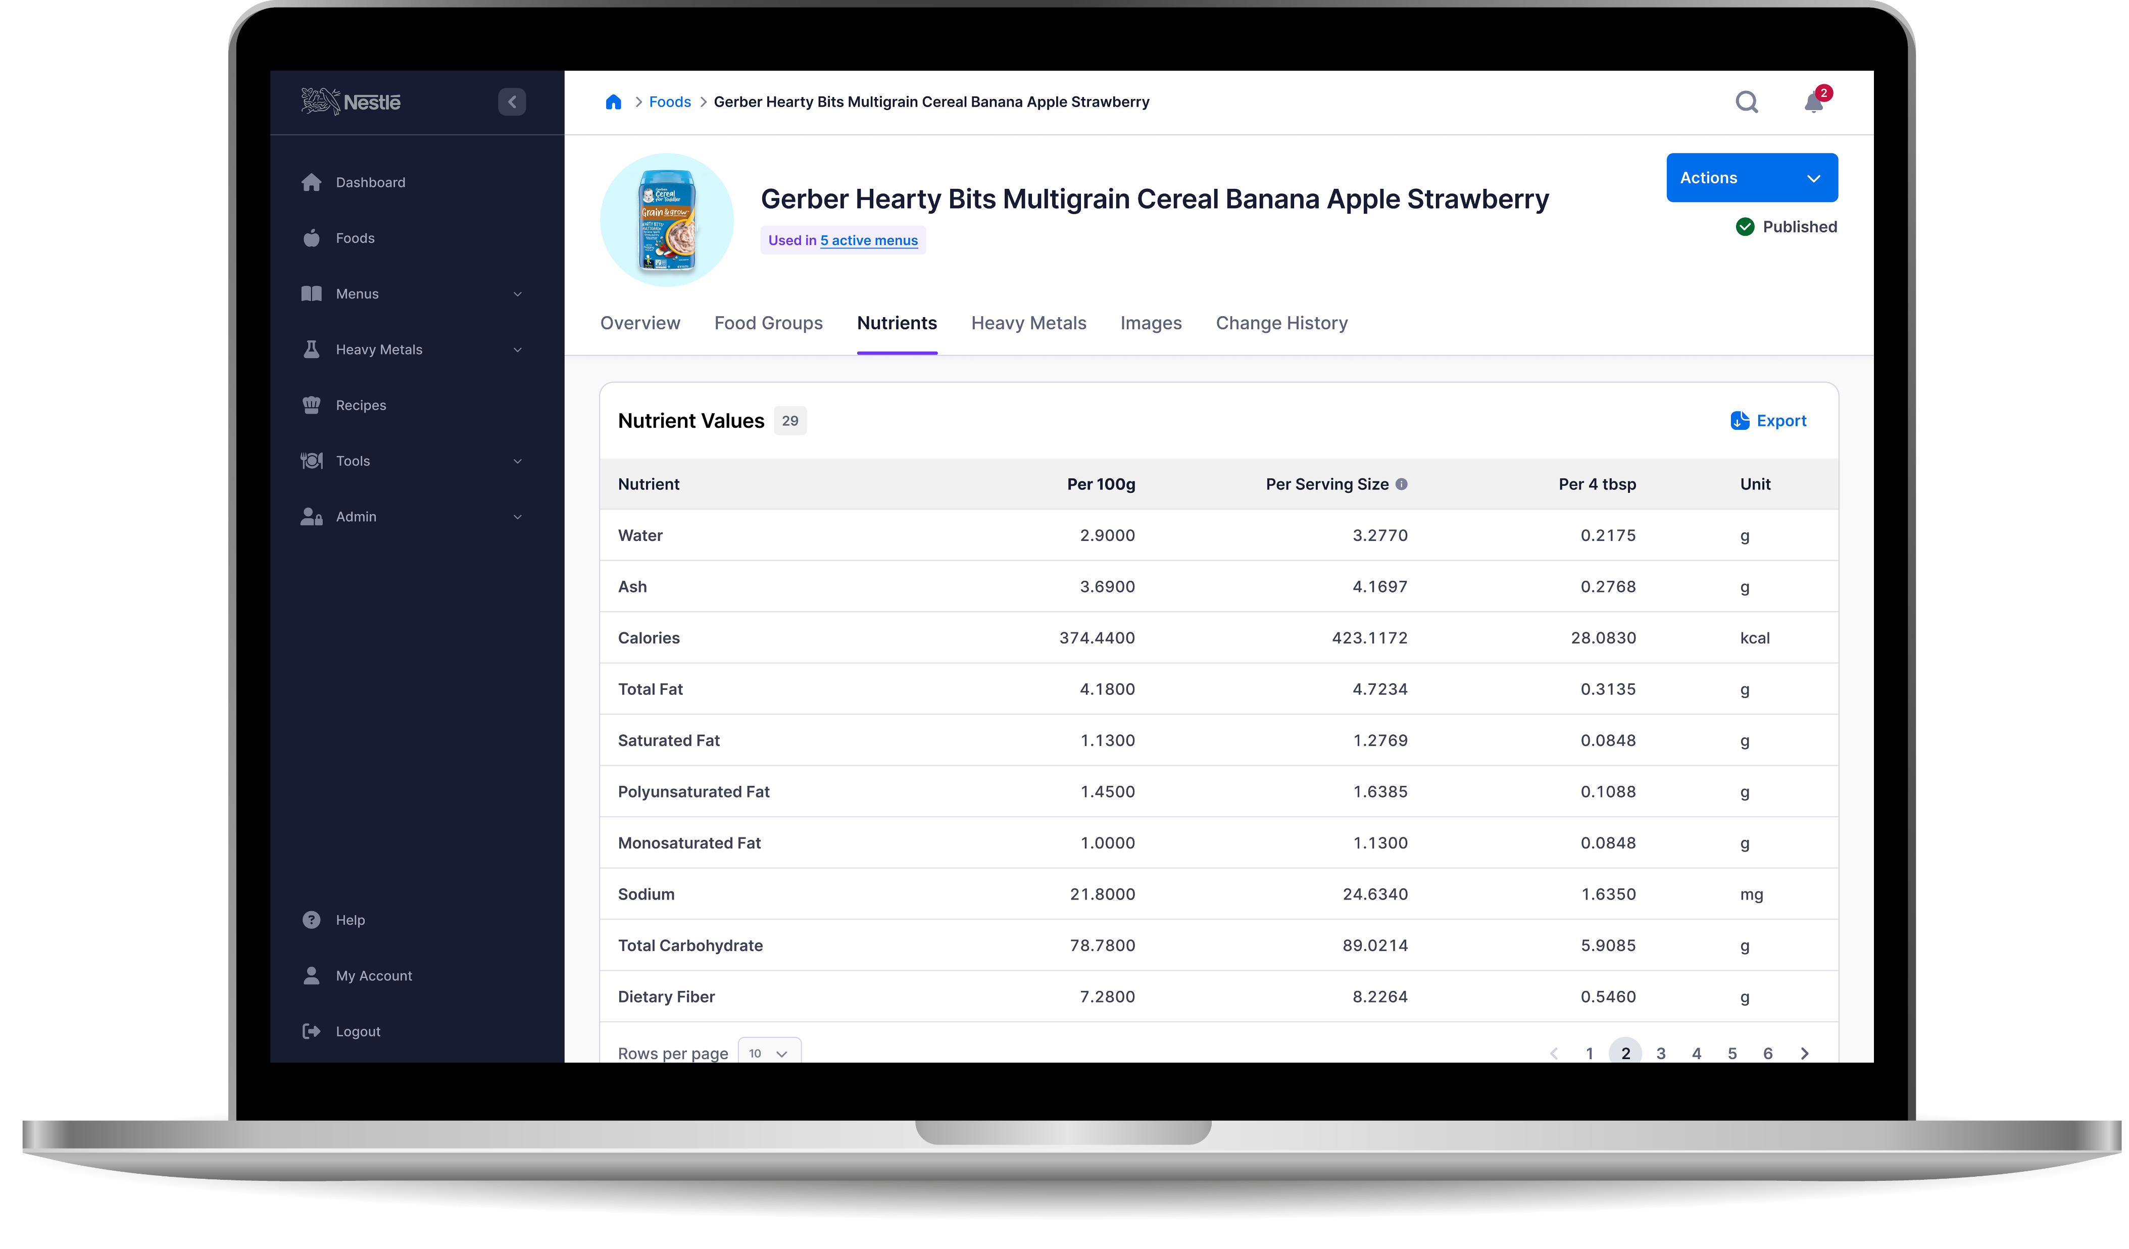

Industry
Healthcare
Application
Enterprise

Slide 43
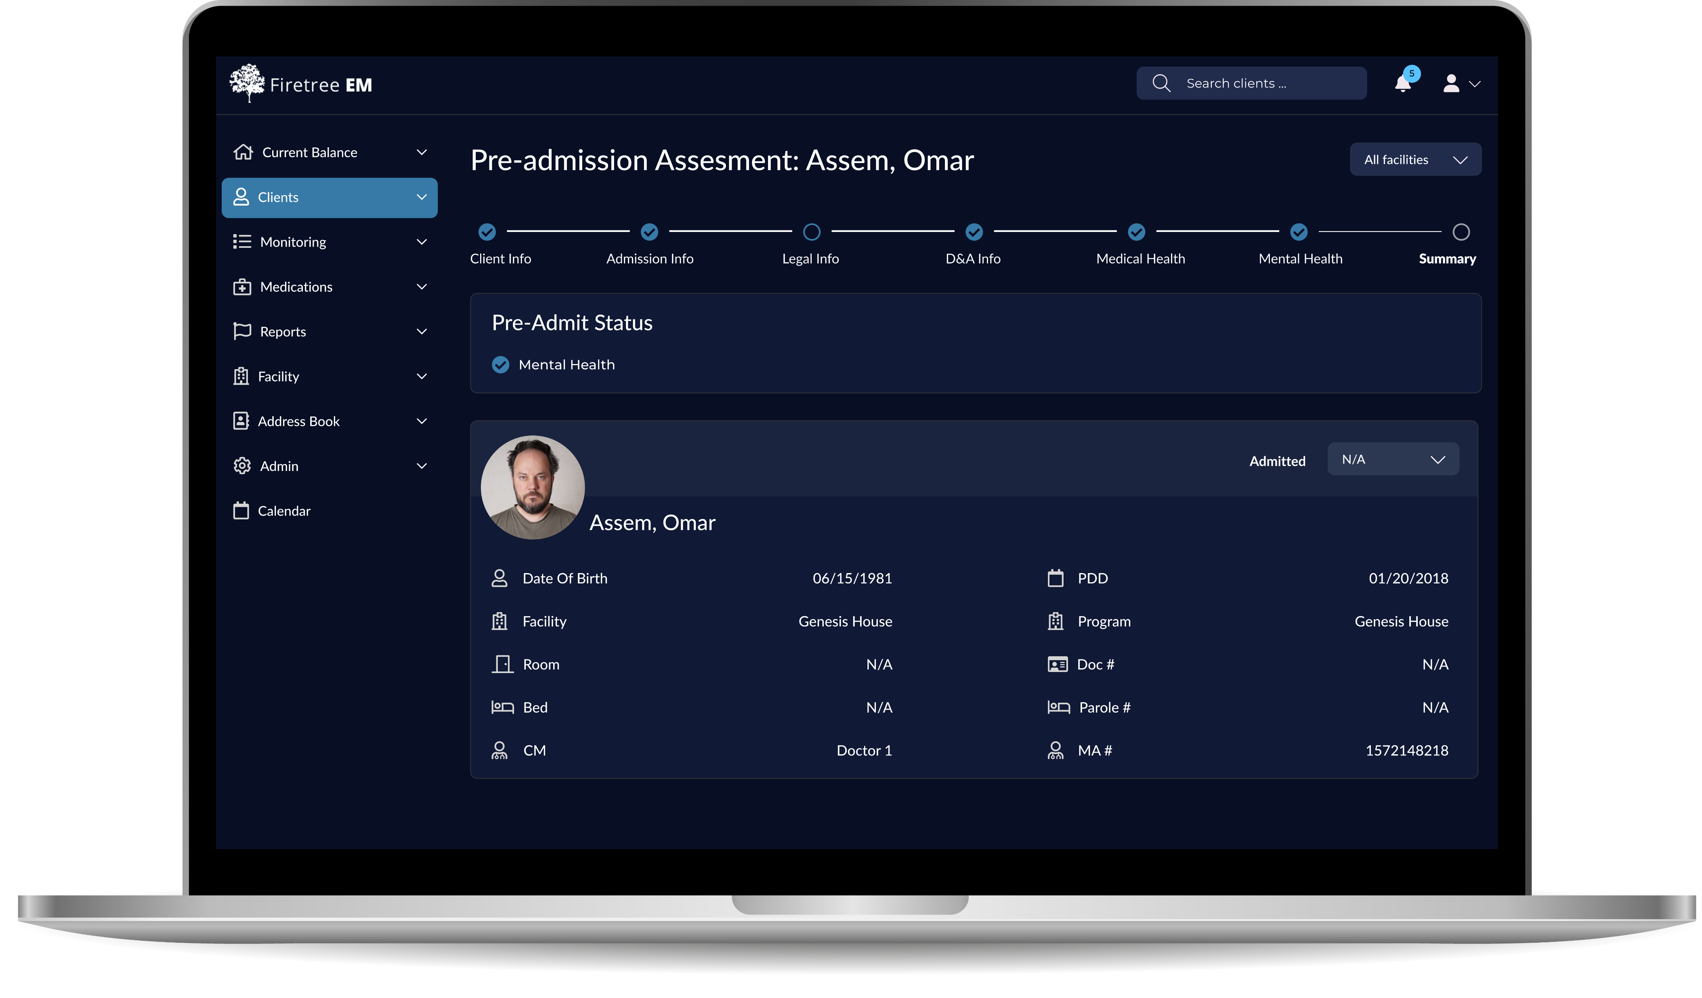

Industry
Healthcare
Application
Enterprise

Slide 44
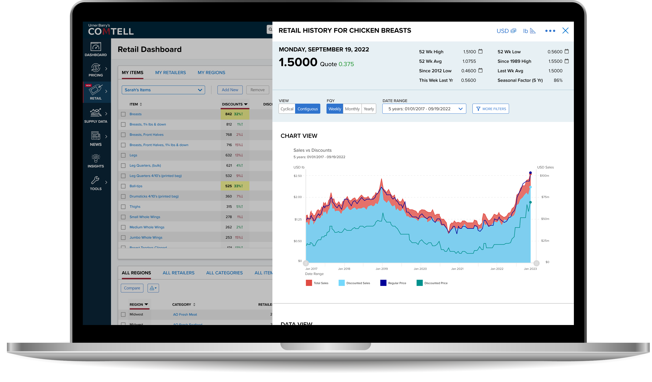

Industry
Fintech
Application
SaaS

Slide 45
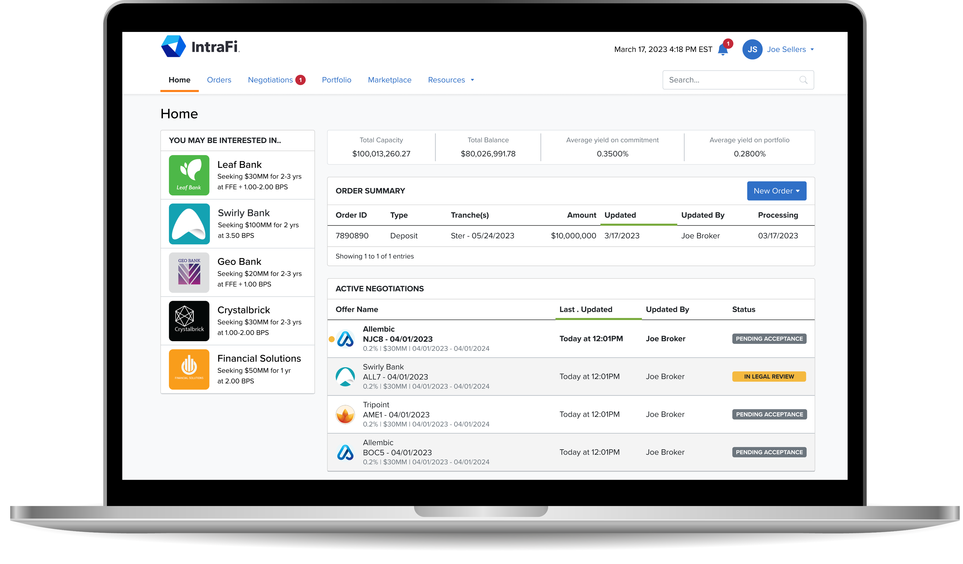

Industry
Fintech
Application
SaaS

Slide 46
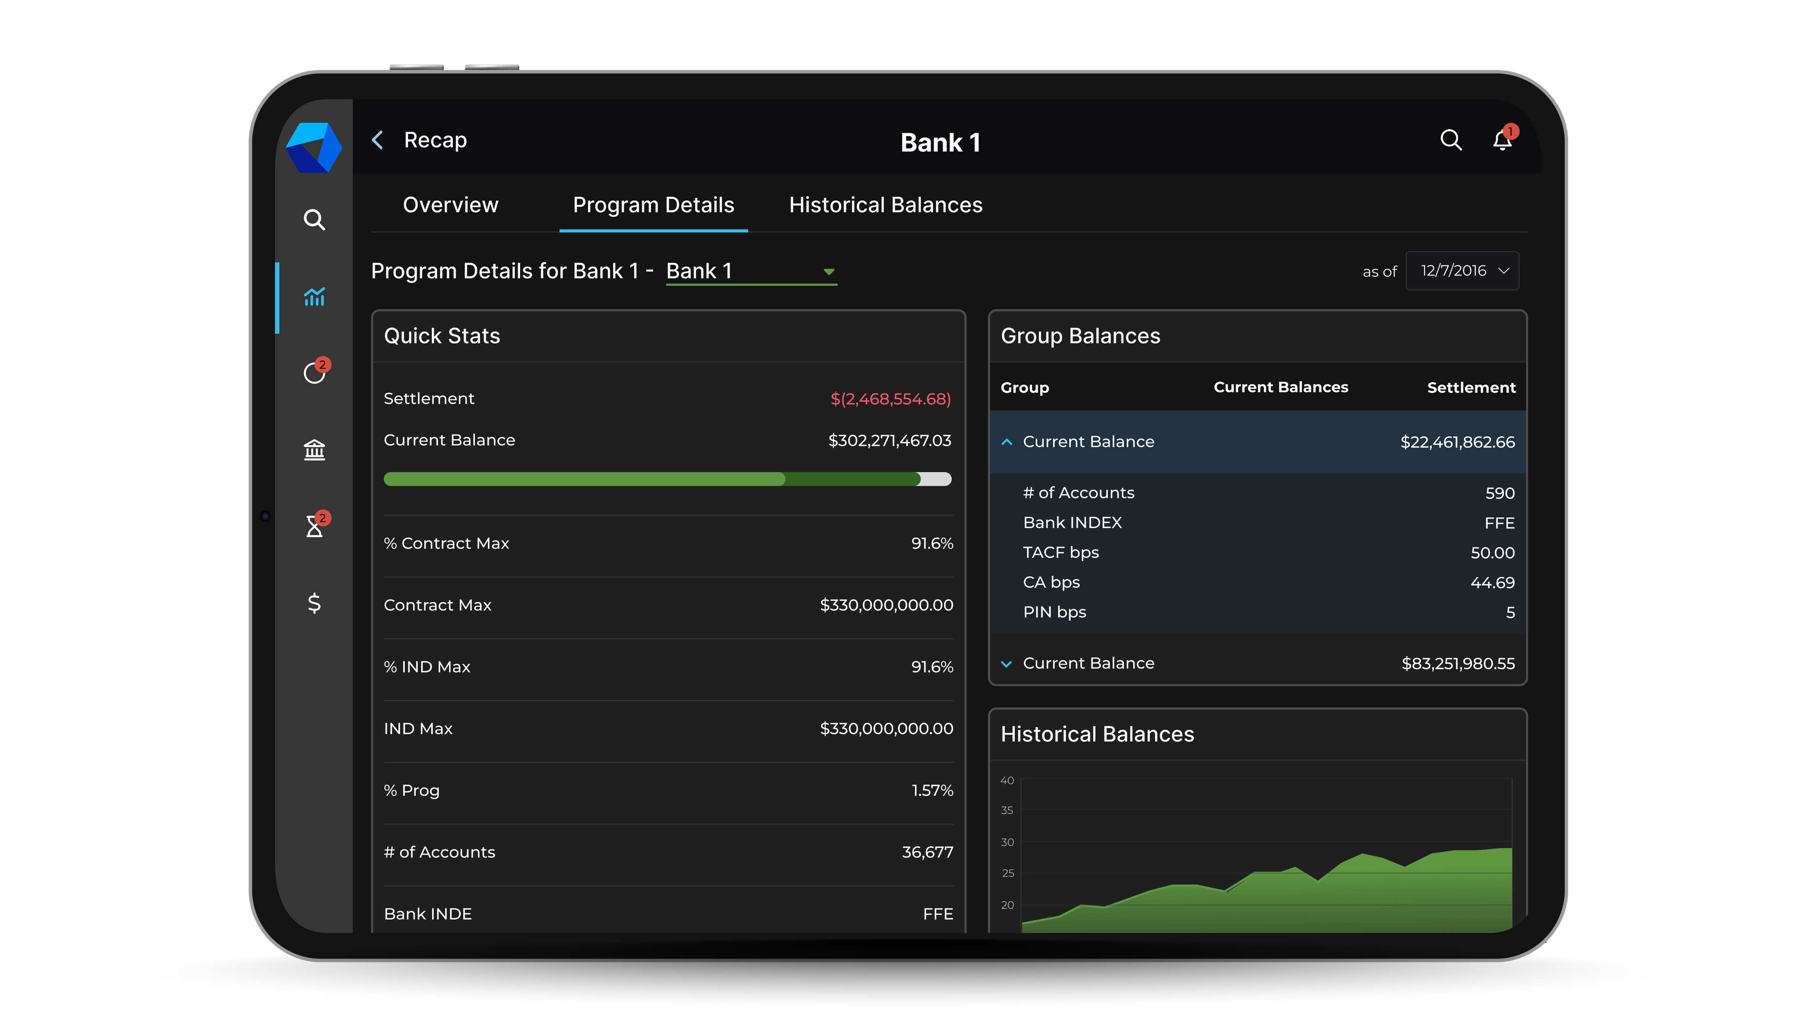
Industry
Fintech
Application
Enterprise

Slide 47
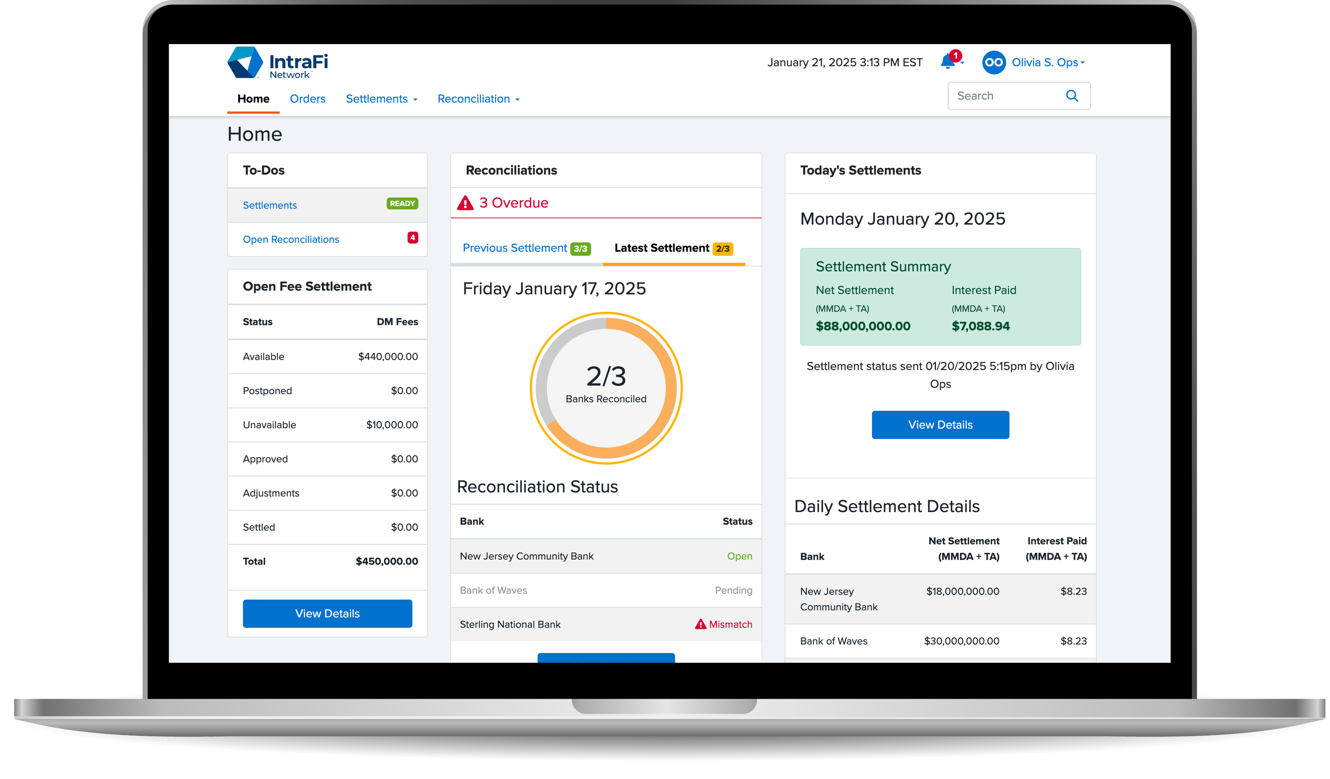
Industry
Fintech
Application
Enterprise

Slide 48


Industry
Insurance
Application
Enterprise

Slide 49


Industry
Insurance
Application
Enterprise

Slide 50

Industry
Insurance
Application
SaaS

Slide 51


Industry
Fintech
Application
Enterprise

Slide 52




Let’s get started!
(855) 489-8326
info@uxteam.com
uxteam.com

