Slide 1
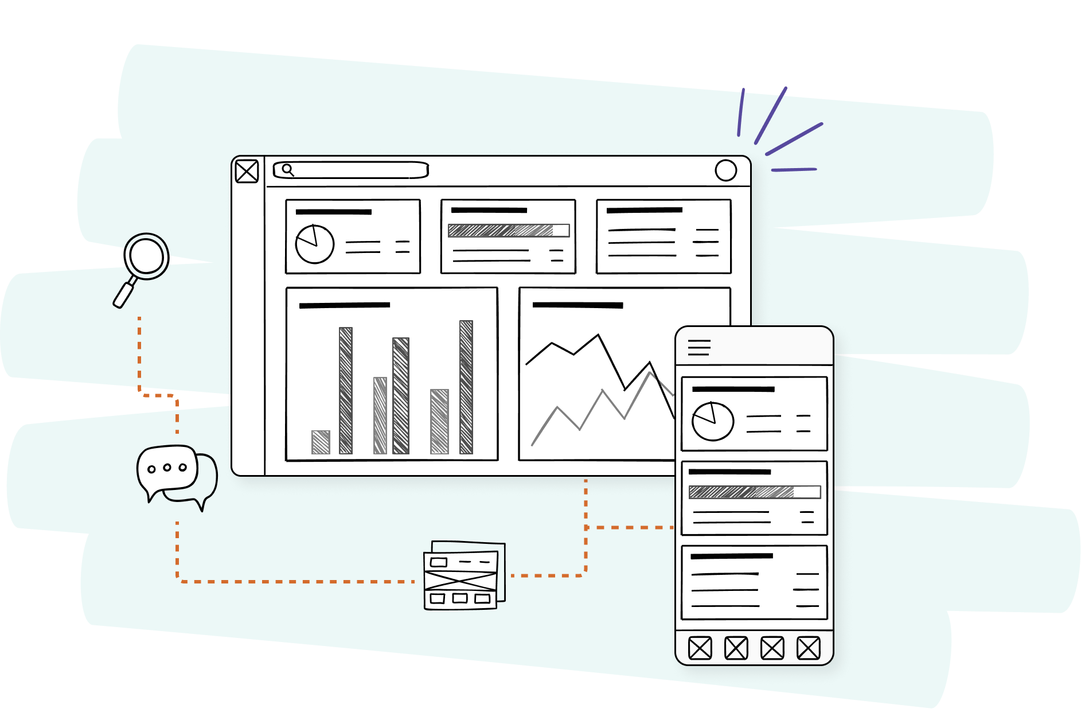
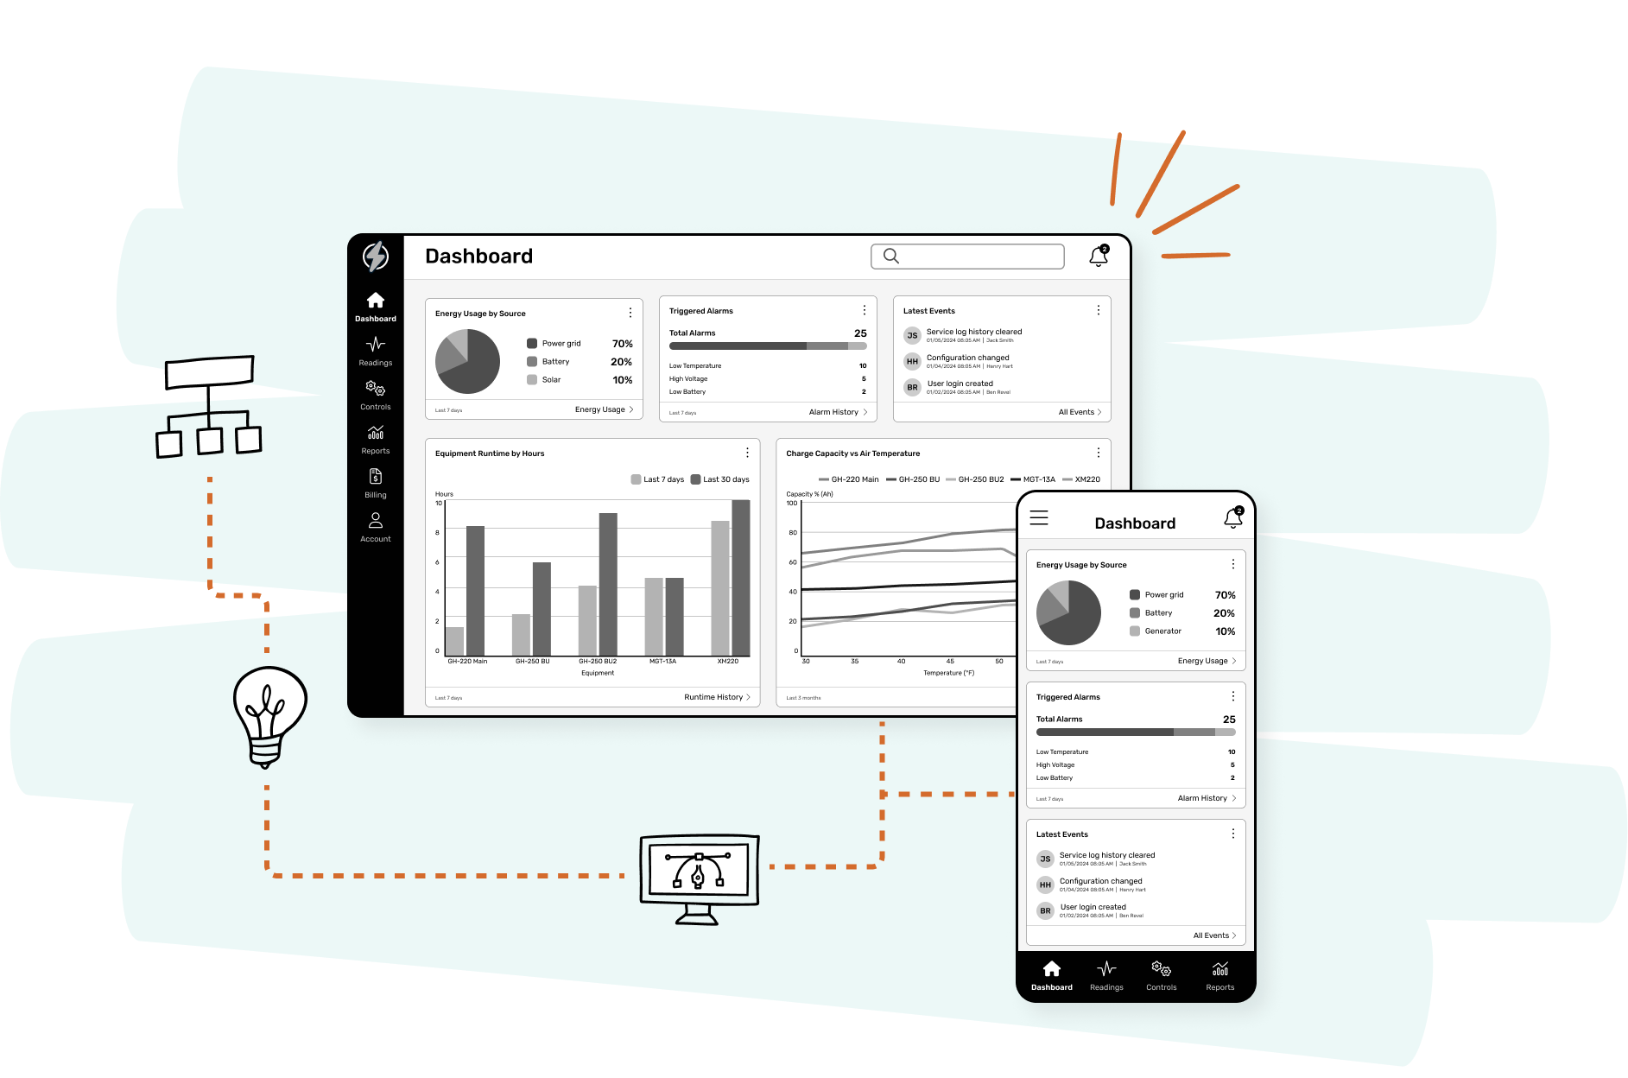
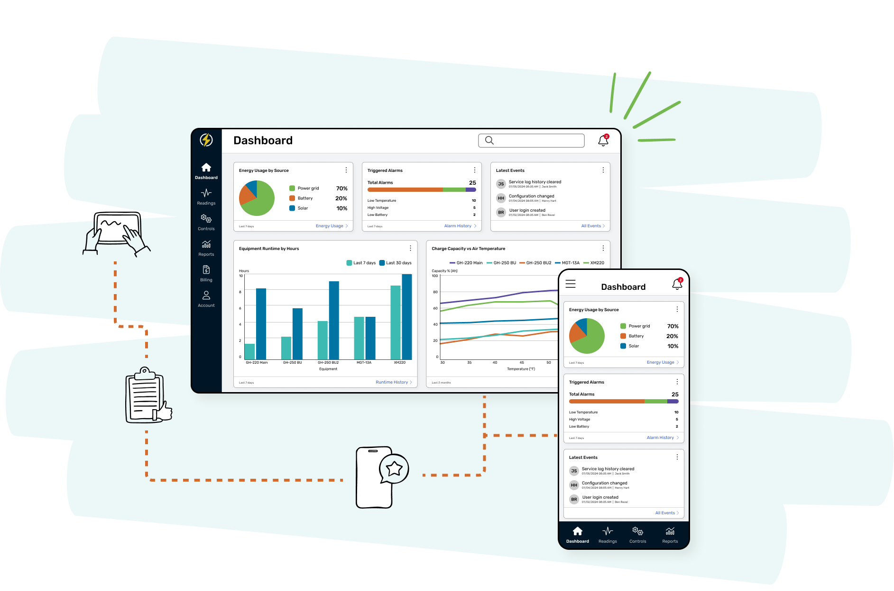
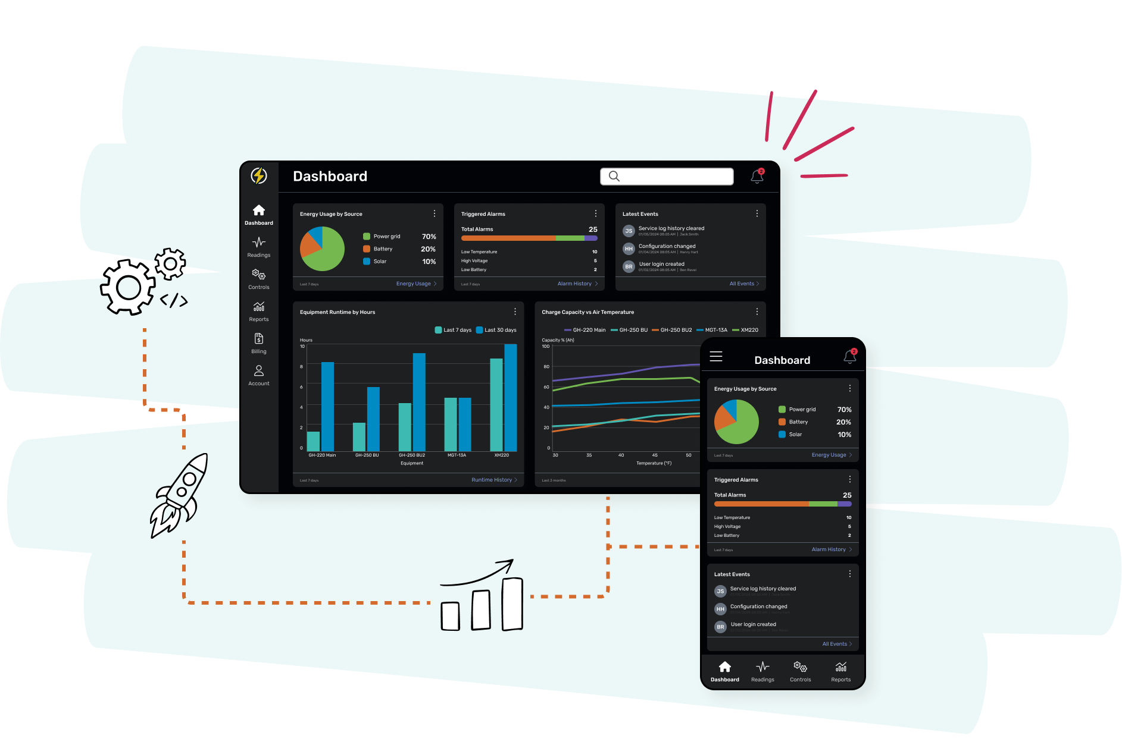


Slide 2

Who we are

Slide 3

2014
200+
100%
SSAE 18
year we started
projects
US-based
certified
Awarded Top UX Design Agency in New Jersey with 12+ awards on Clutch!

Slide 4










Clients

Slide 5
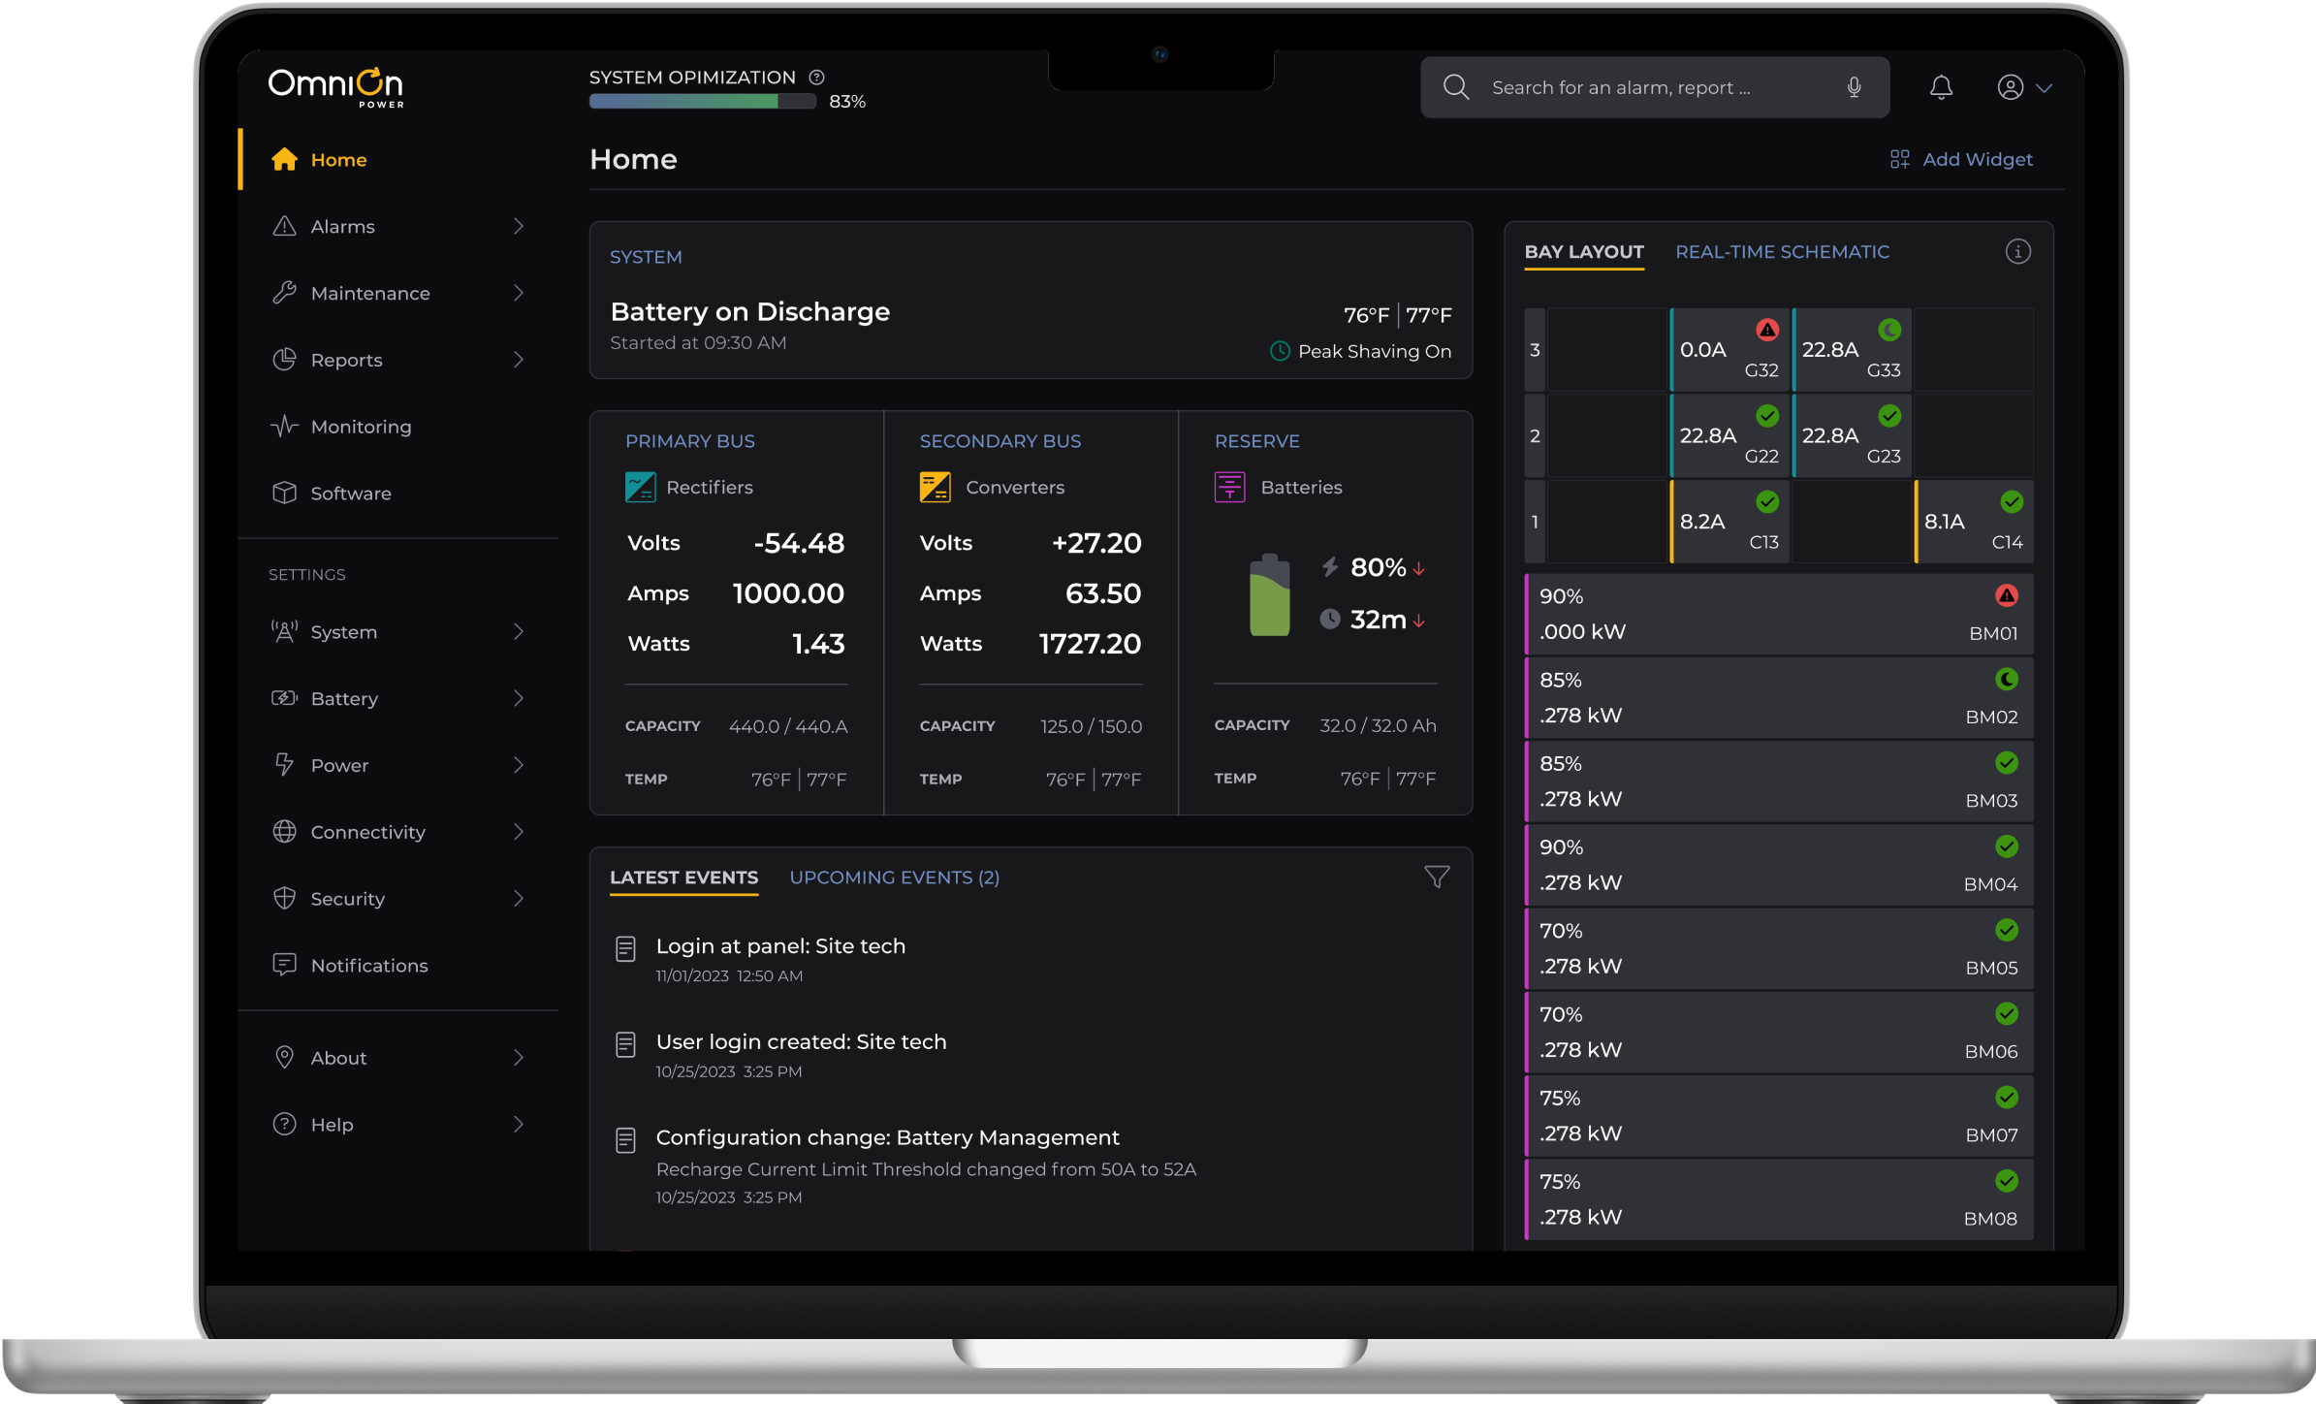
Expertise in software design

Slide 6
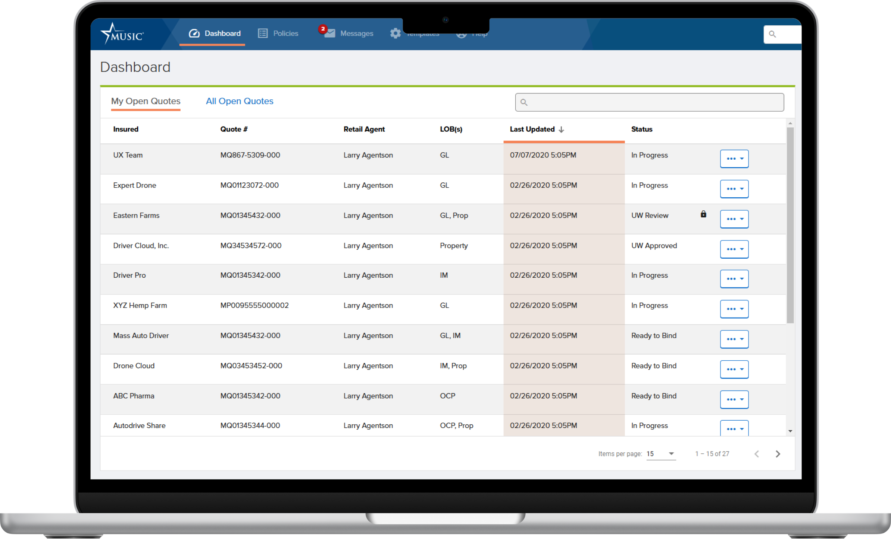
Enterprise software

Slide 7
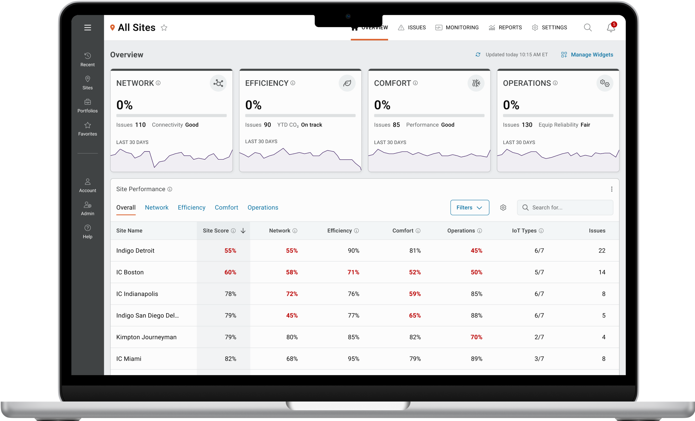
SaaS apps

Slide 8
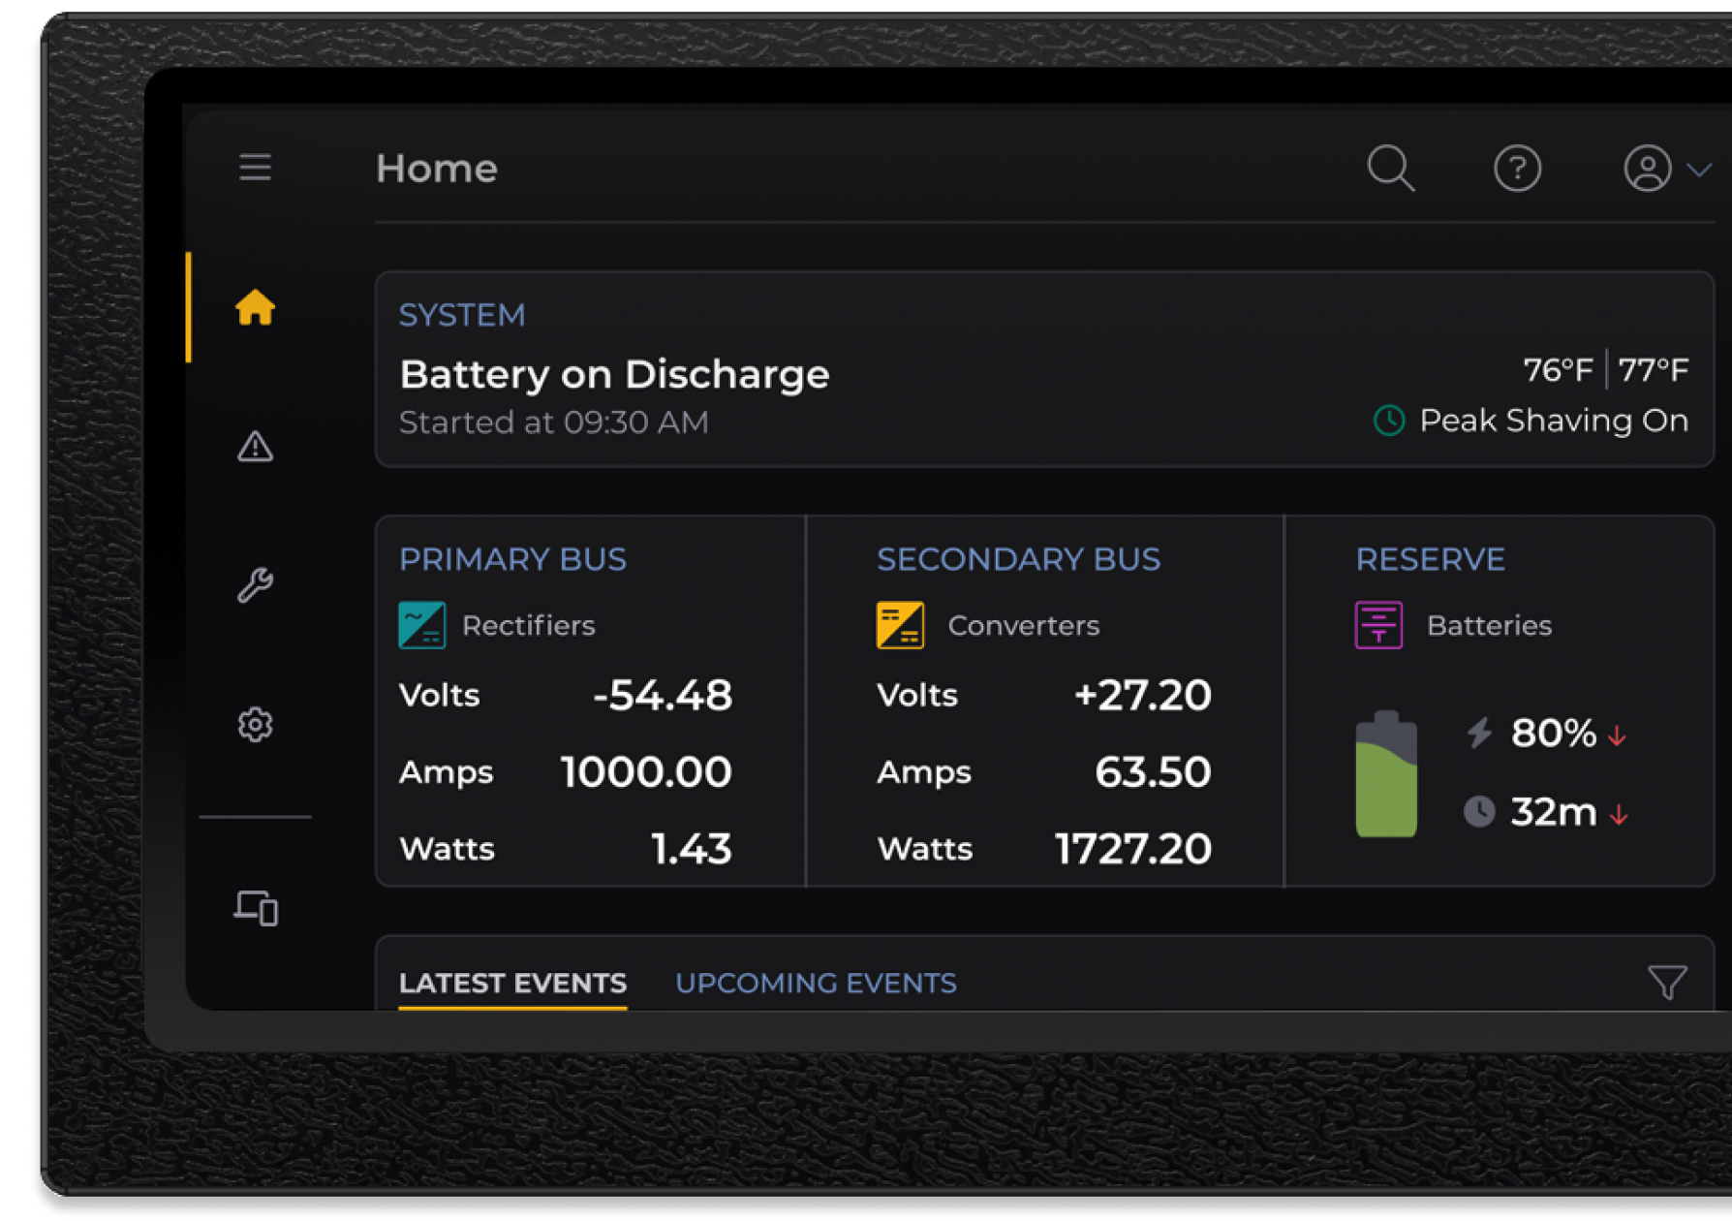
Hardware UIs

Slide 9
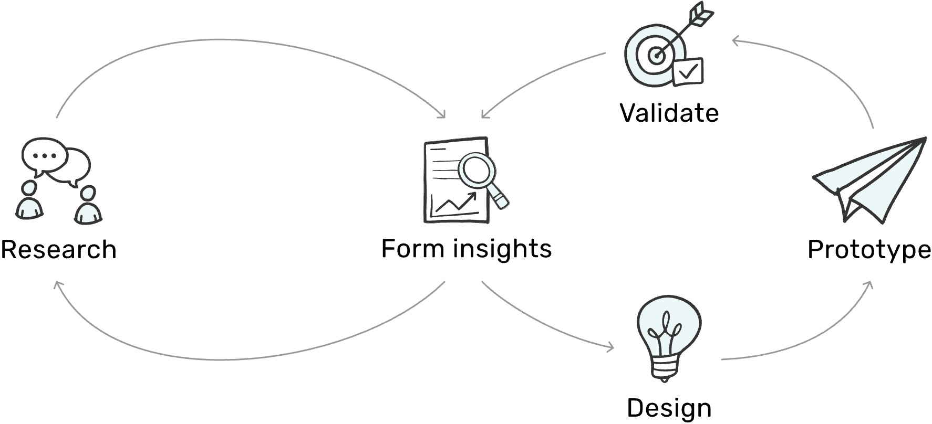
Evidence-based design process

Slide 10

Design solutions

Slide 11


Evidence drives all design decisions

Slide 12
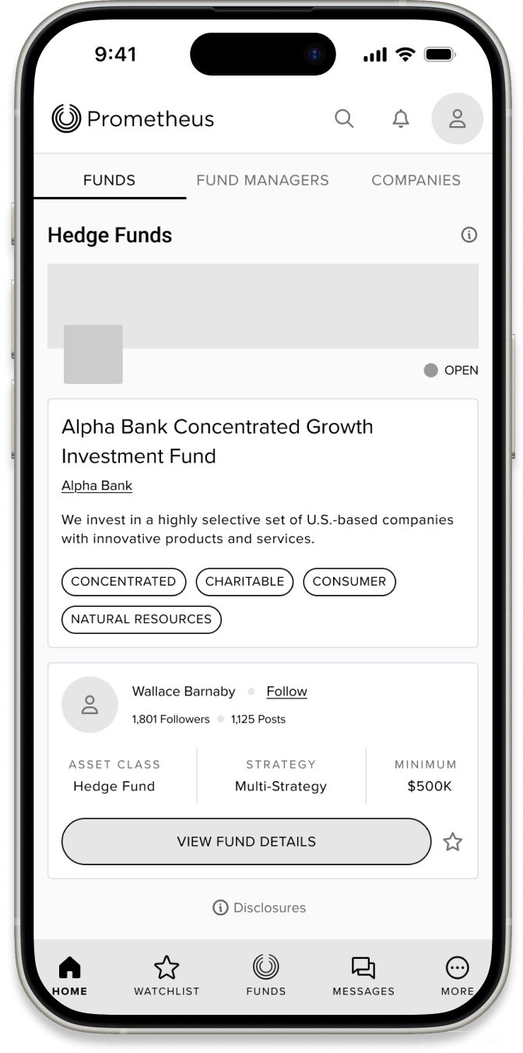
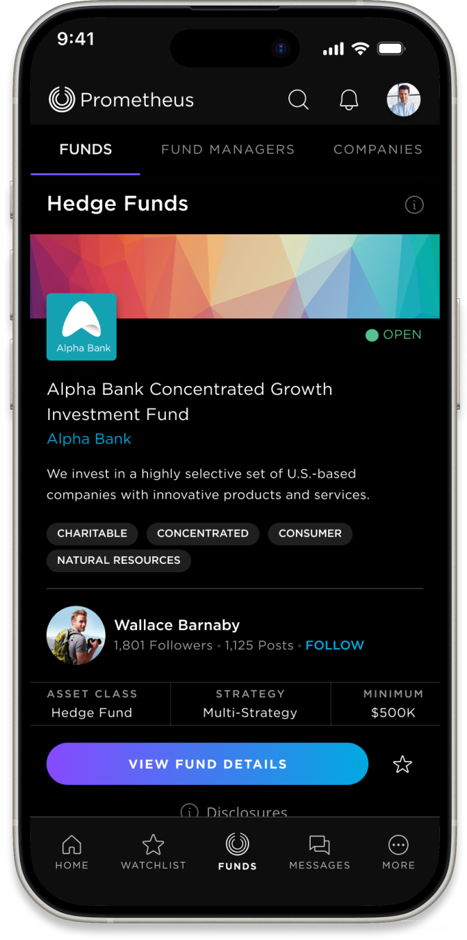
Prototypes enable us to design smarter, launch faster, and reduce dev costs

Slide 13
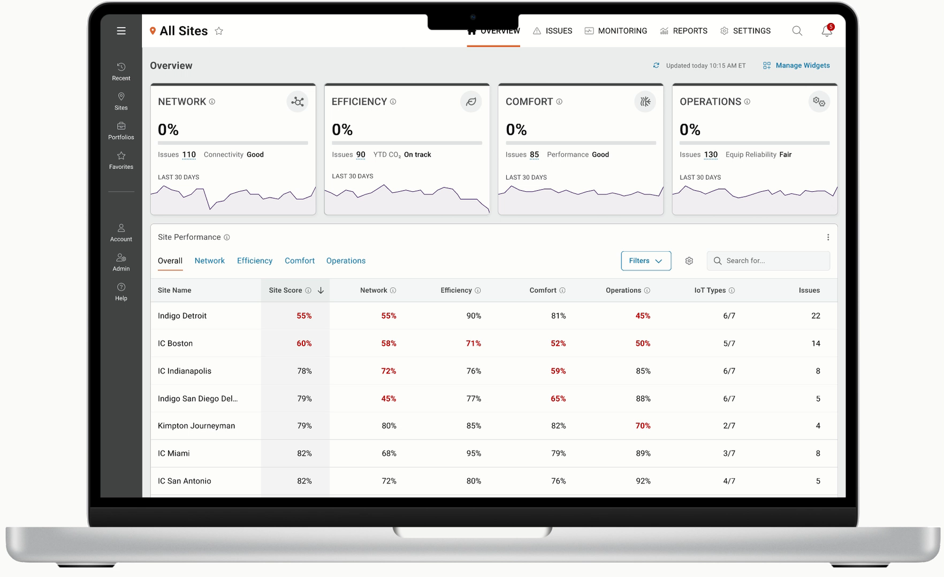
High-fidelity prototypes

Slide 14
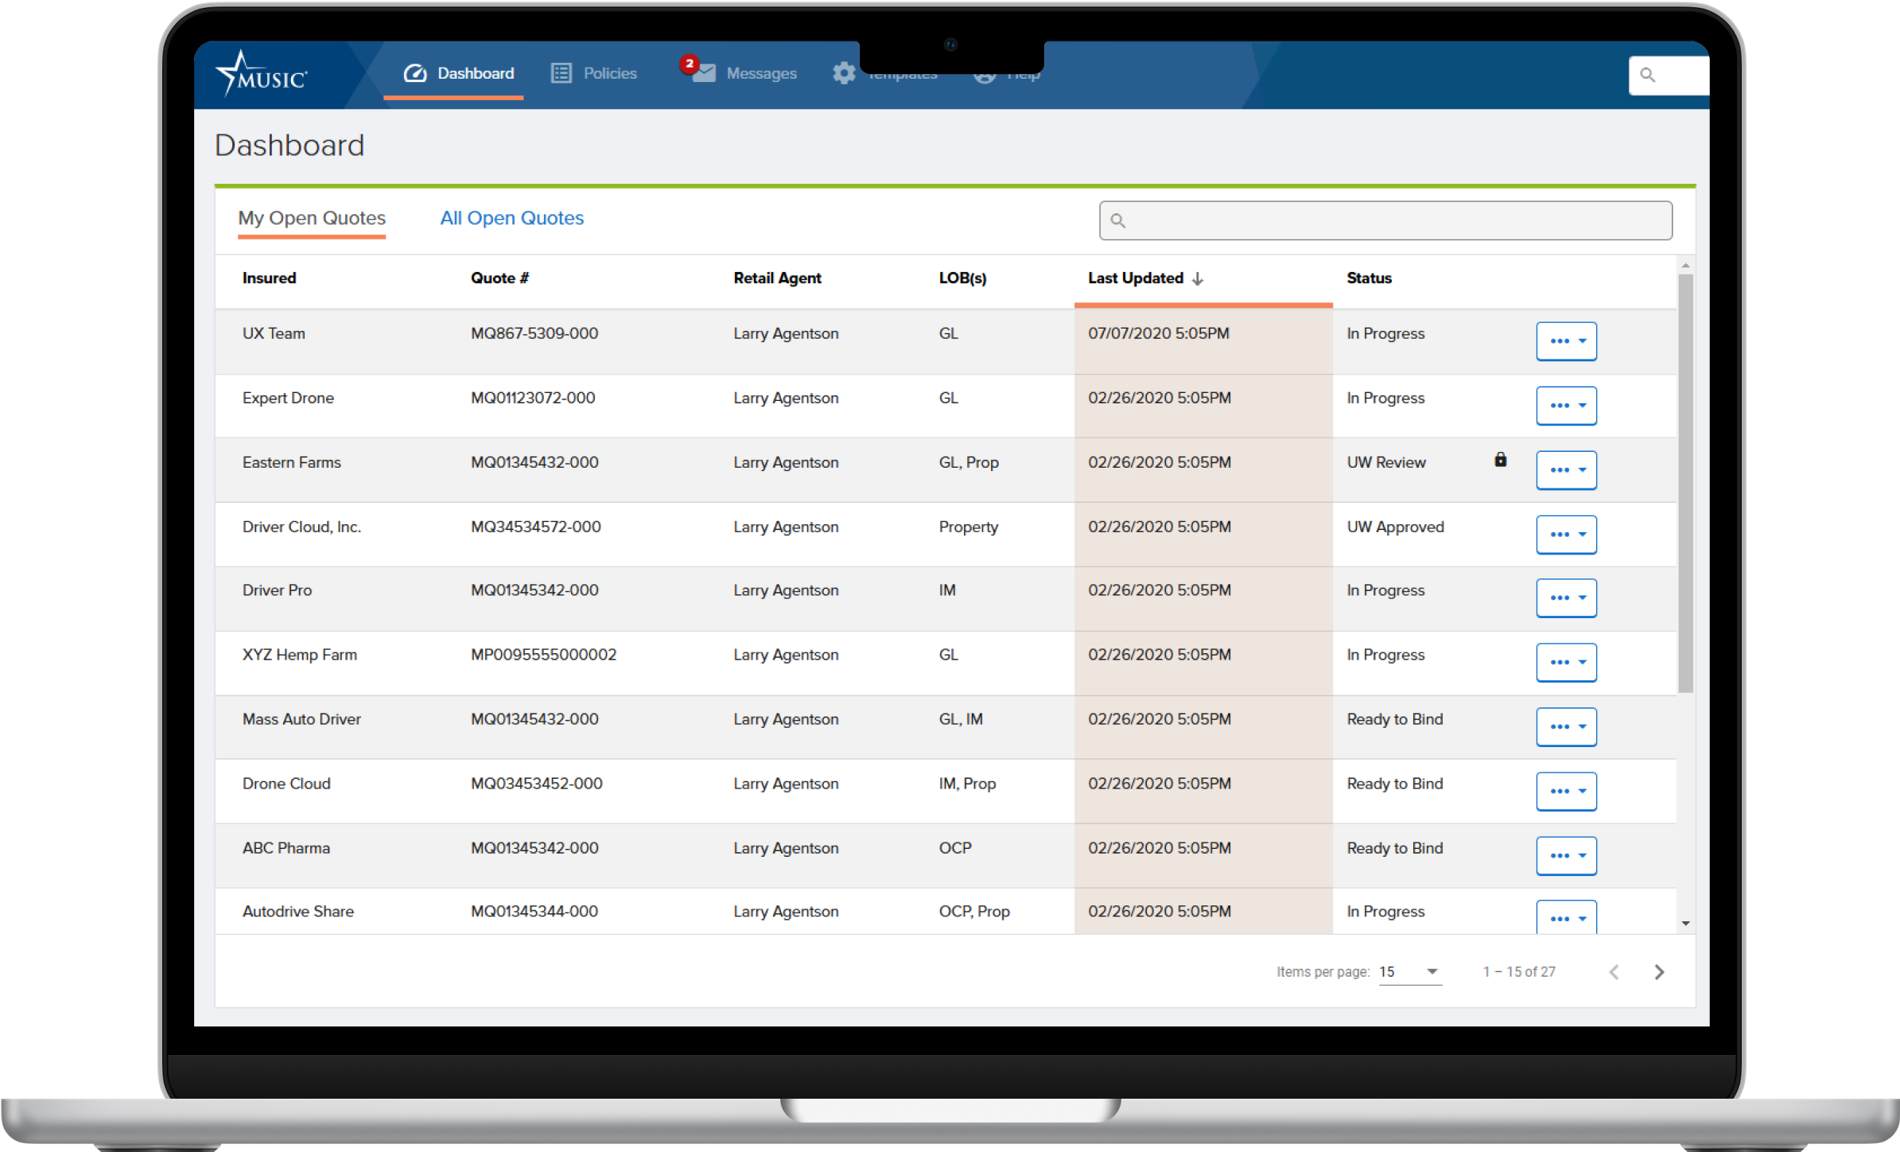





Front-end prototypes

Slide 15
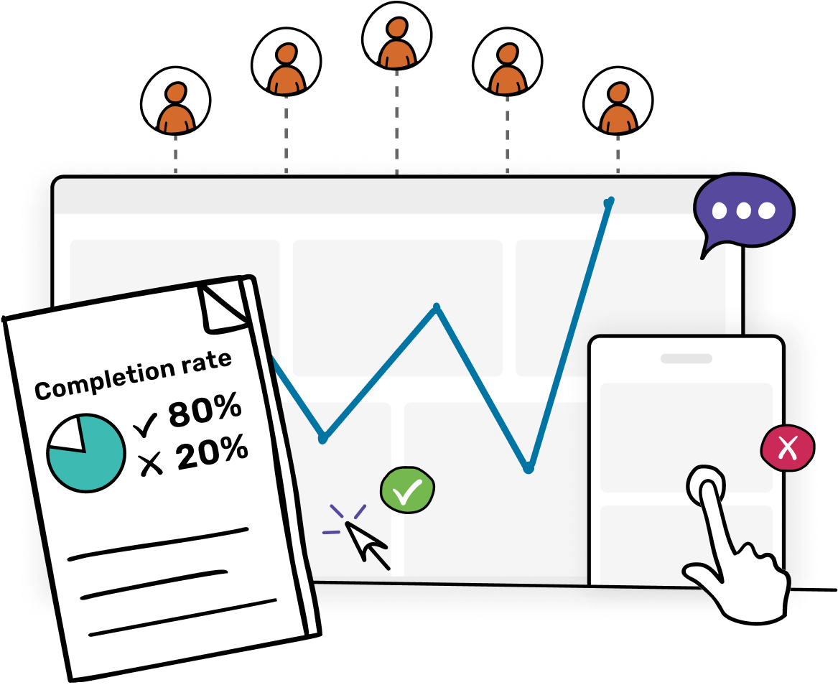
Usability testing reveals potential design flaws before development starts.

Slide 16

Development solutions

Slide 17





Prototype
Design Systems and Documentation
Dev handoff + support ensures nothing gets lost during development
Front-end Assets
UX support
Refinements

Slide 18
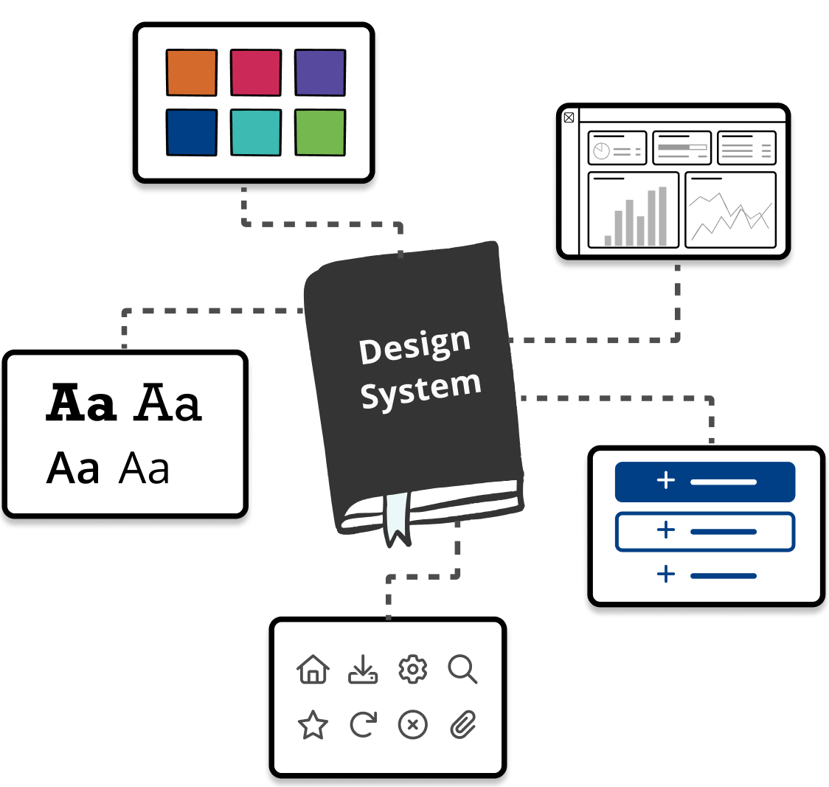
Design systems for consistency & dev efficiency

Slide 19
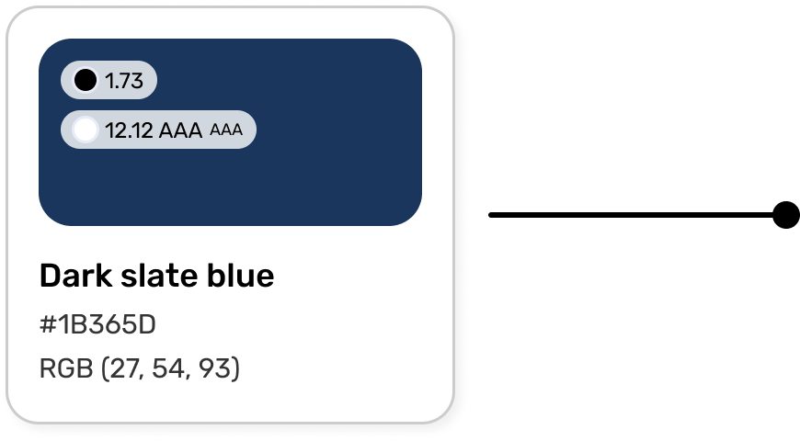
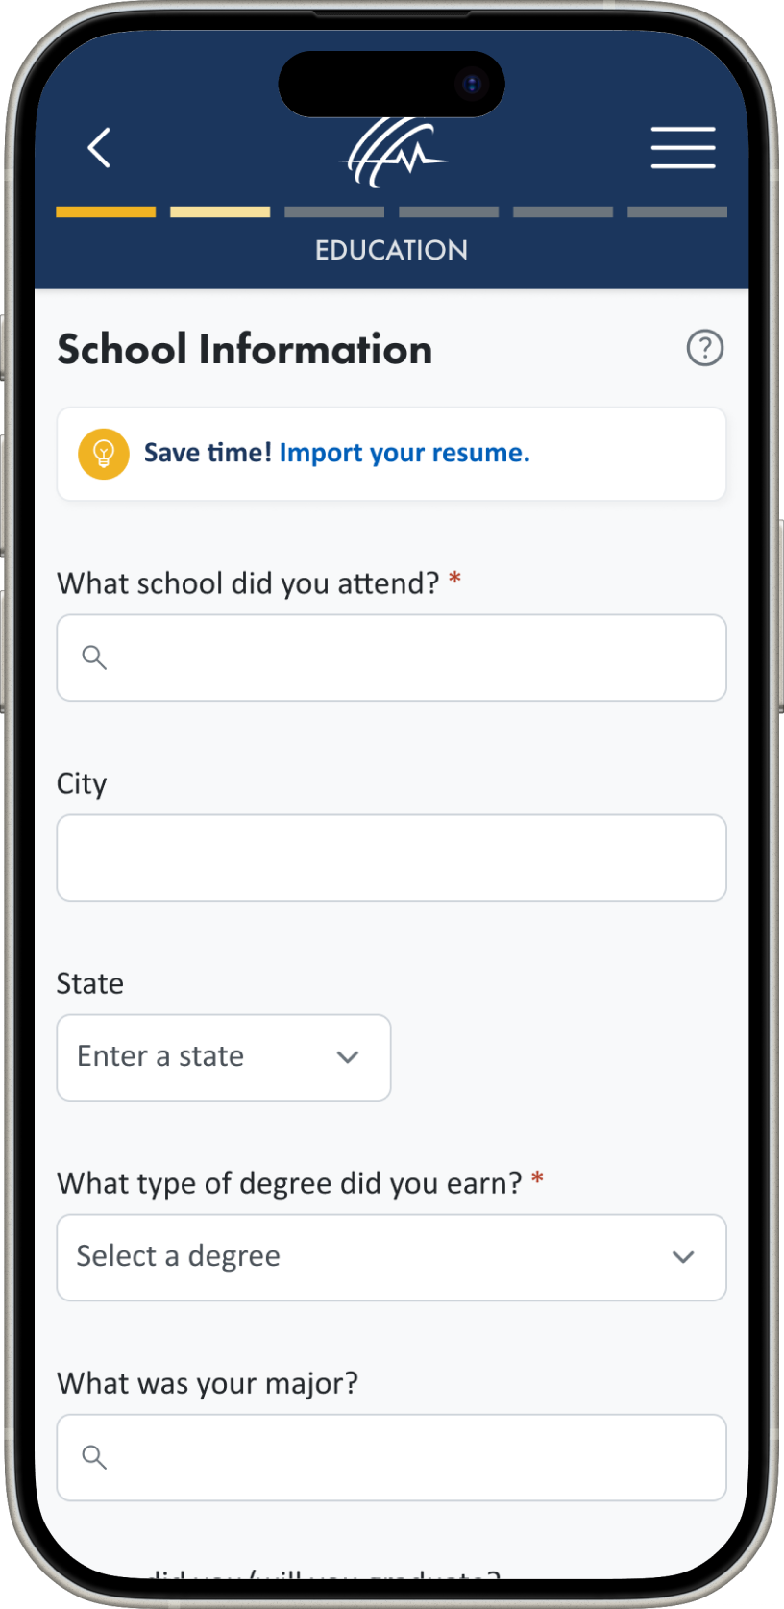
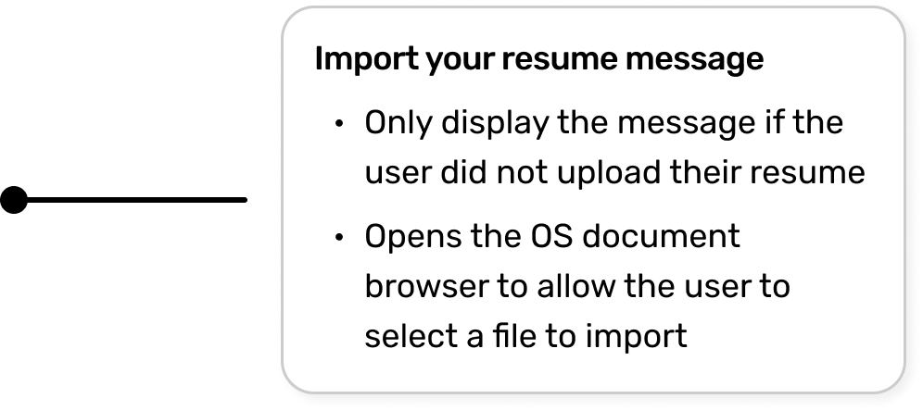
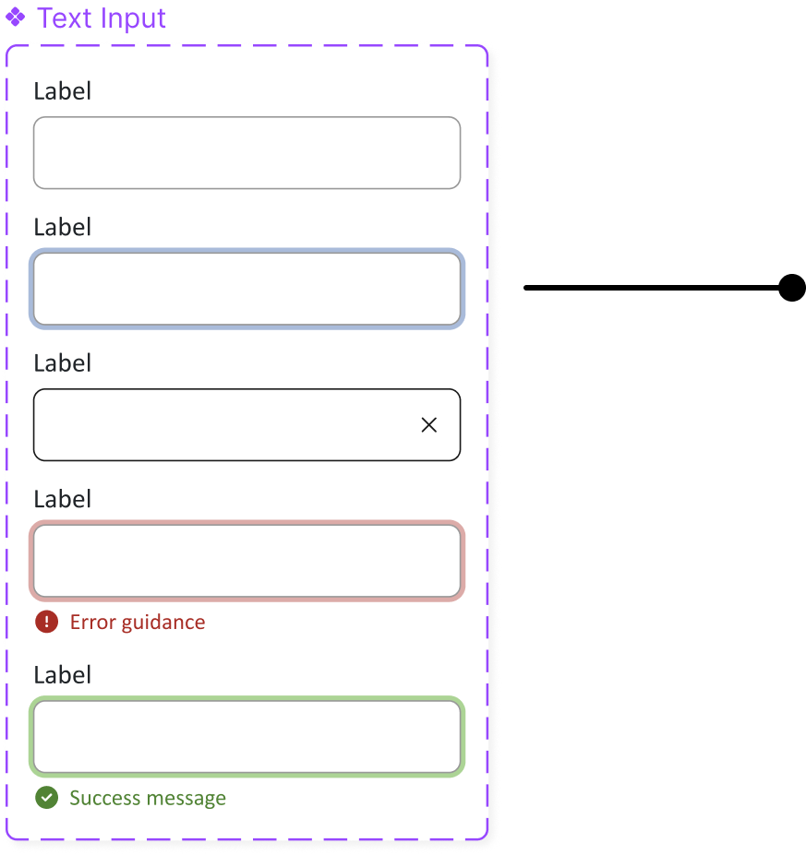
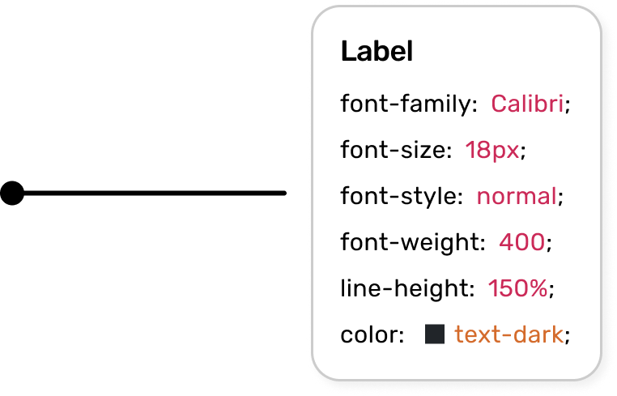

Slide 20
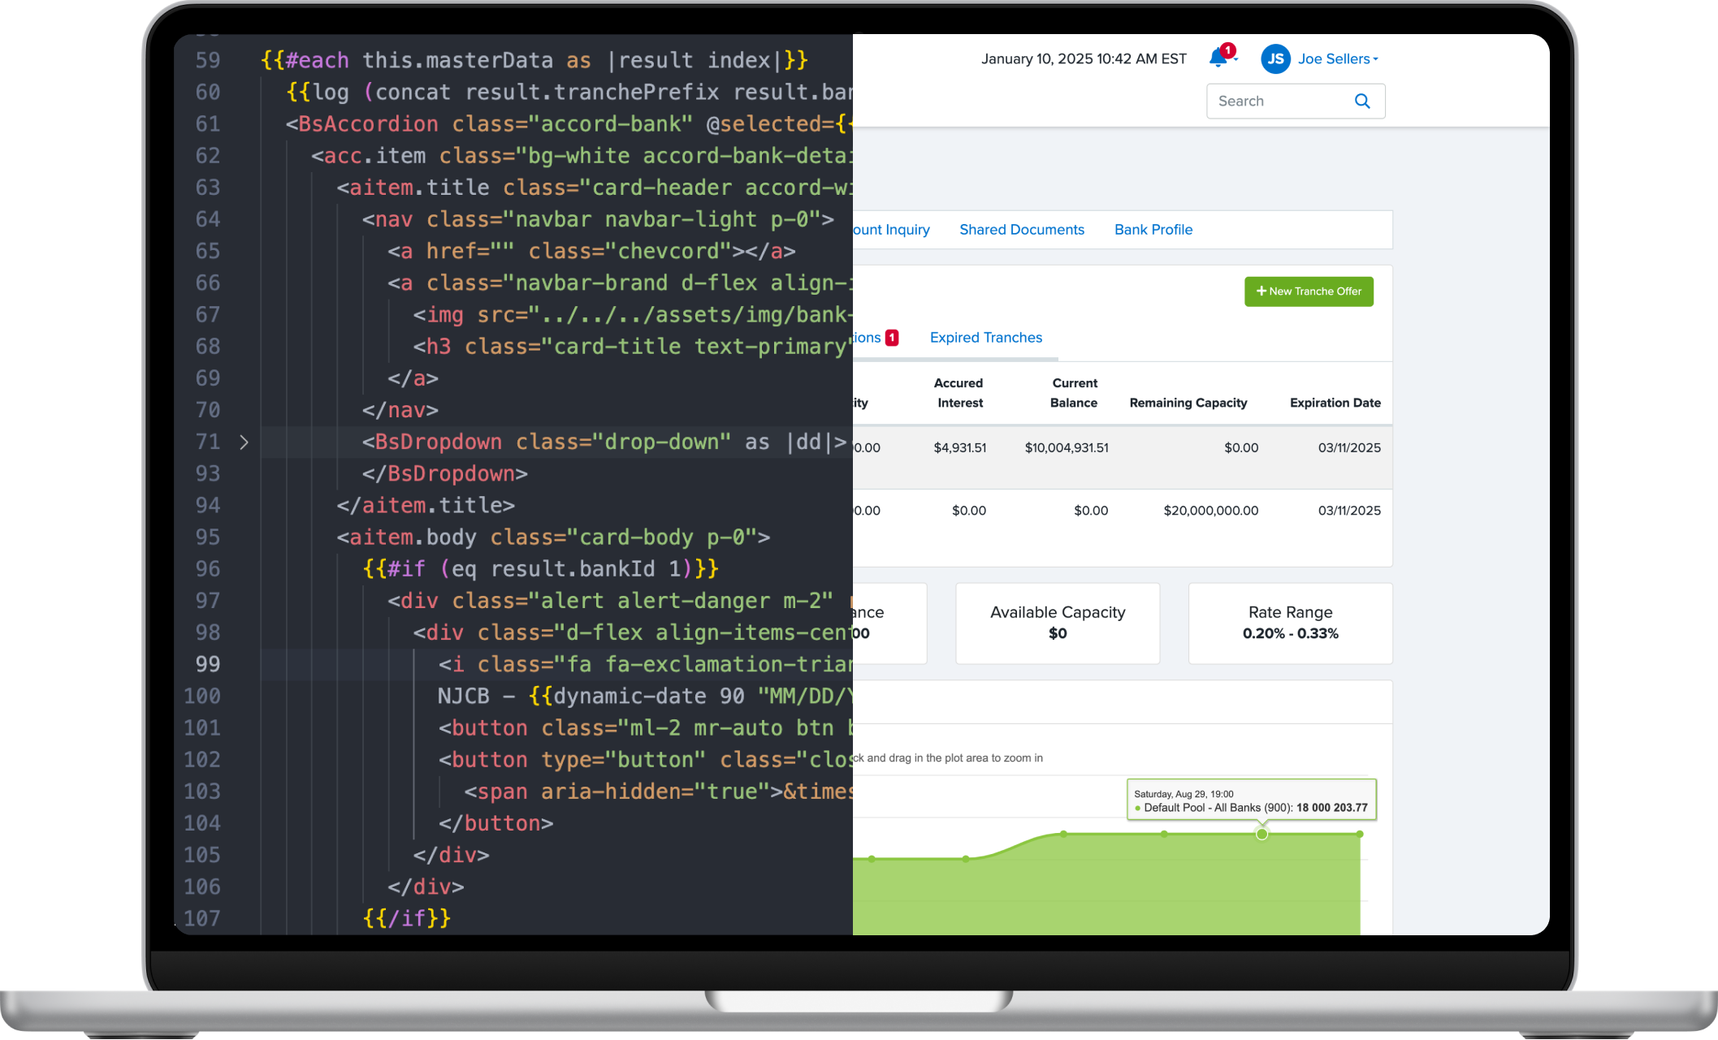

Front-end assets

Slide 21

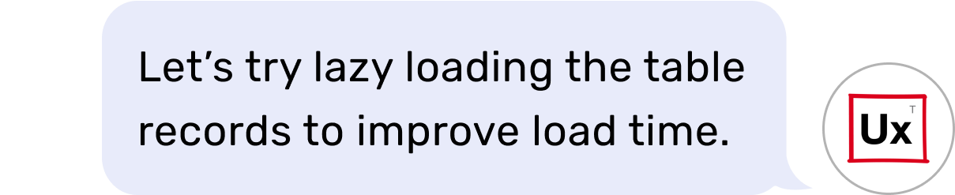

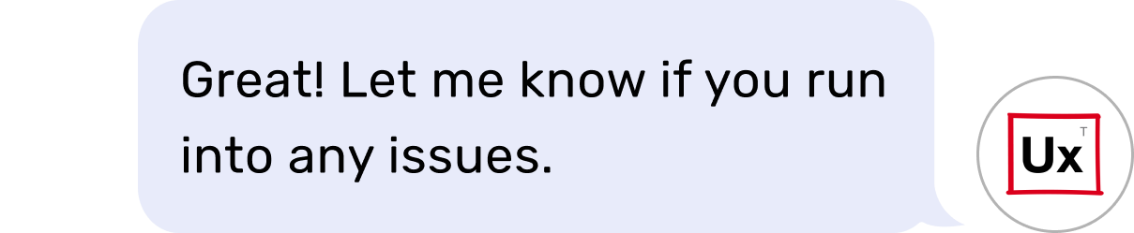
UX support during & after development

Slide 22




Middle & back-end development
Software architecture
Proof of concepts
QA testing
Application development

Slide 23

Pricing models

Slide 24
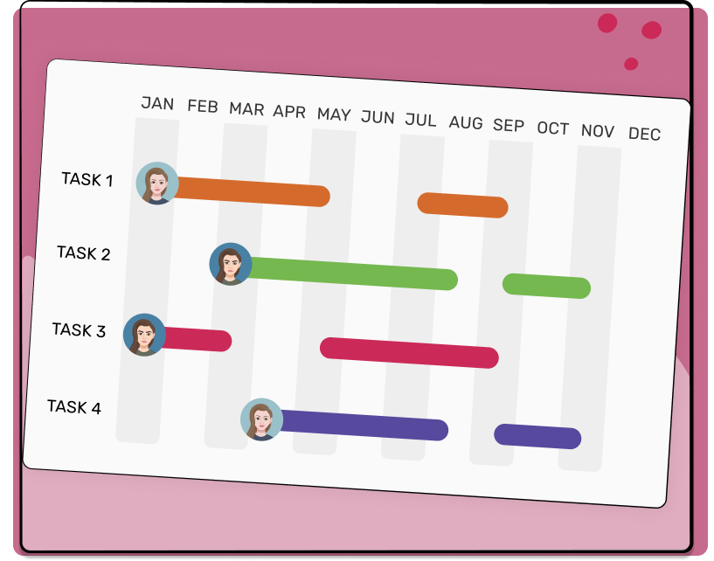
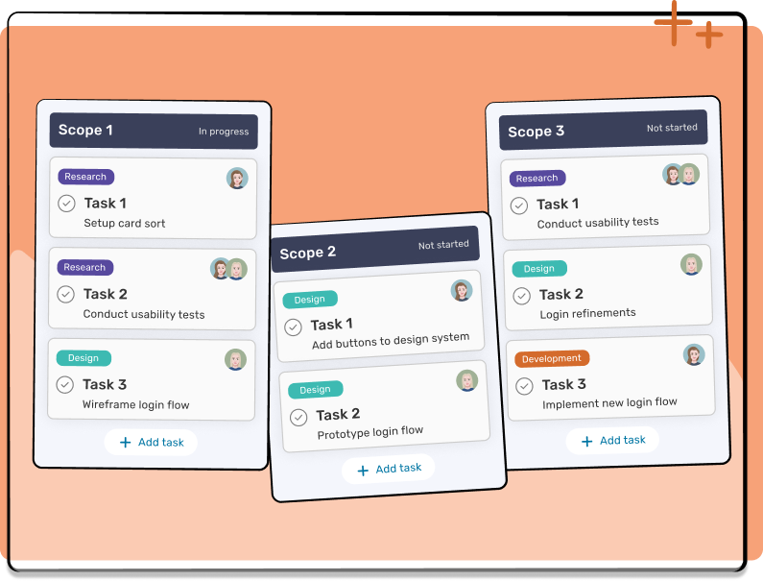
Transparent pricing models
Project-based Dedicated Team
Recurring Dedicated Team
Best for:
Projects with well-defined scopes of work
Fixed-price project costs
Projects with tight timelines
Best for:
Ad hoc requests and undefined scopes of work
Unlimited projects and products
Predictable monthly fee

Slide 25

Portfolio

Slide 26
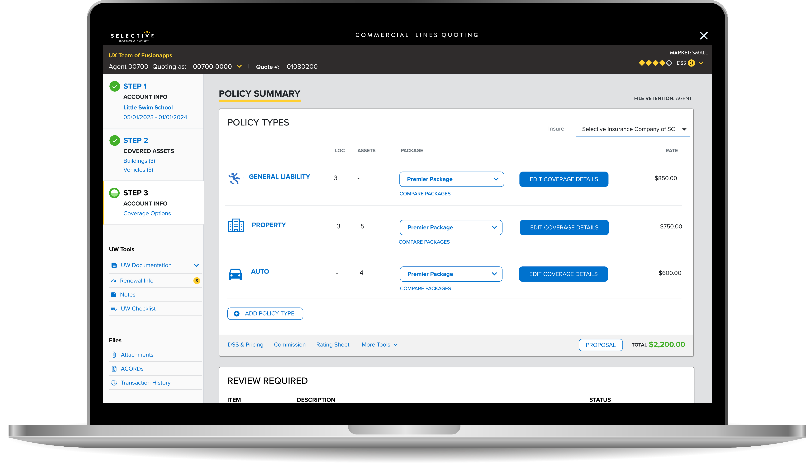

Industry
Insurance
Application
Enterprise

Slide 27
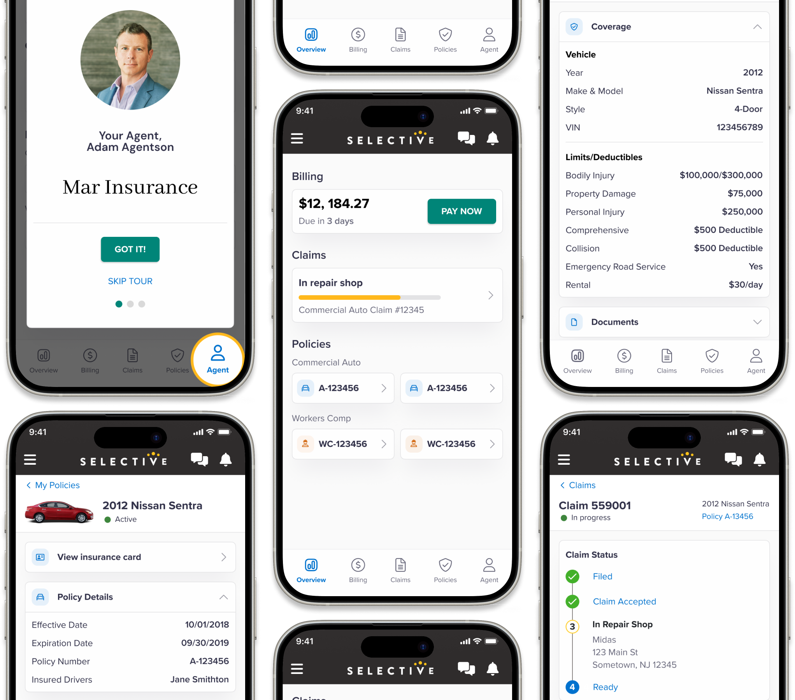
Industry
Insurance
Application
SaaS

Slide 28
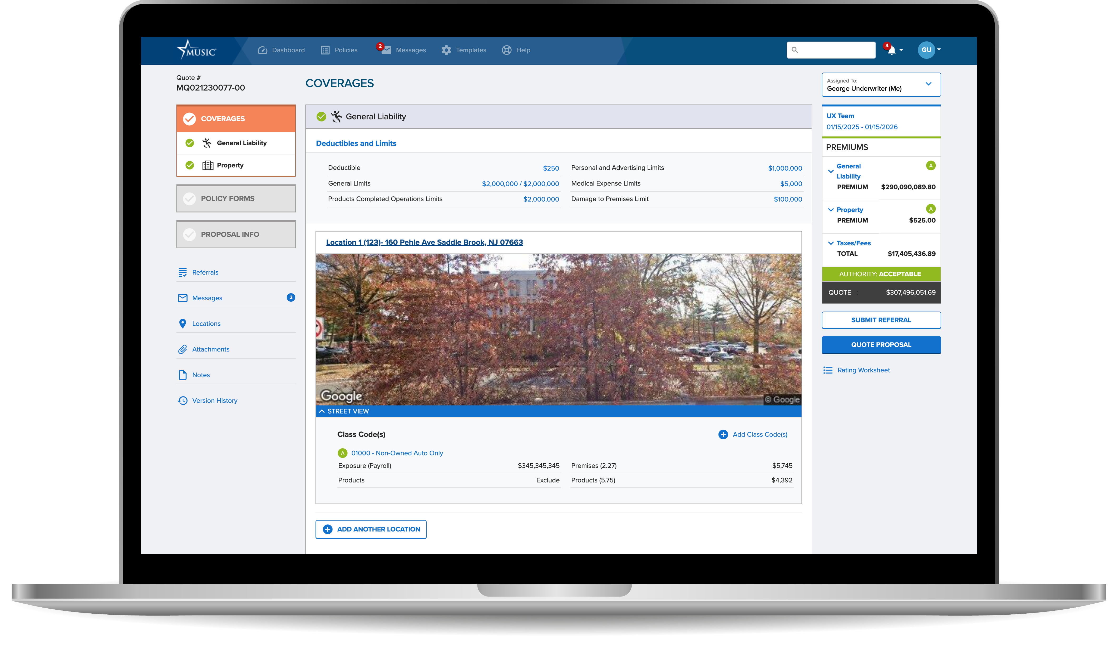

Industry
Insurance
Application
Enterprise

Slide 29
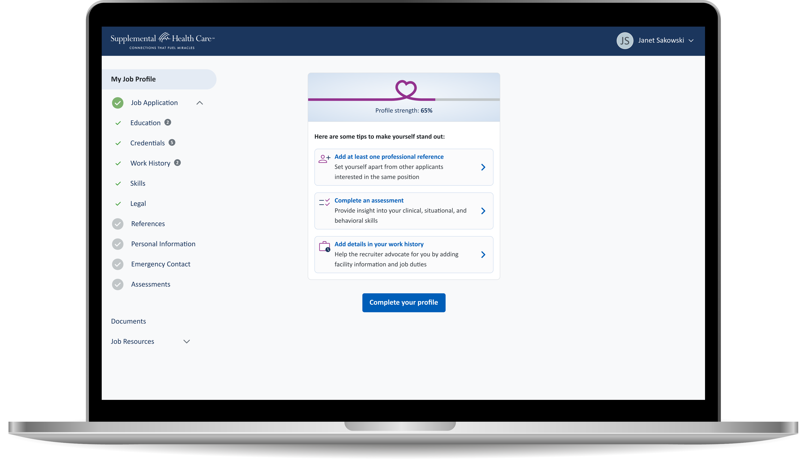



Industry
Healthcare staffing
Application
SaaS
Device

Slide 30
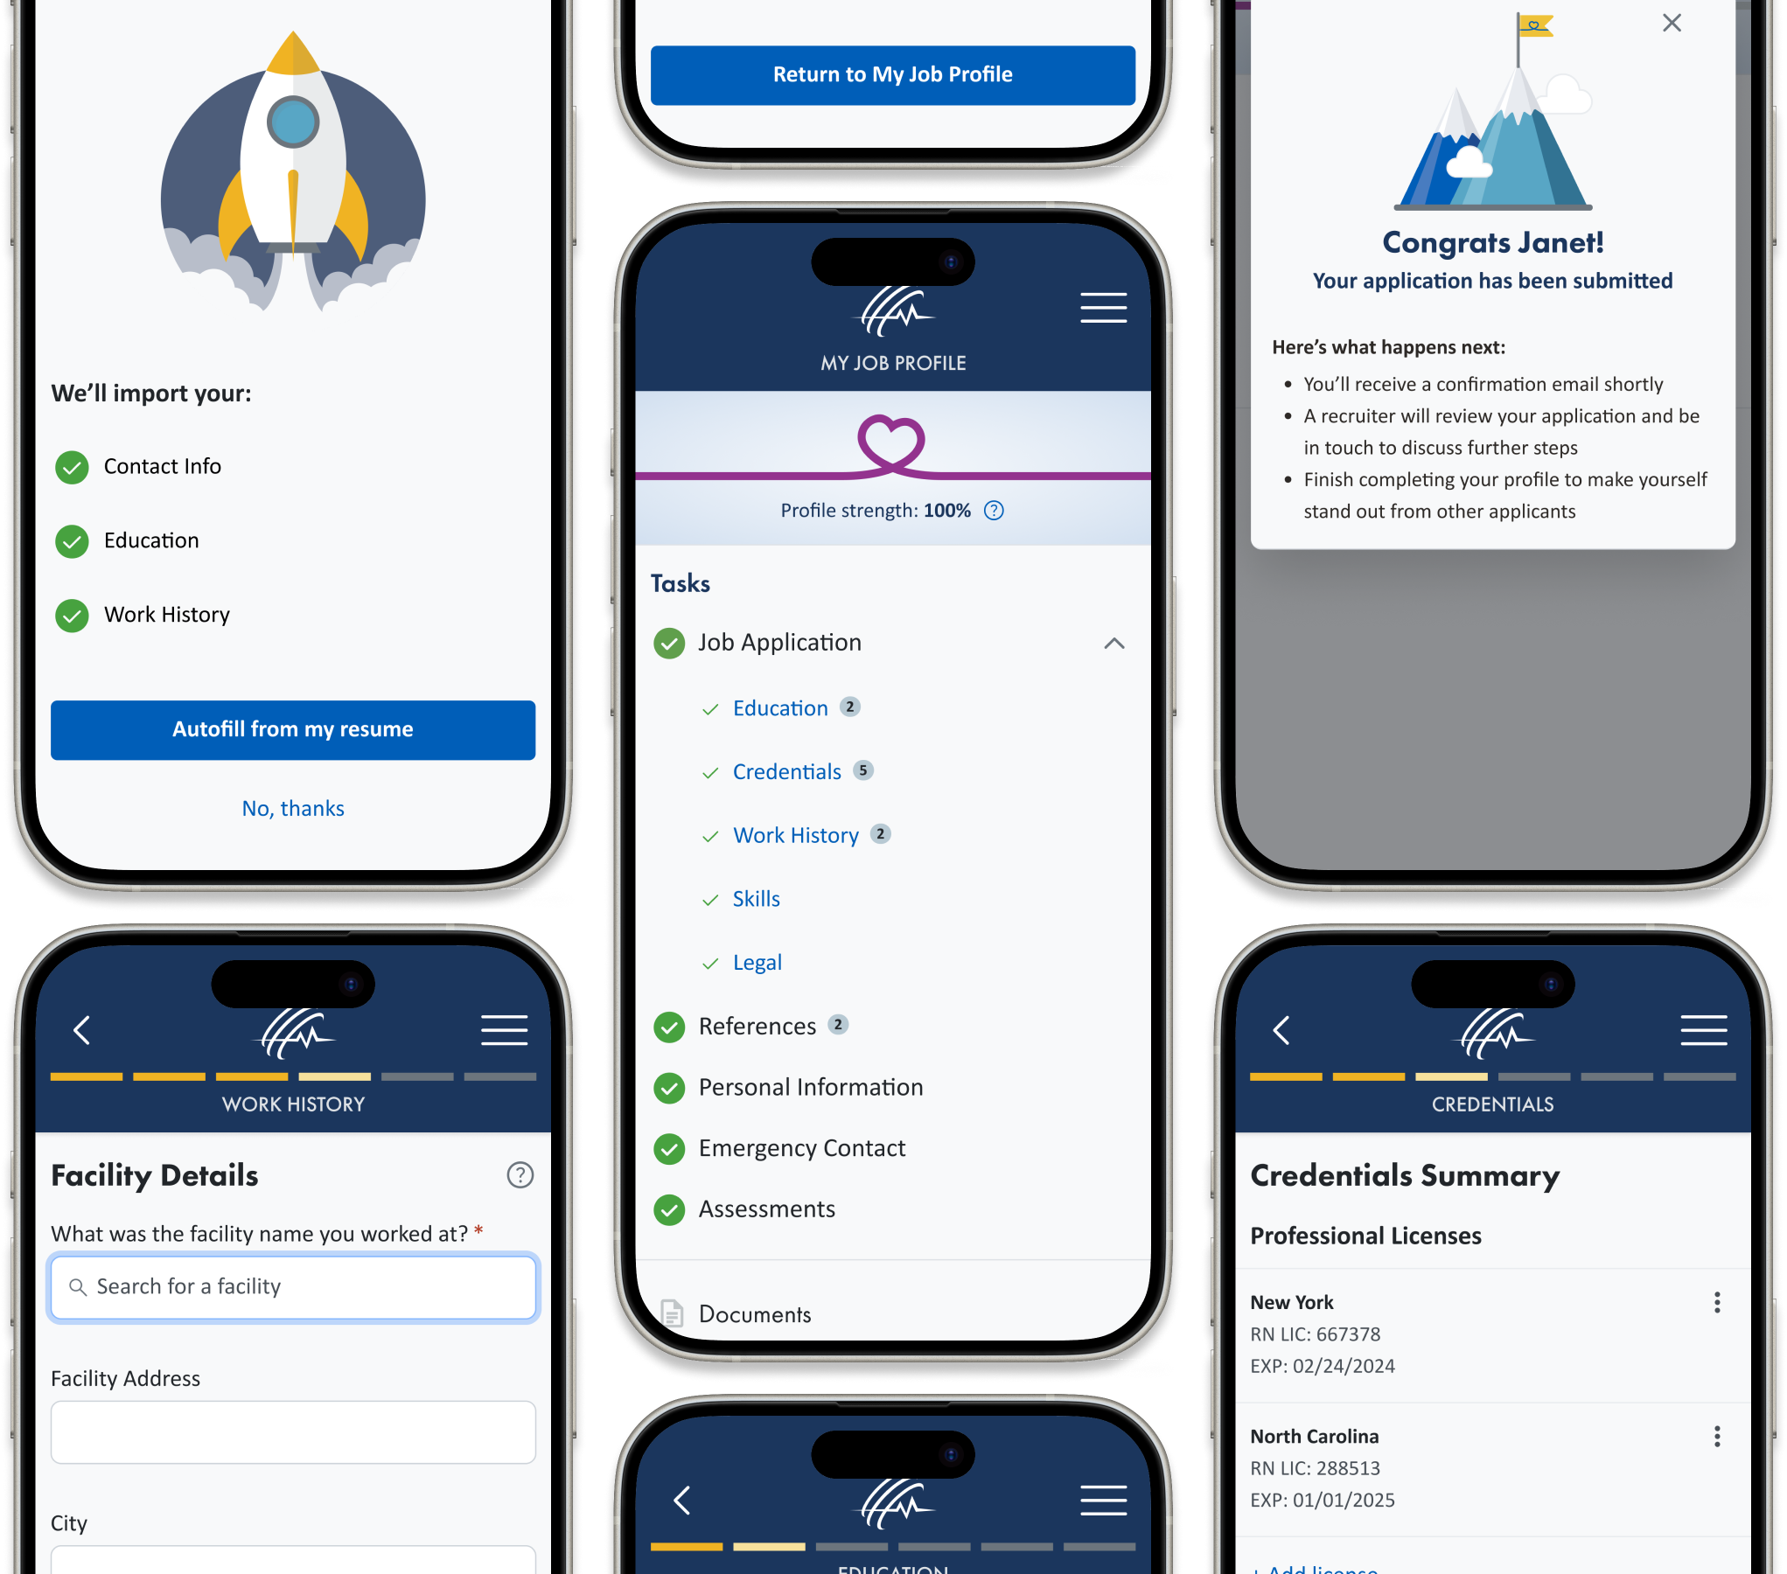


Industry
Building management
Application
Healthcare staffing
Device

Slide 31
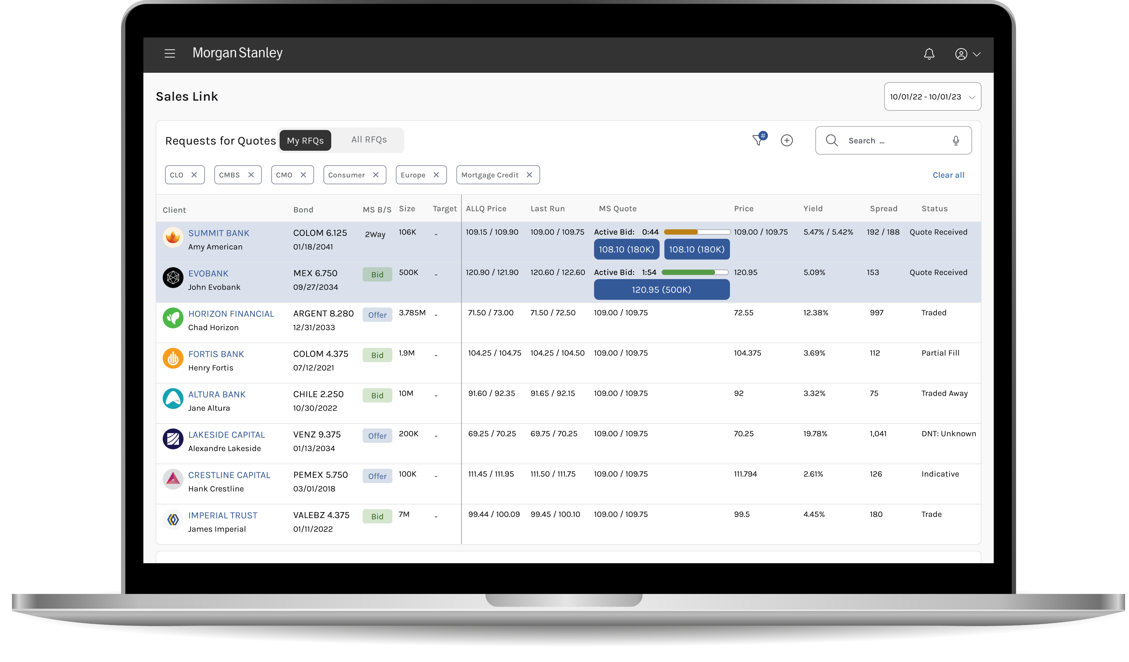

Industry
Fintech
Application
Enterprise

Slide 32
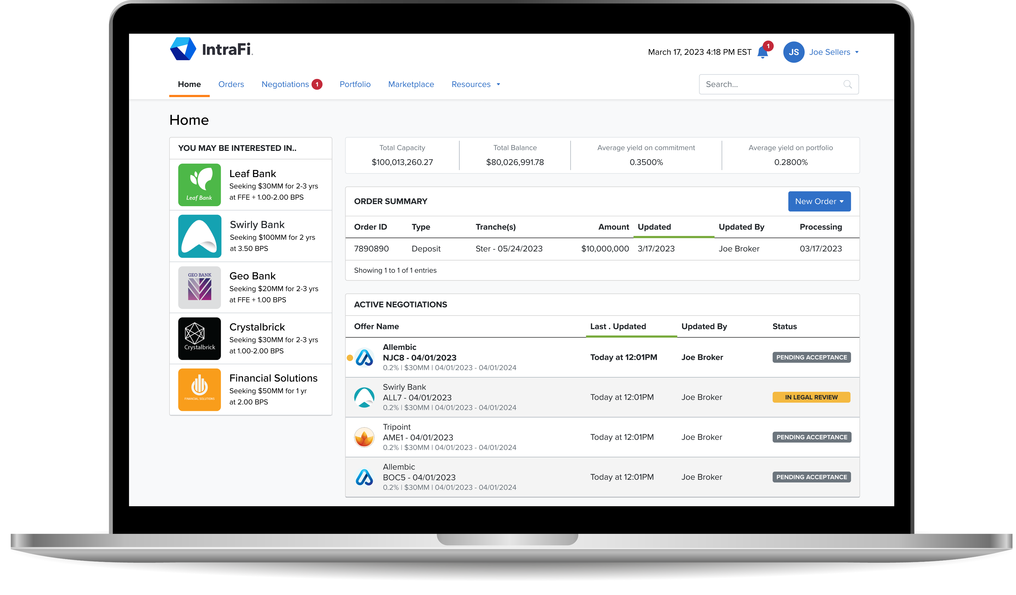

Industry
Fintech
Application
SaaS

Slide 33
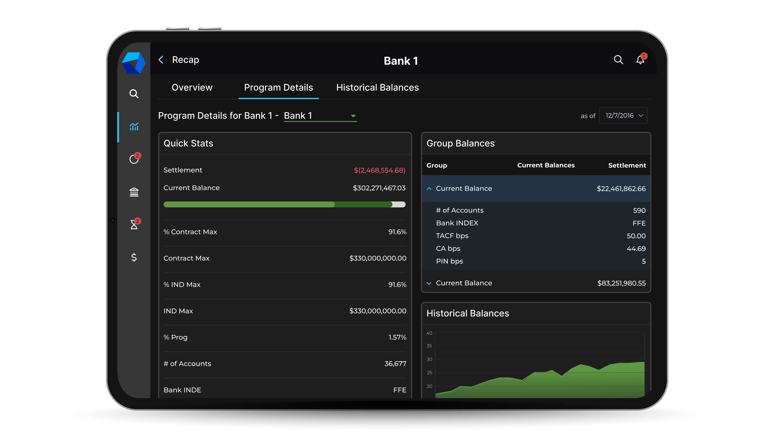
Industry
Fintech
Application
Enterprise

Slide 34
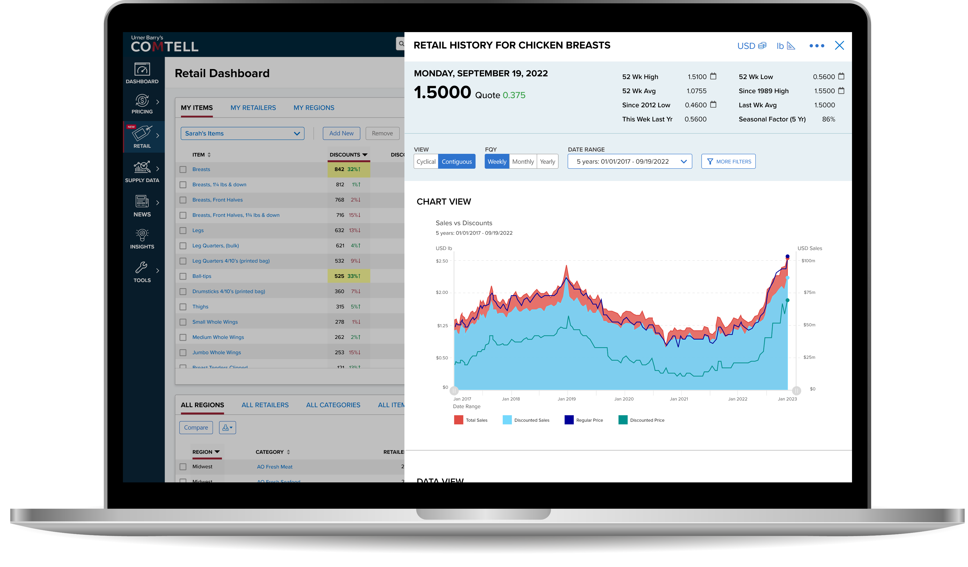

Industry
Fintech
Application
SaaS

Slide 35
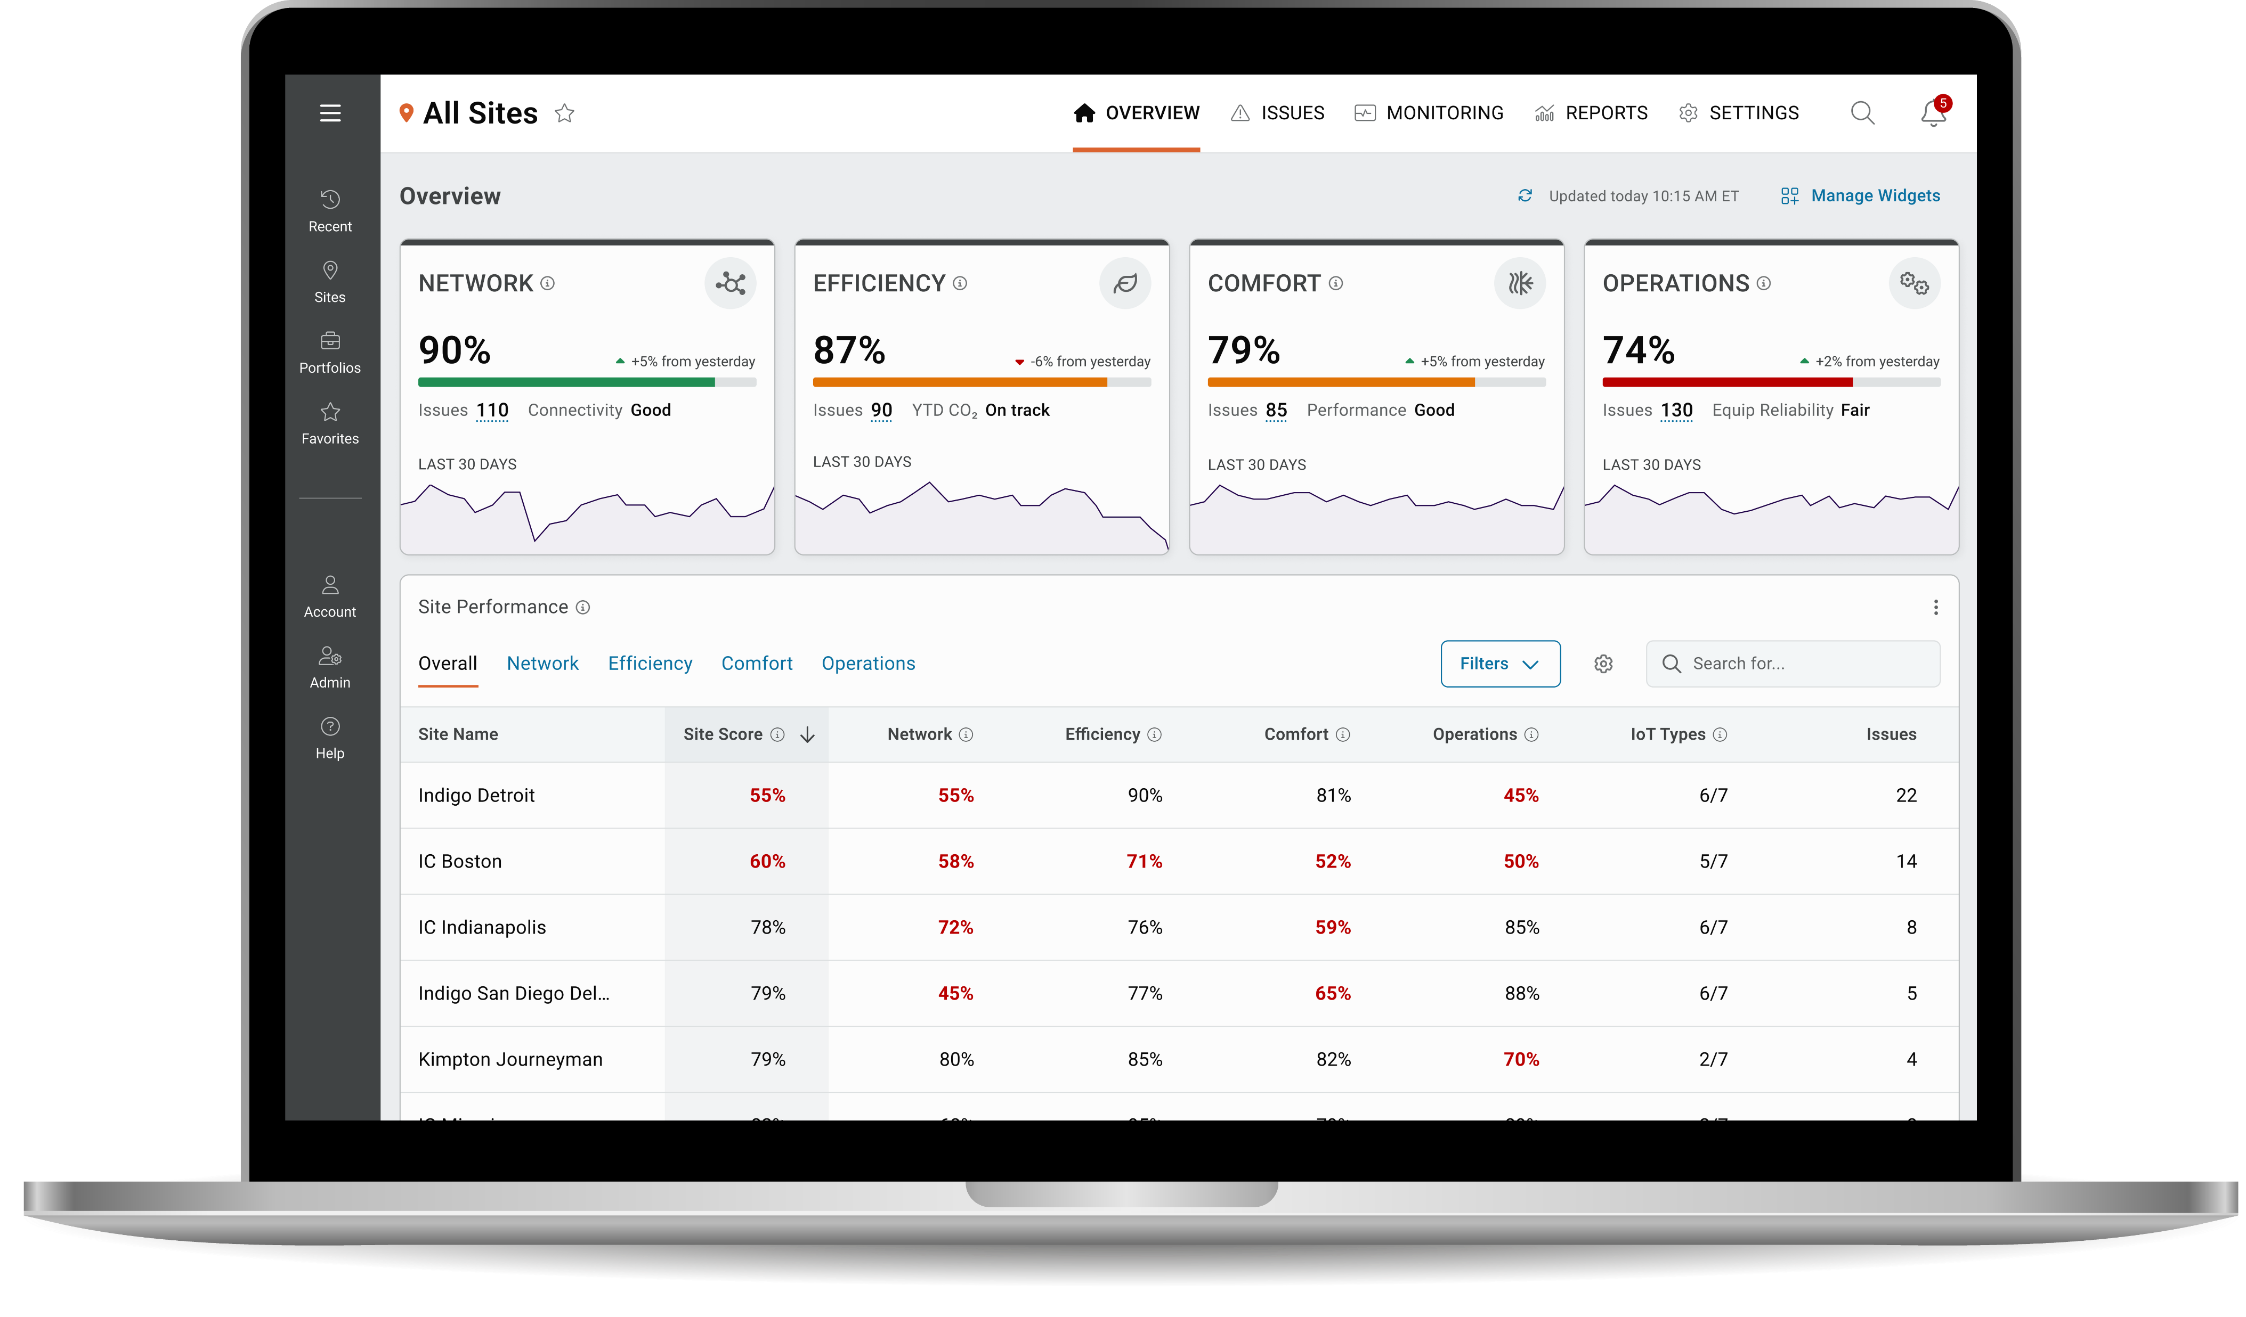

Industry
Building management
Application
SaaS
Device

Slide 36
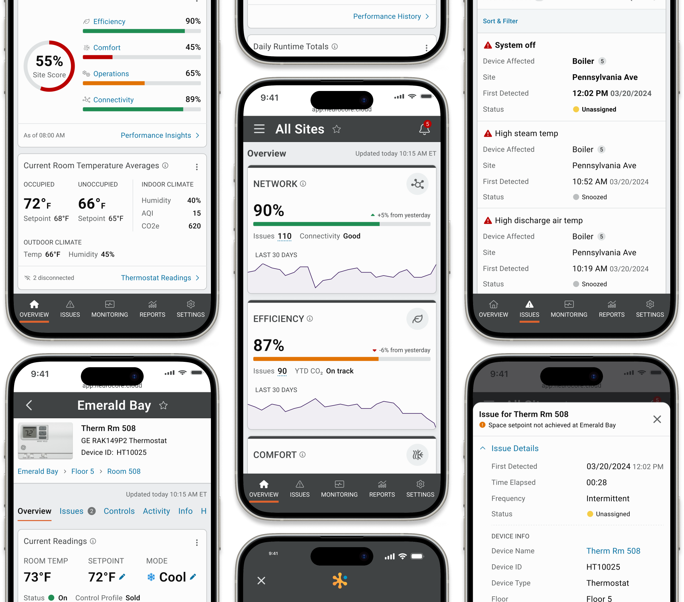
Industry
Building management
Application
SaaS
Device

Slide 37
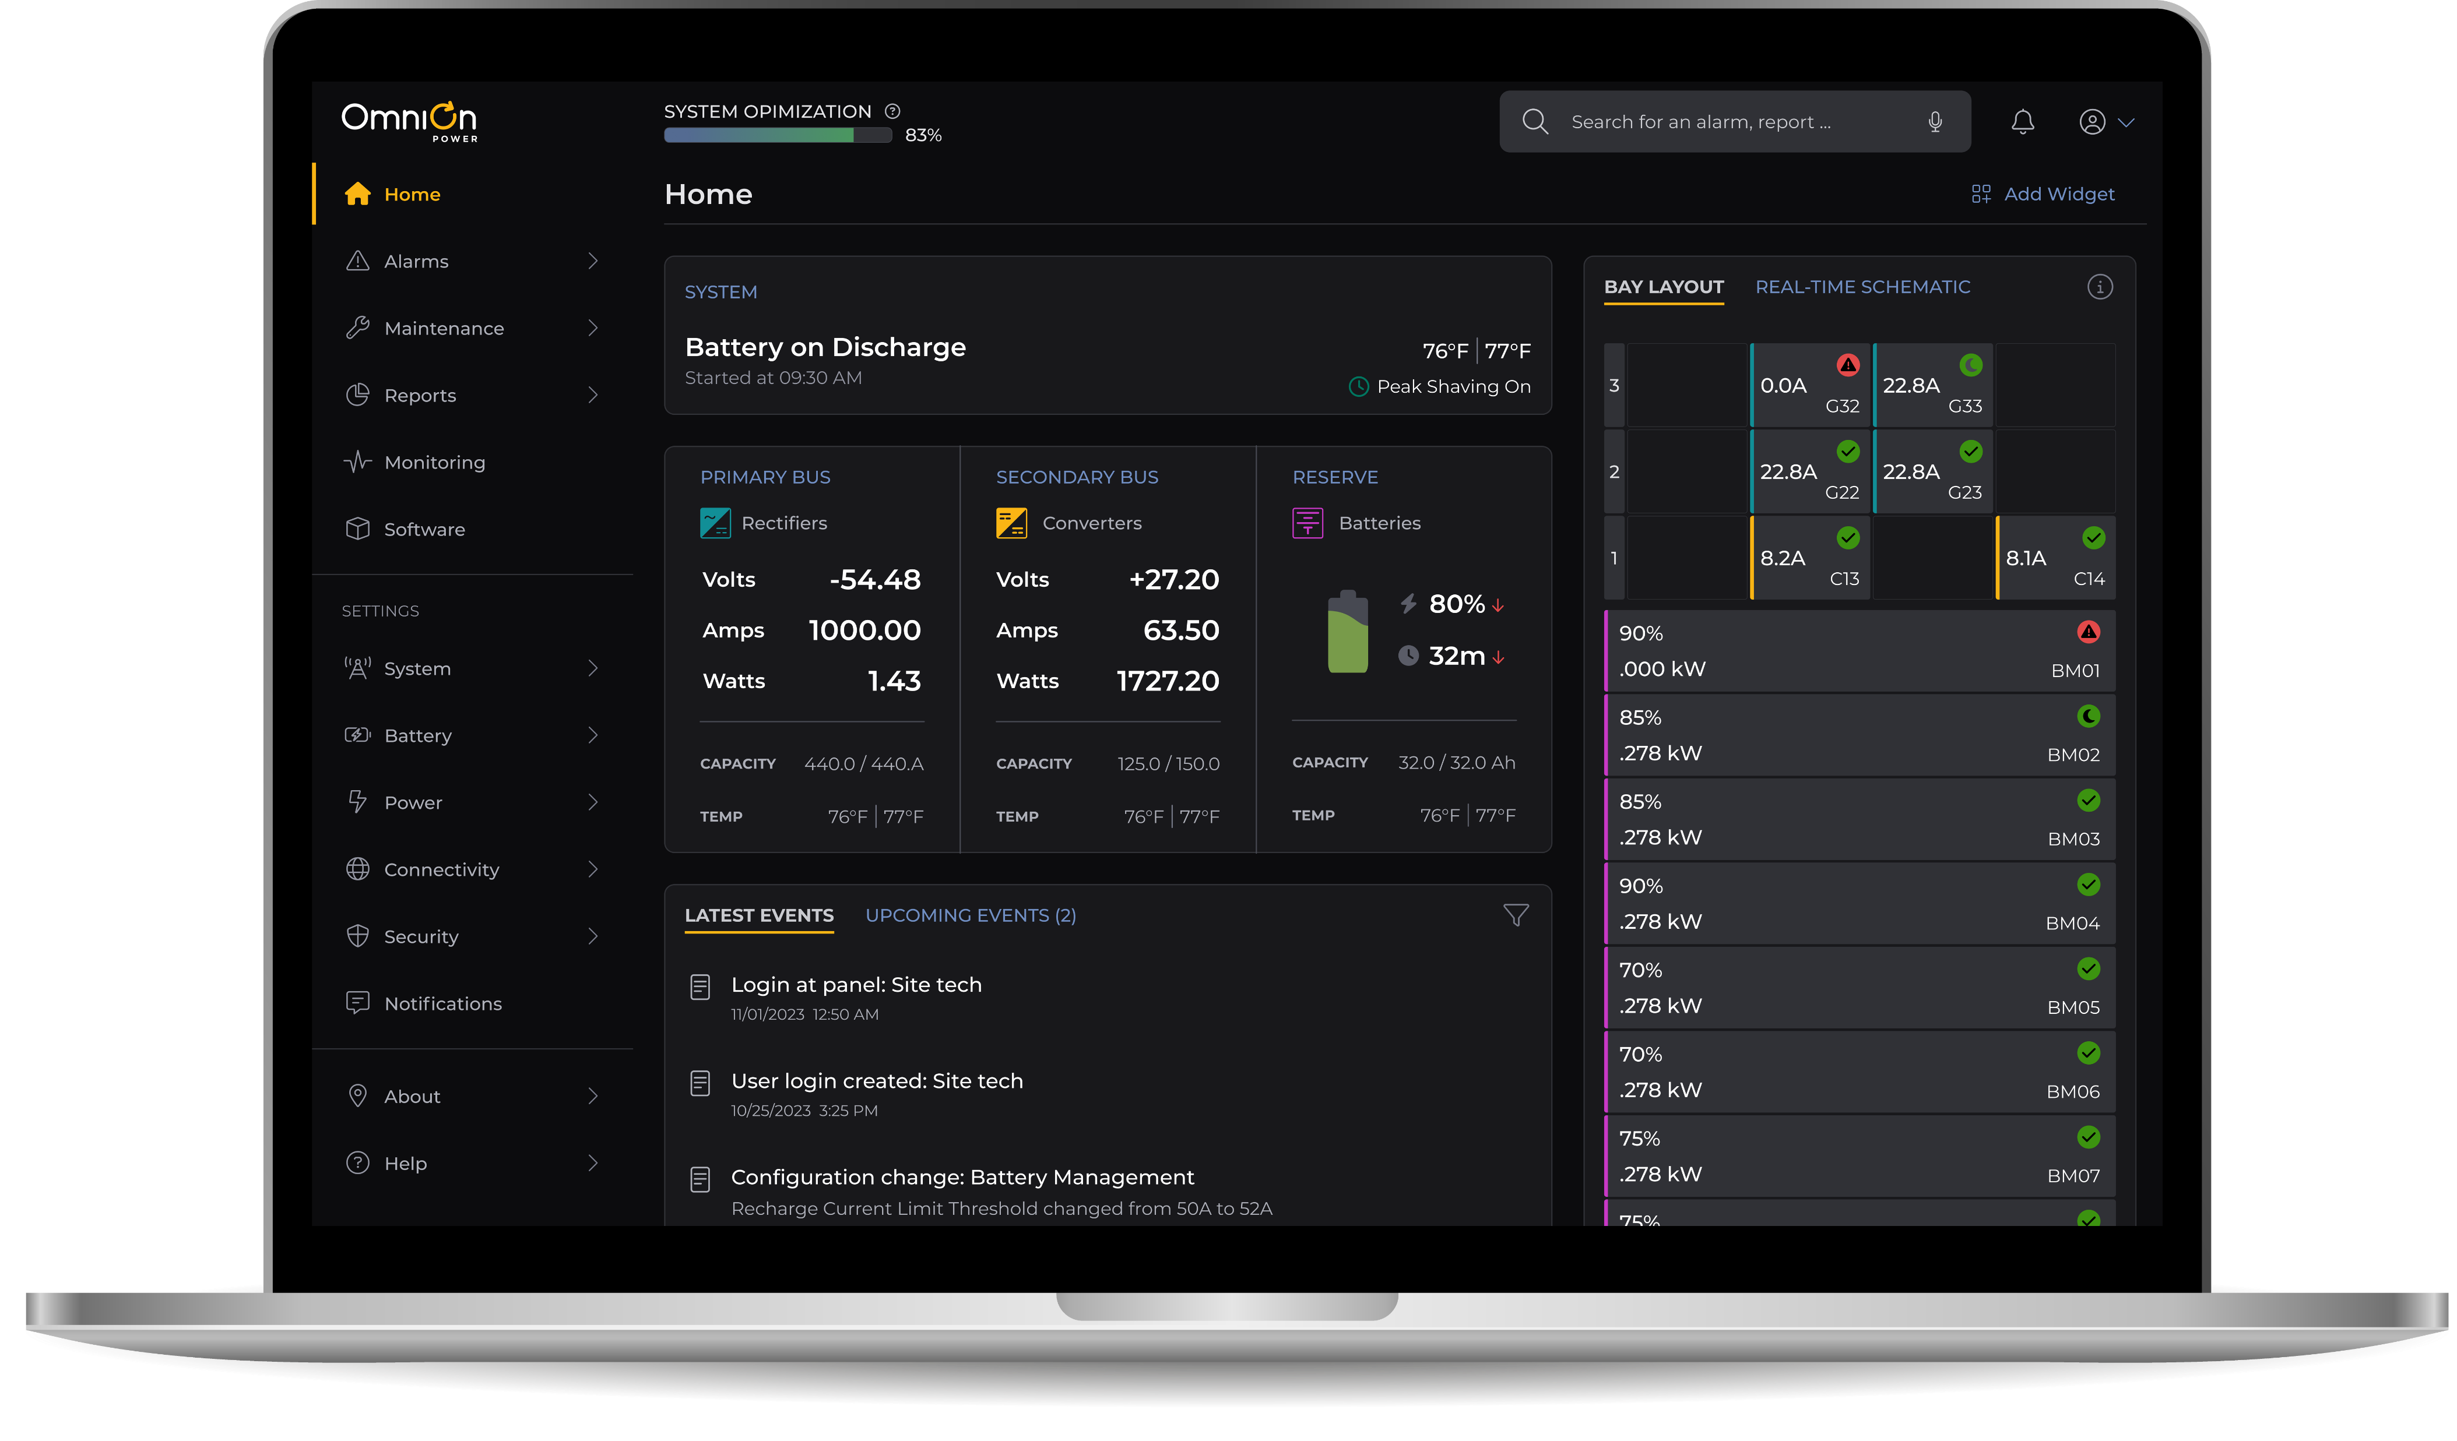


Industry
Power conversion
Application
SaaS, Hardware
Device

Slide 38
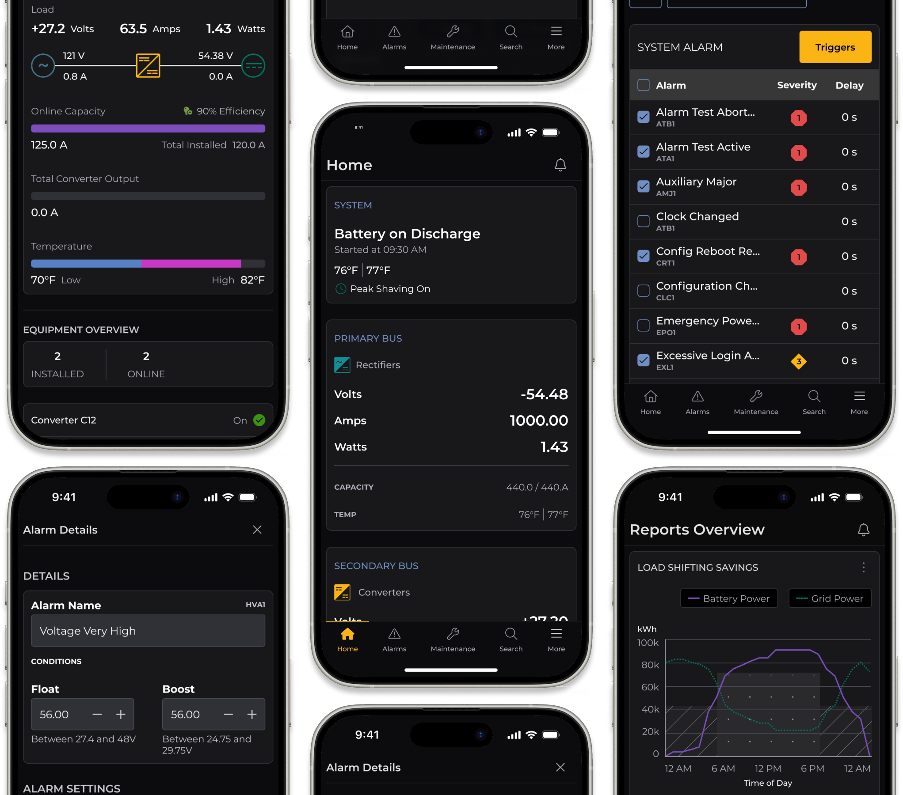
Industry
Power conversion
Application
SaaS, Hardware
Device

Slide 39
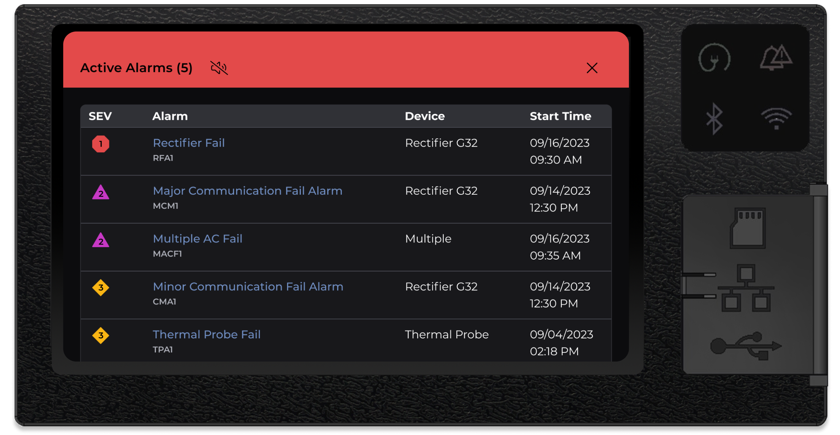
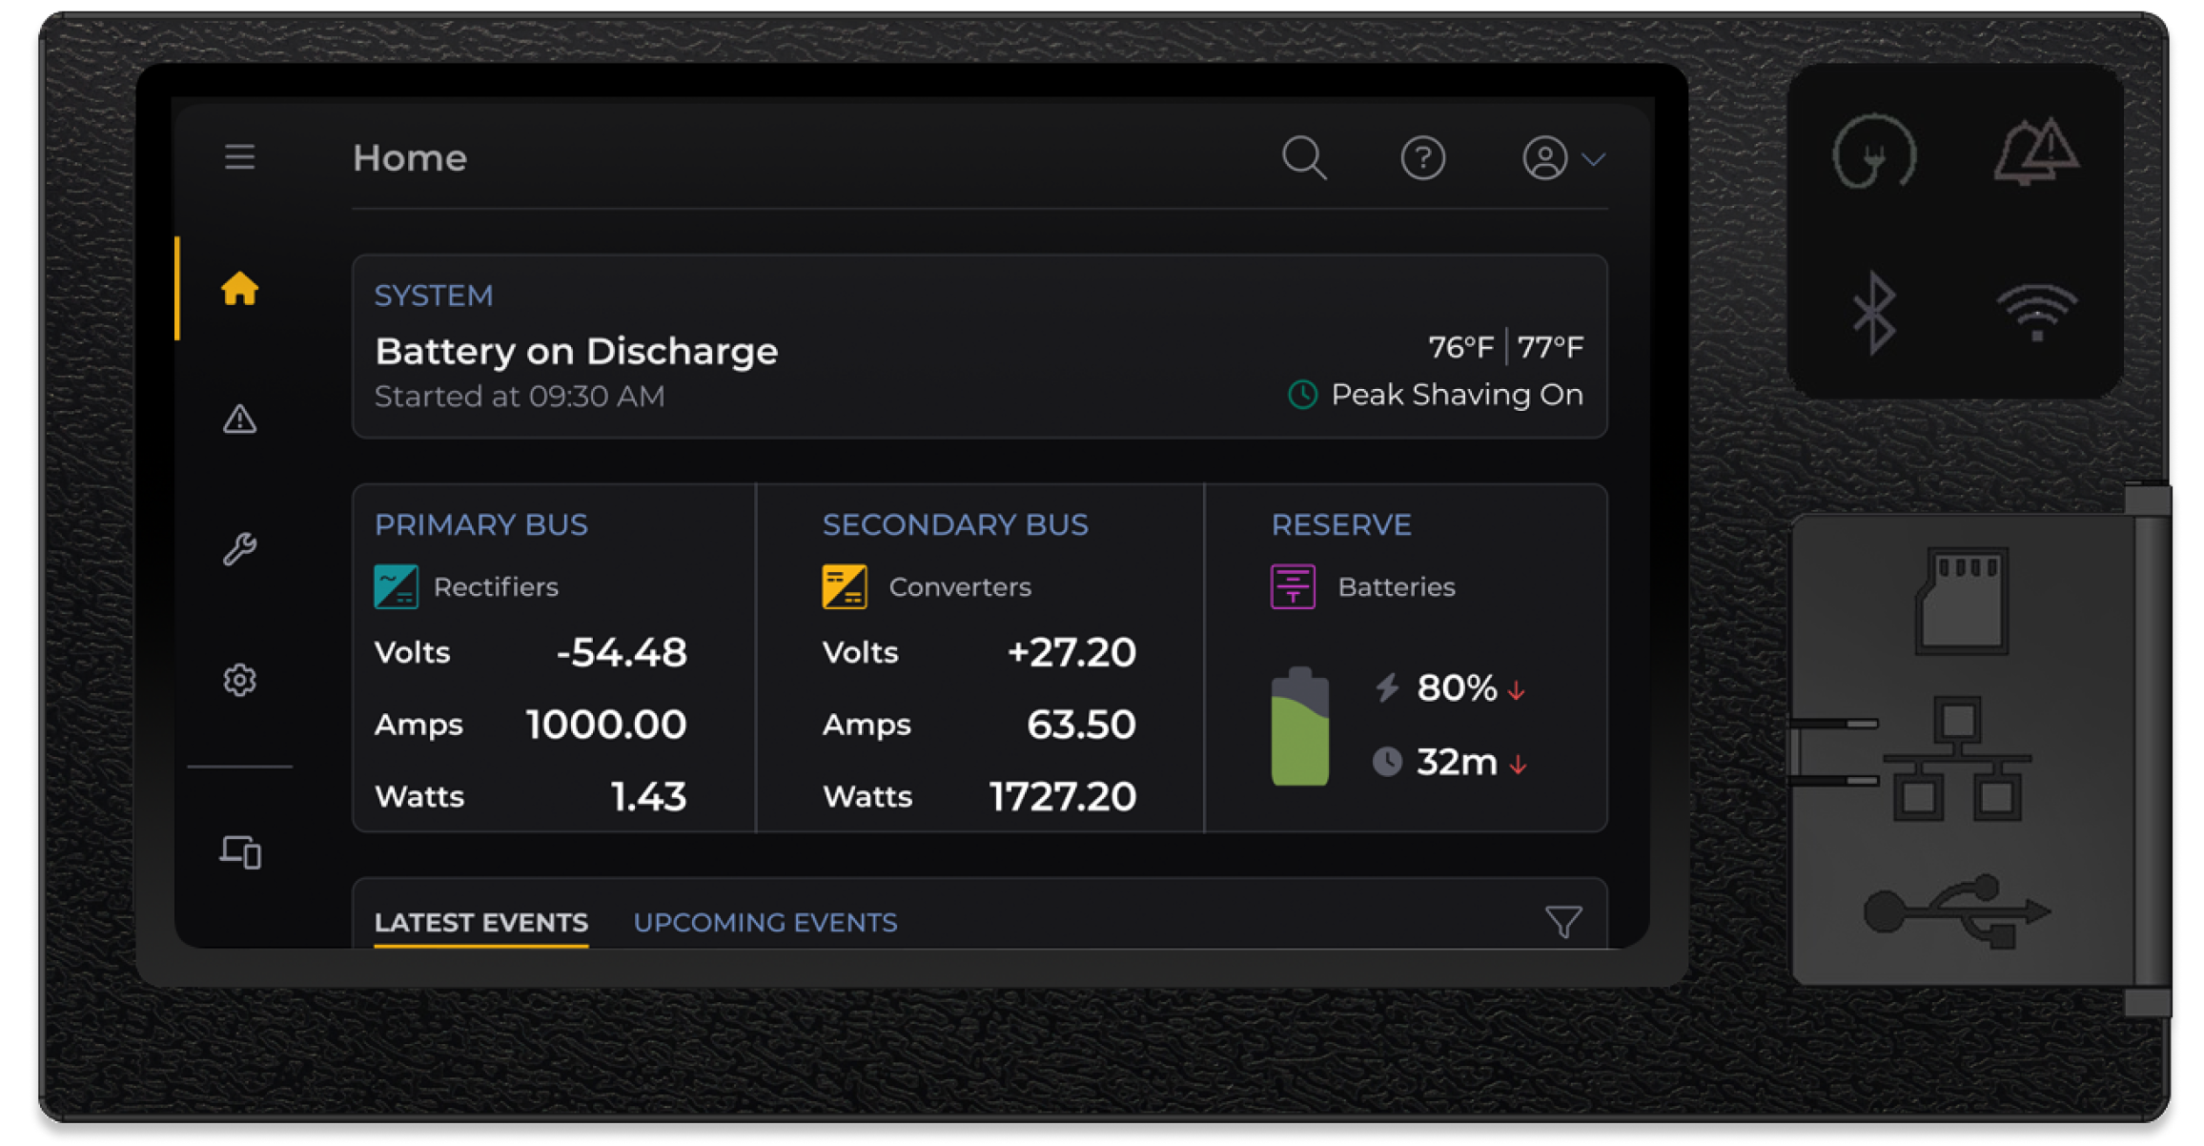

Industry
Power conversion
Application
SaaS, Hardware
Device

Slide 40
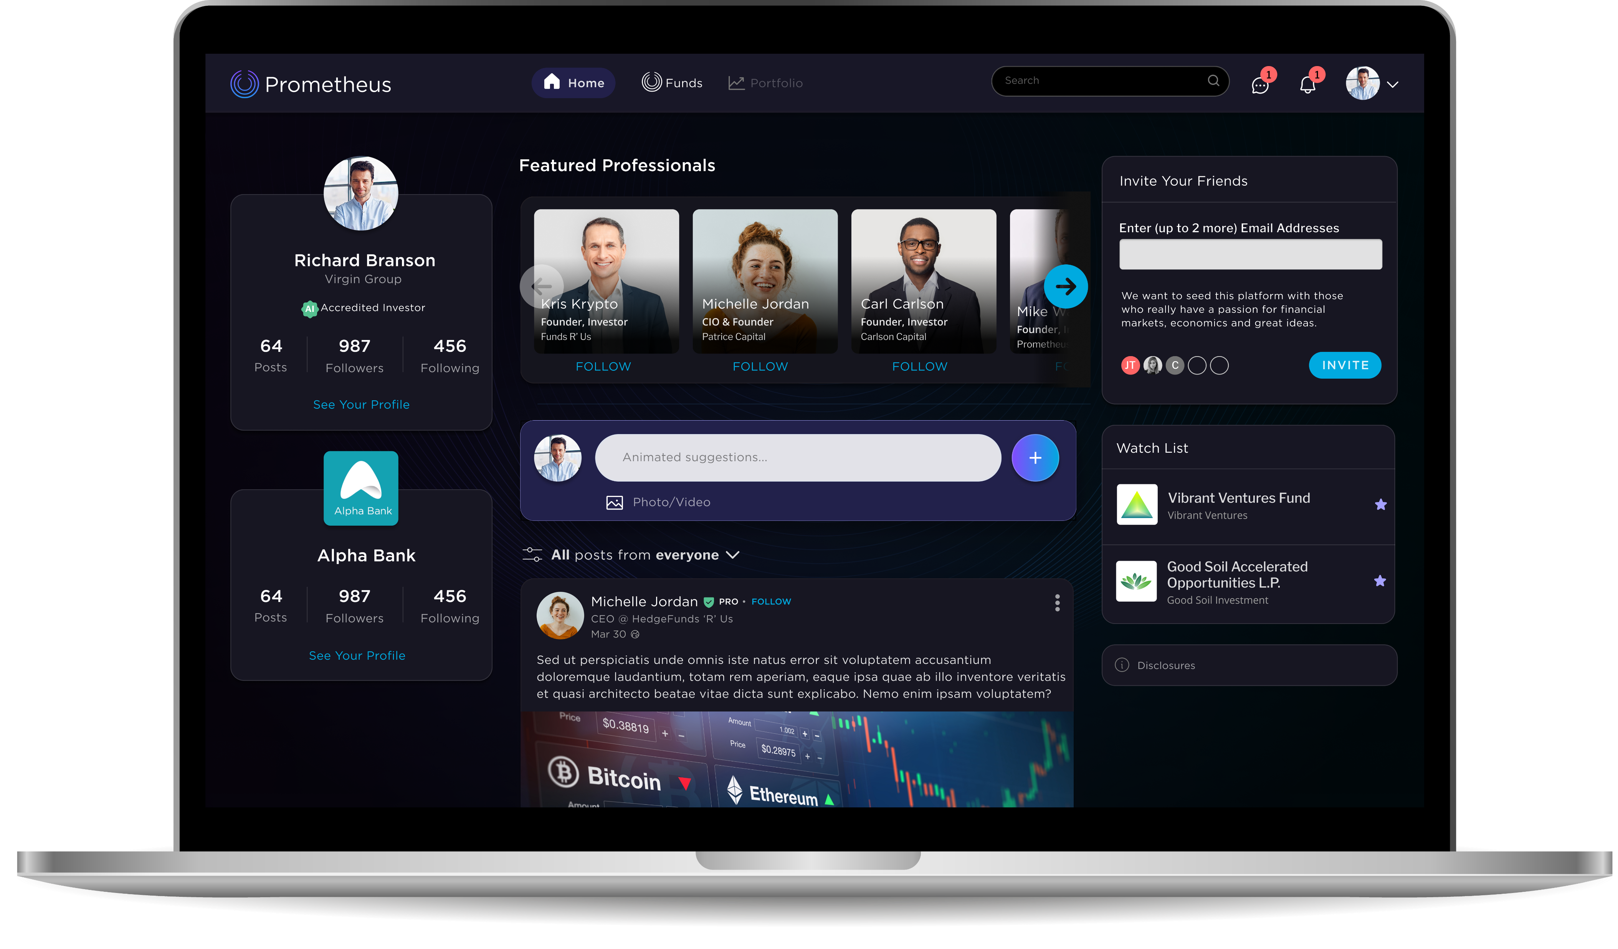

Industry
Fintech
Application
SaaS
Device

Slide 41
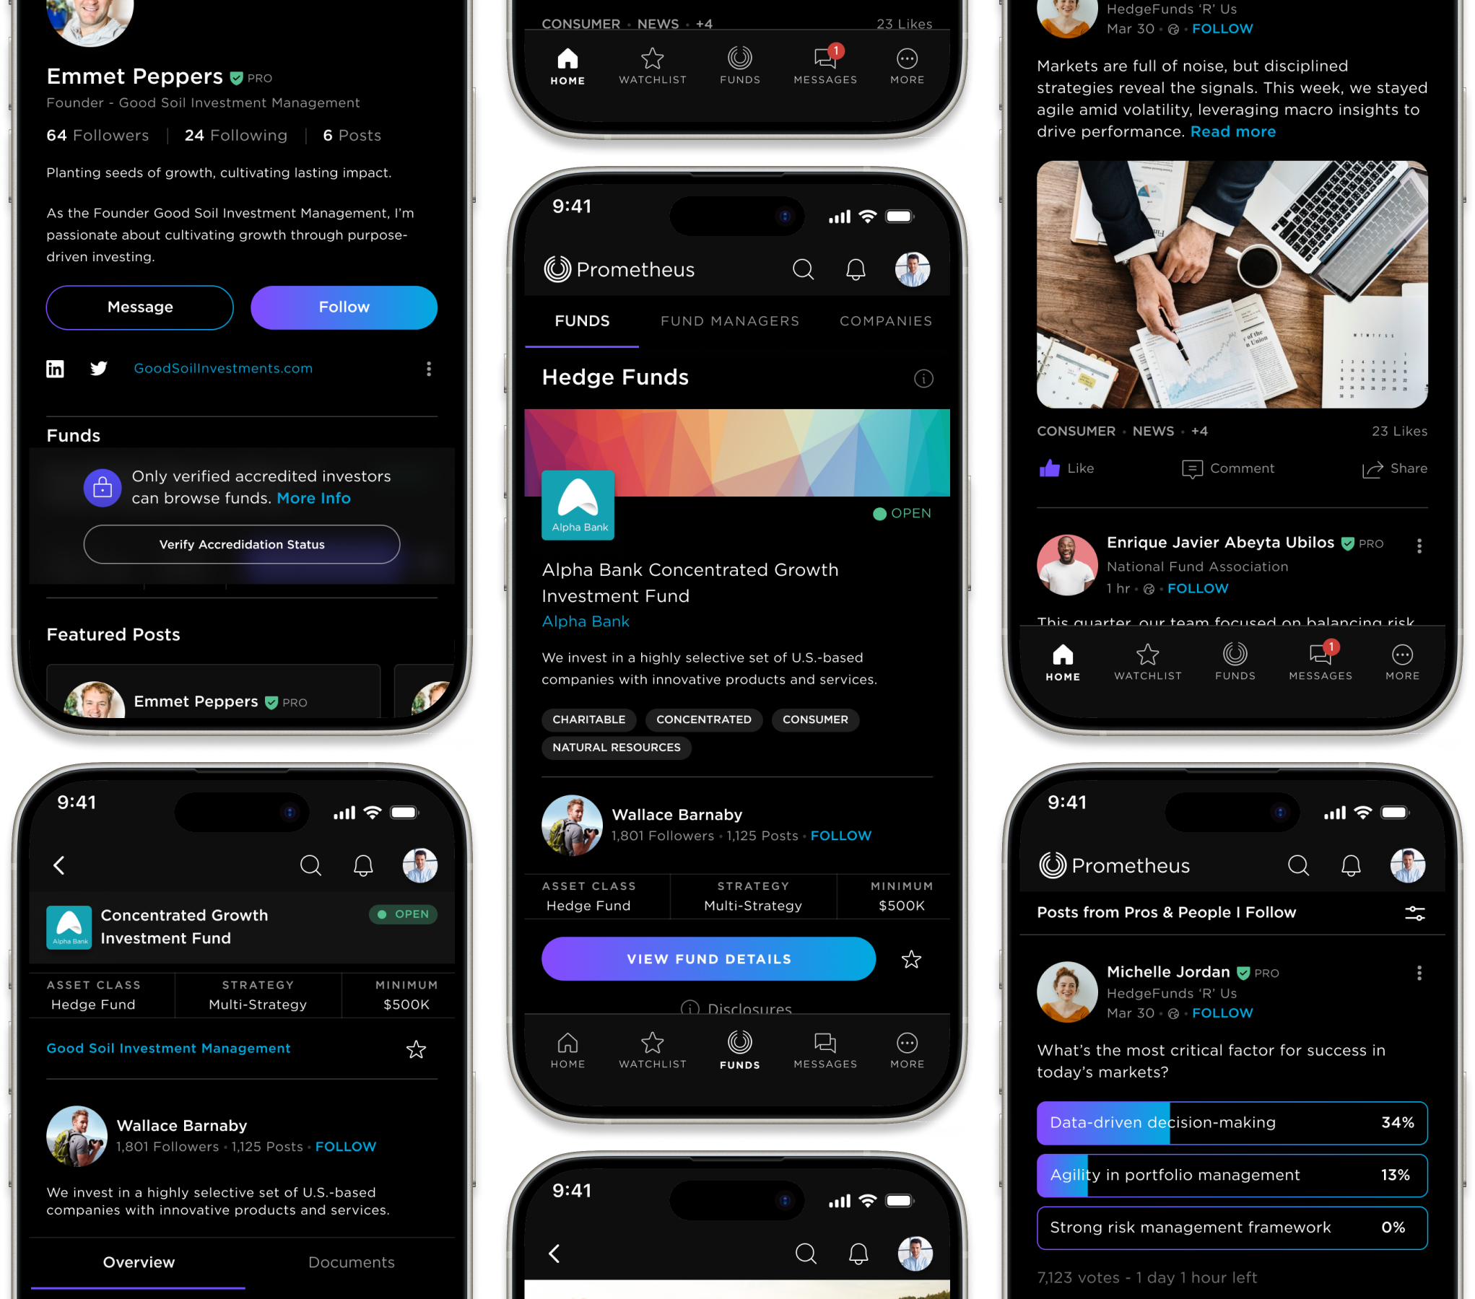
Industry
Fintech
Application
SaaS
Device

Slide 42
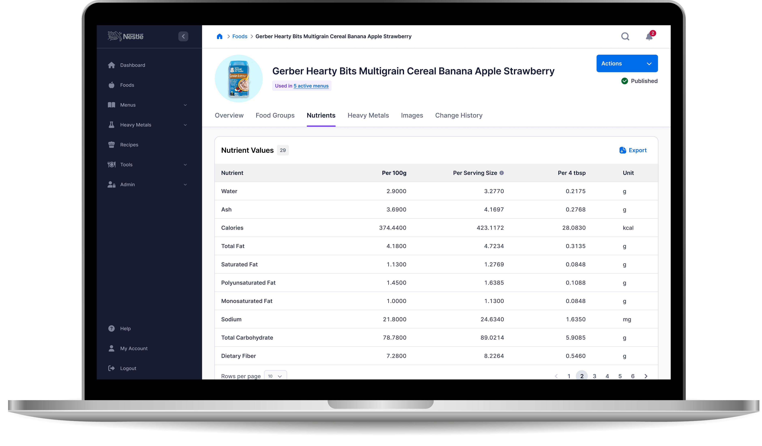

Industry
Healthcare
Application
Enterprise

Slide 43
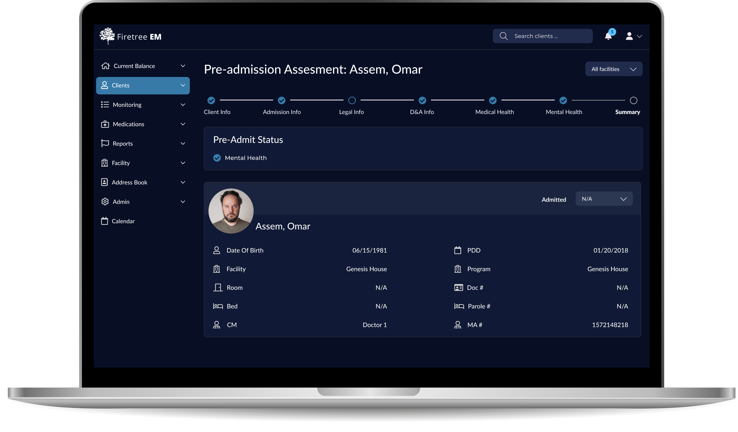

Industry
Healthcare
Application
Enterprise

Slide 44
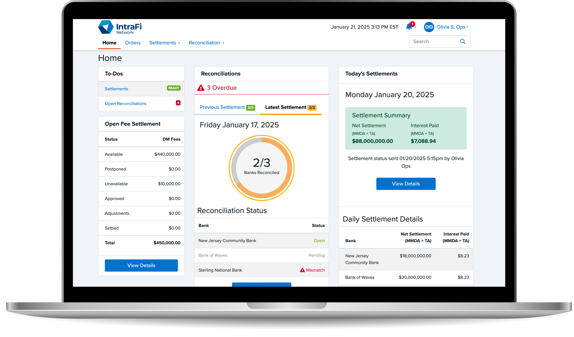
Industry
Fintech
Application
Enterprise

Slide 45




Let’s get started!
(855) 489-8326
info@uxteam.com
uxteam.com

